Slide 1
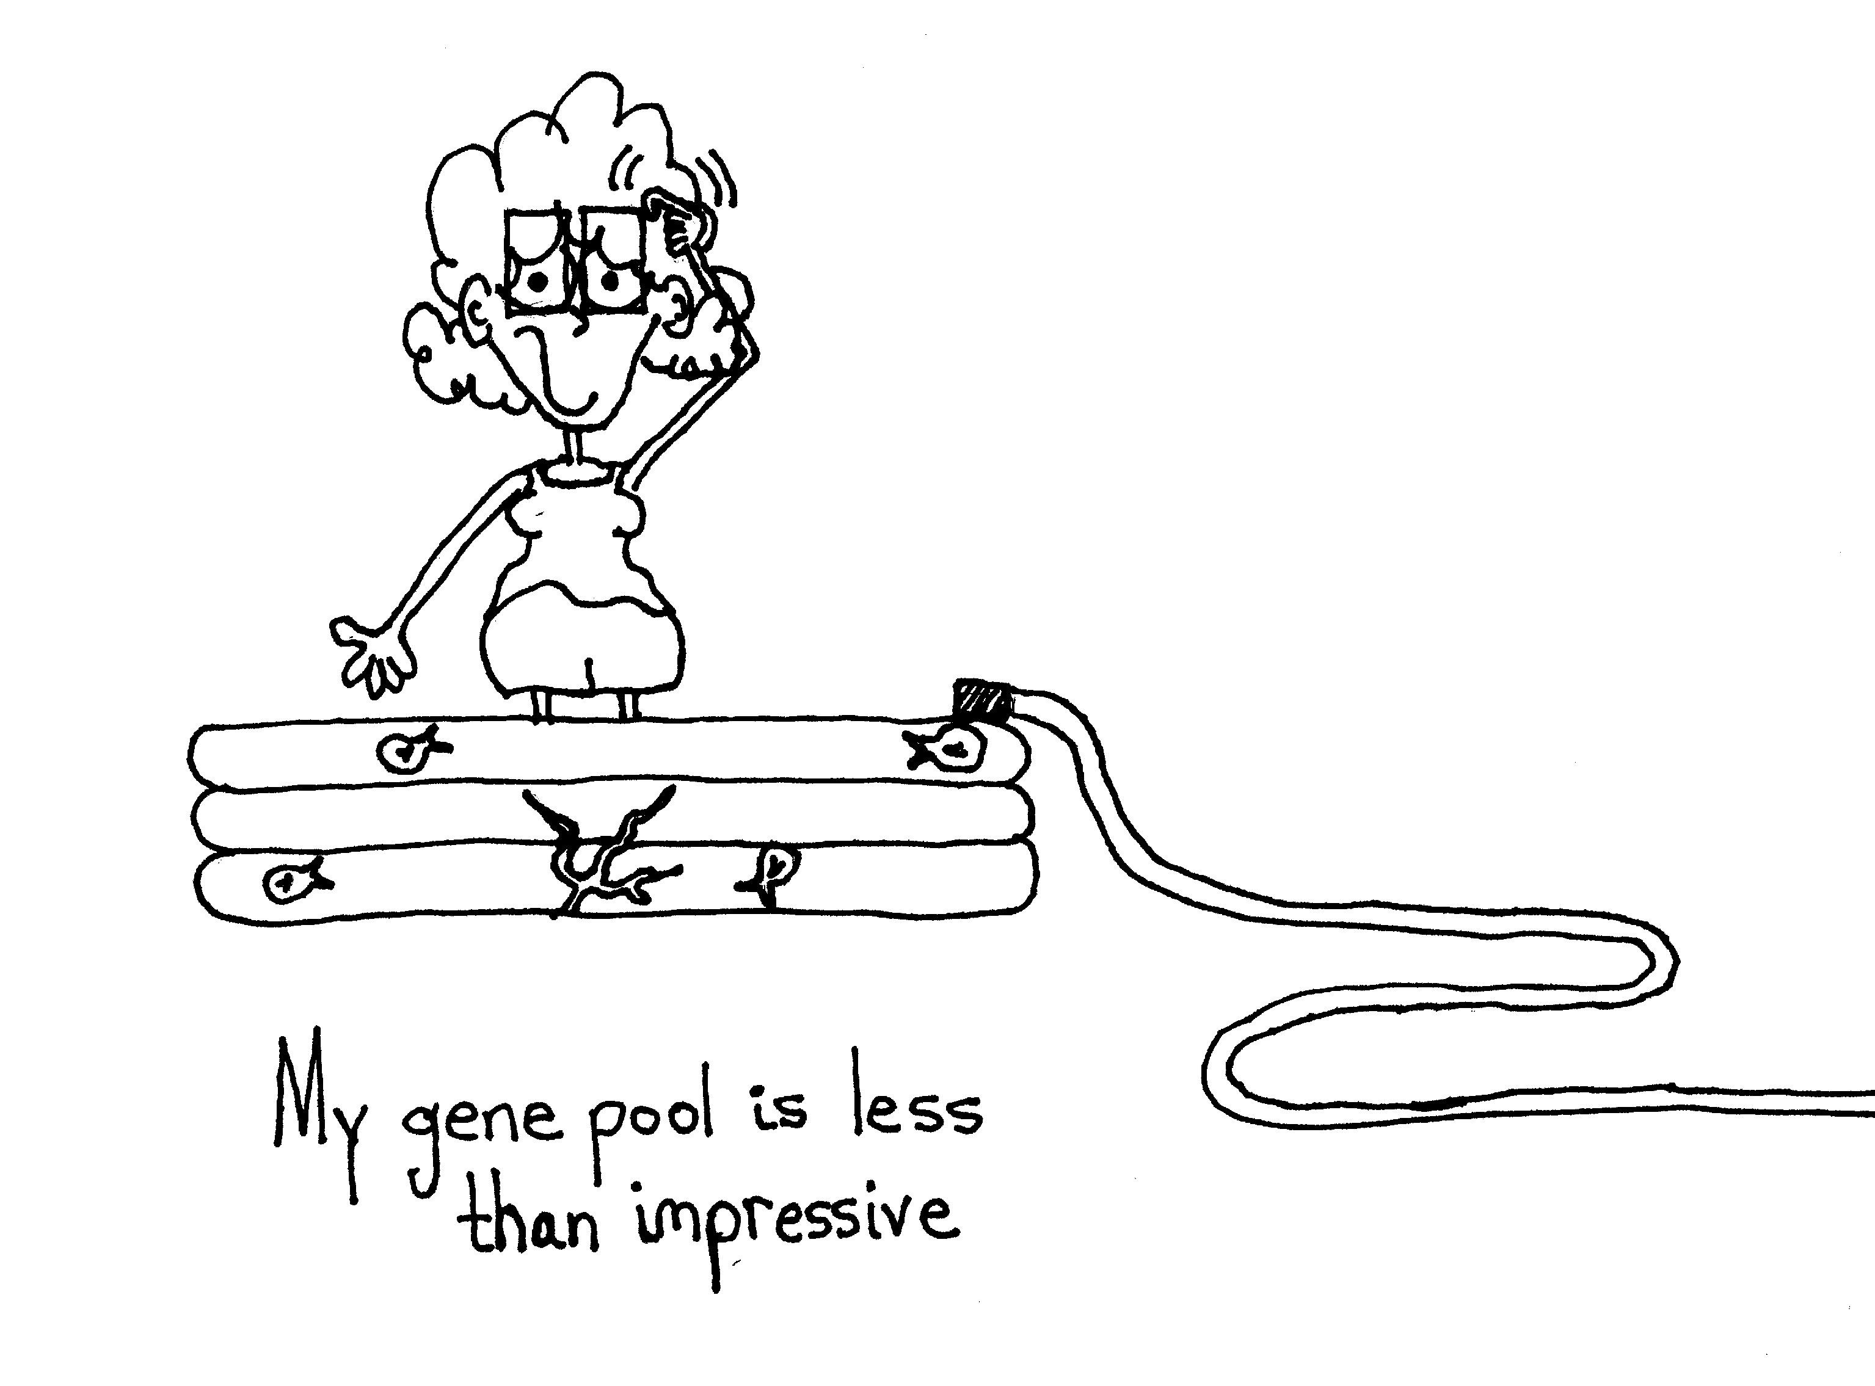
Hope
Abbigail
Nulf
Adult Special Education Teacher
Desert Rose Adult High School

Slide 2
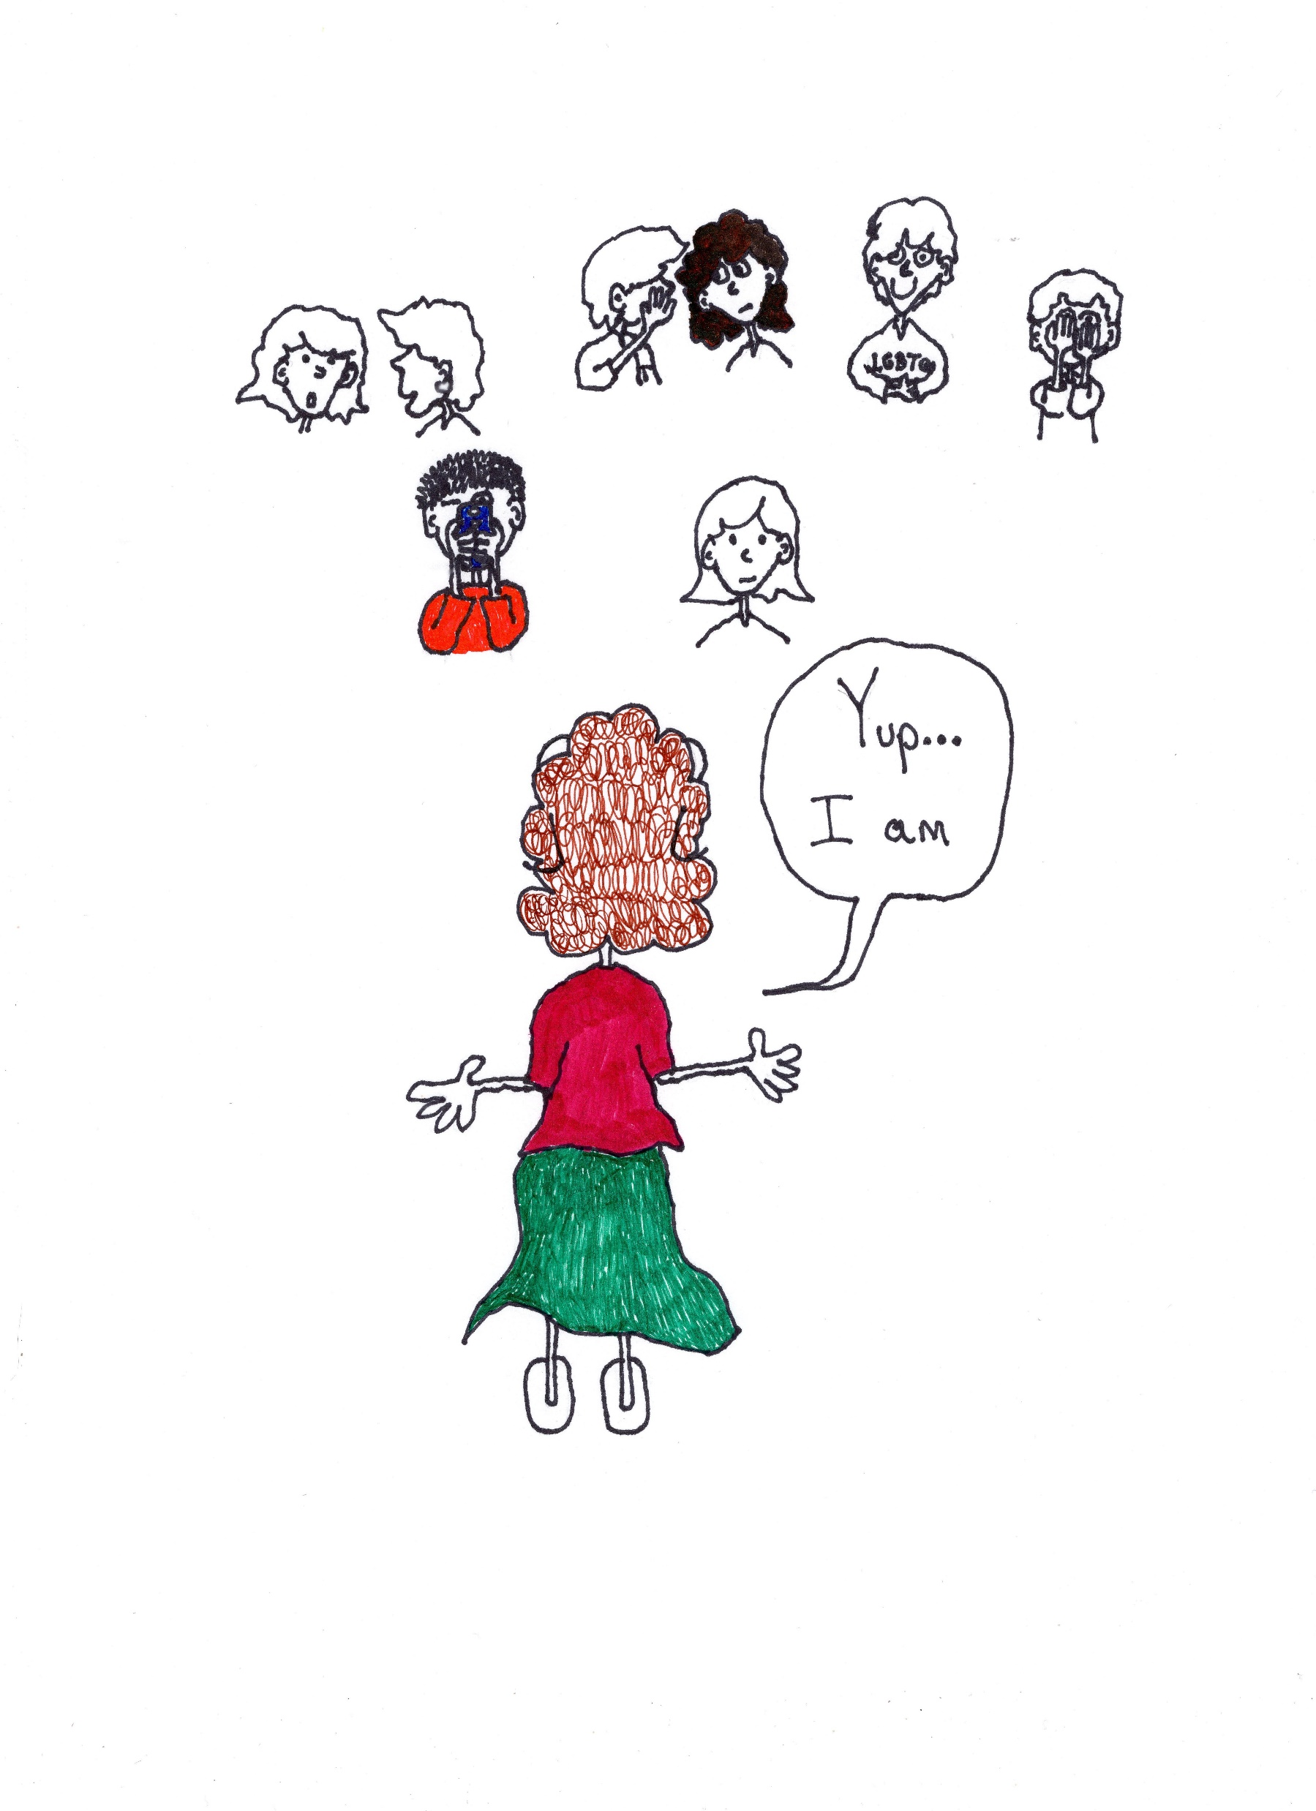
Nervous for 2 reasons:
1. For 58% of you I am the first trans person you know (I need to
“represent”..)
2. The art work is mine. I have 8 books of LGBTQ cartoons I began for students like who were
“shadows” on the fringe.

Slide 3
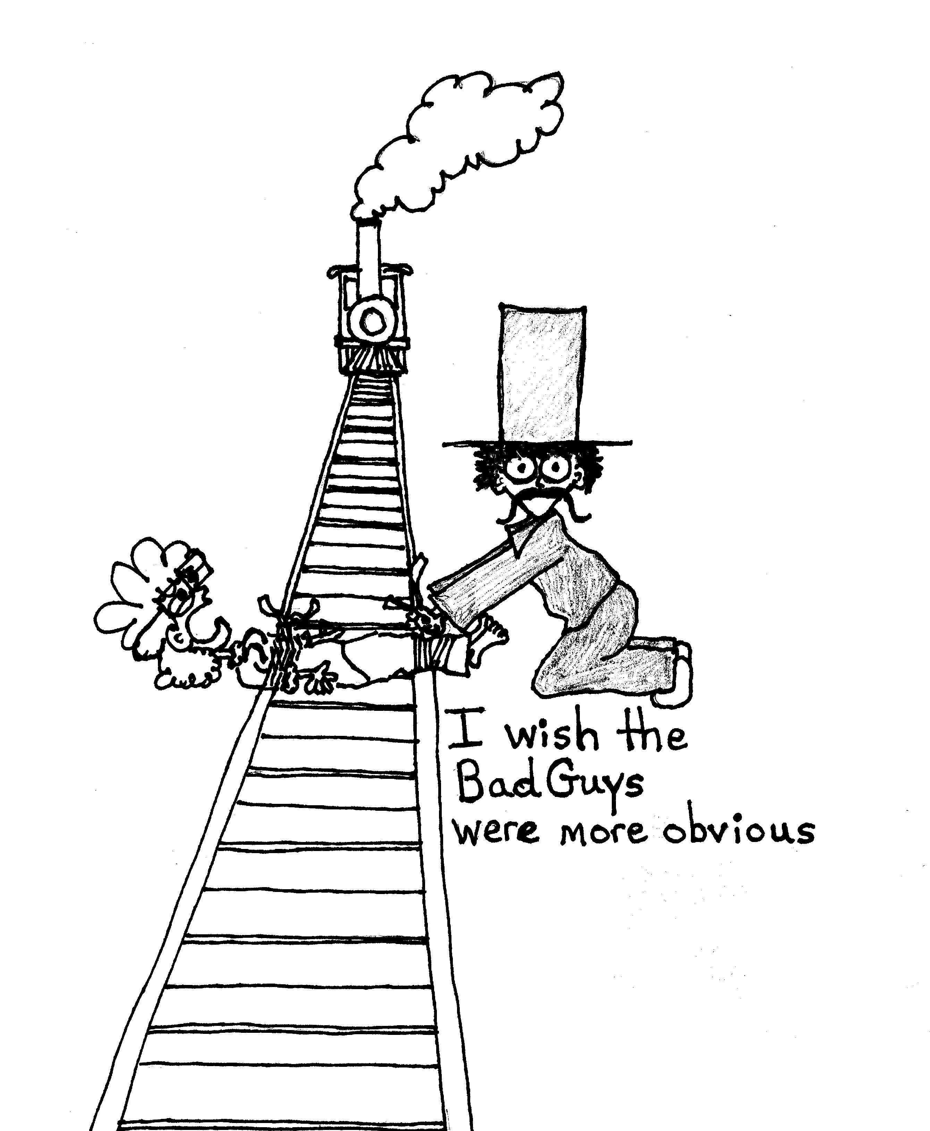
My life lesson for the kids….
….they aren’t

Slide 4
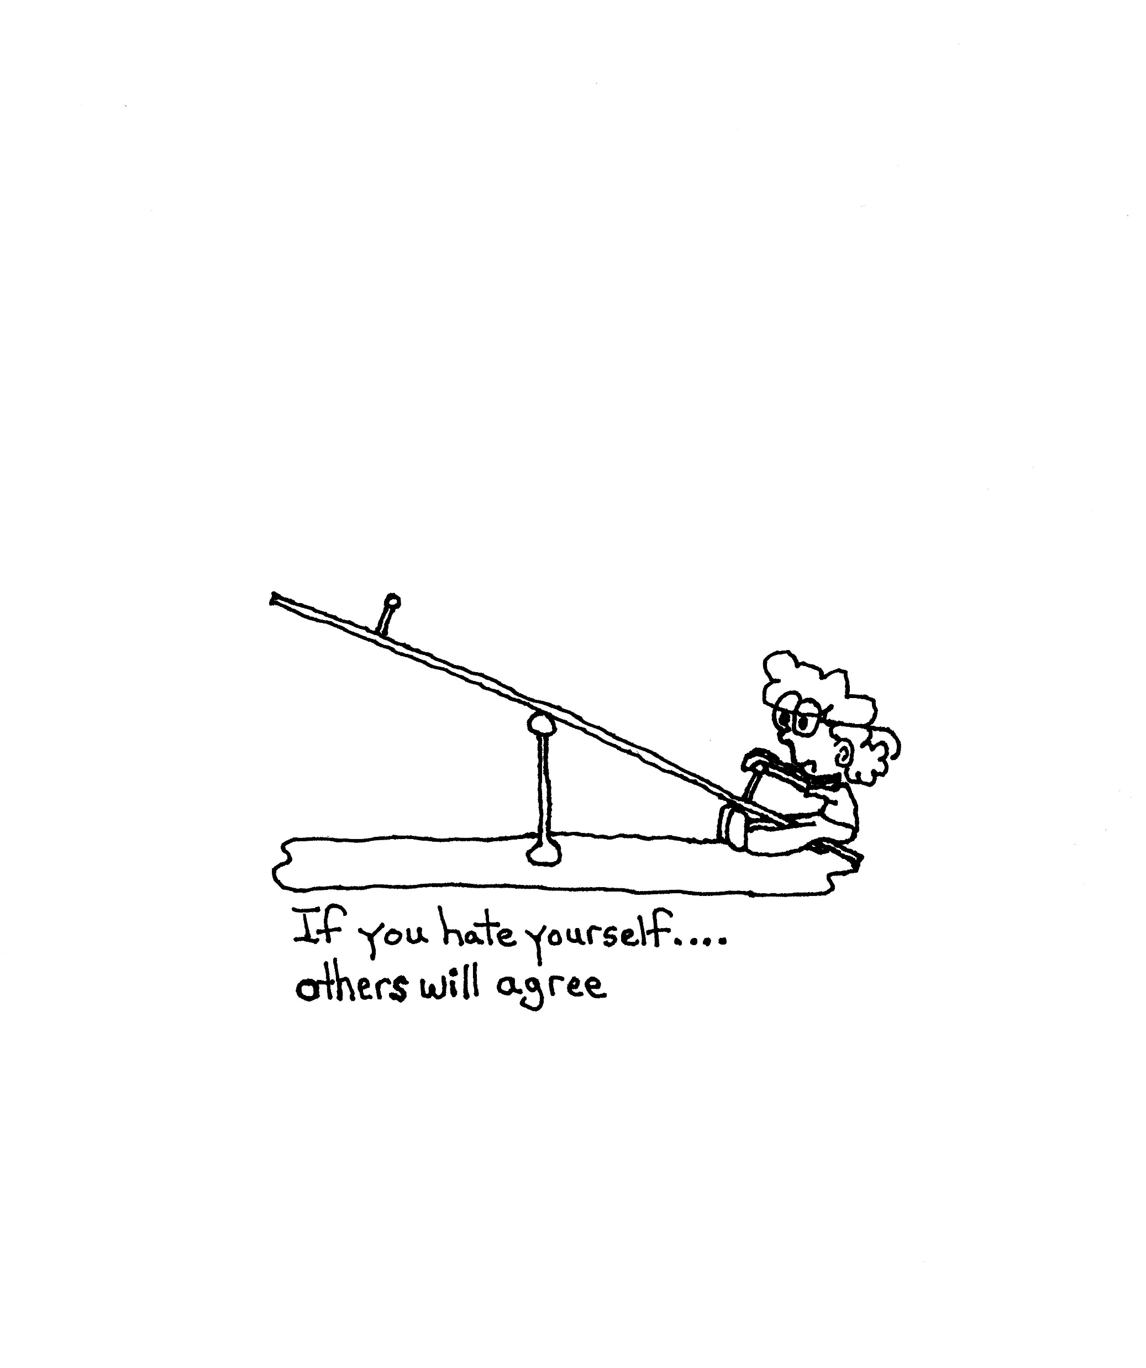
The core of my job is to advocate and teach self-advocacy. Everywhere and any where it is needed.

Slide 5
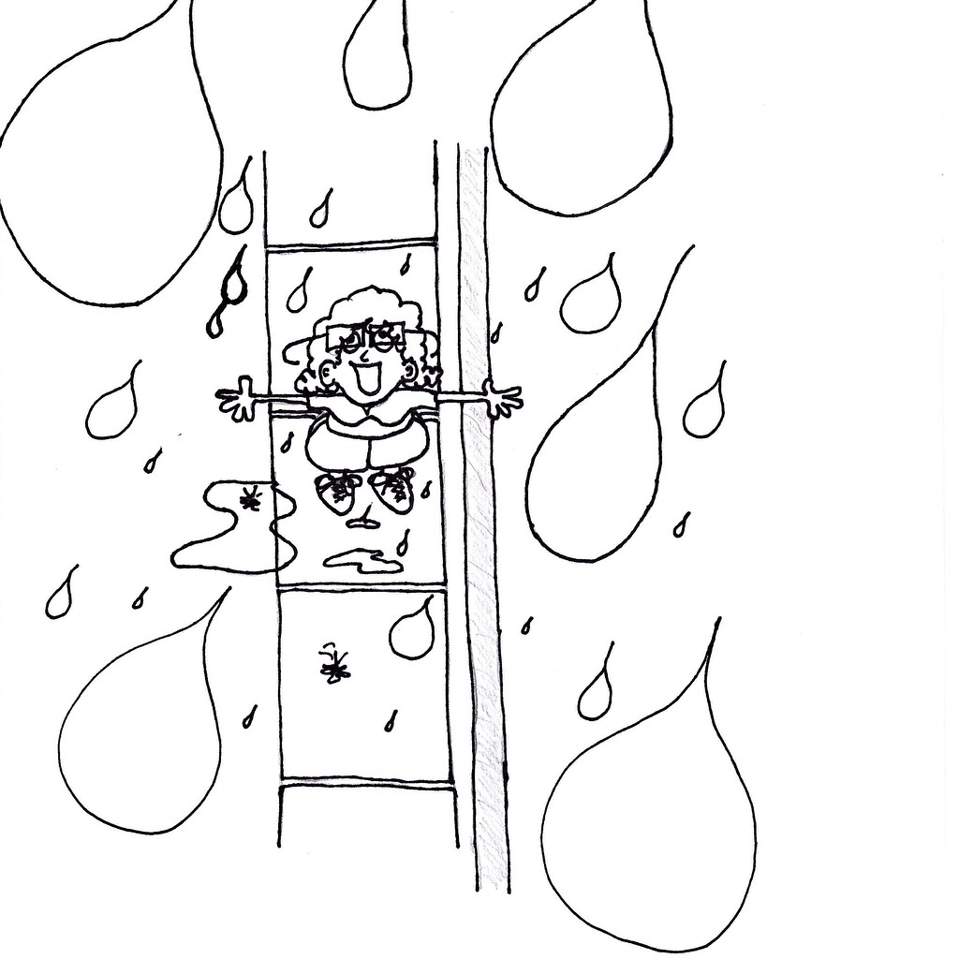
On the Outside Looking In…..
Helping Others
Find a Way In

Slide 6
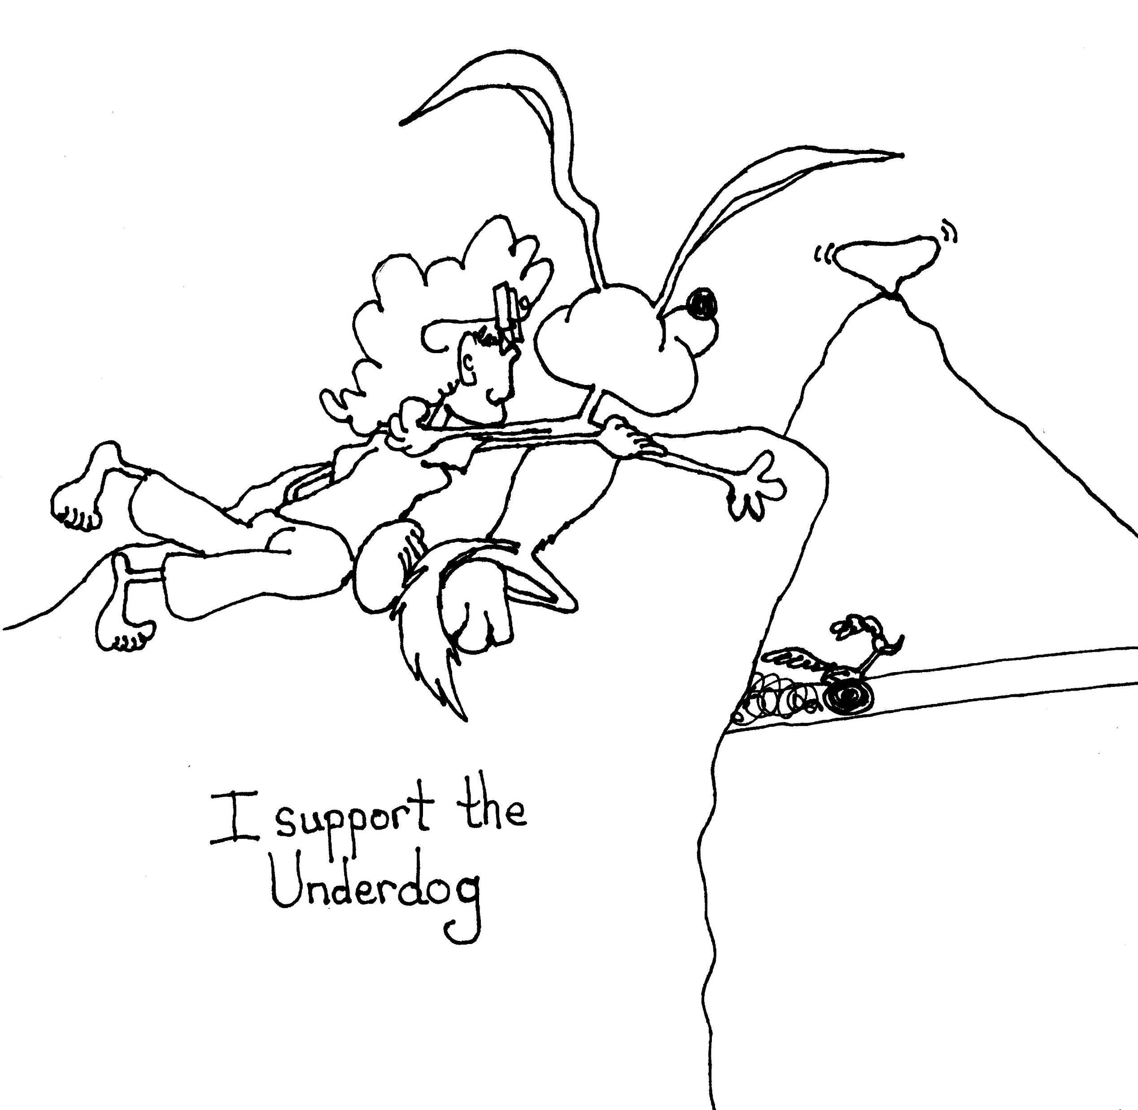
I do This
Mostly
Because I
Love the
Underdogs

Slide 7
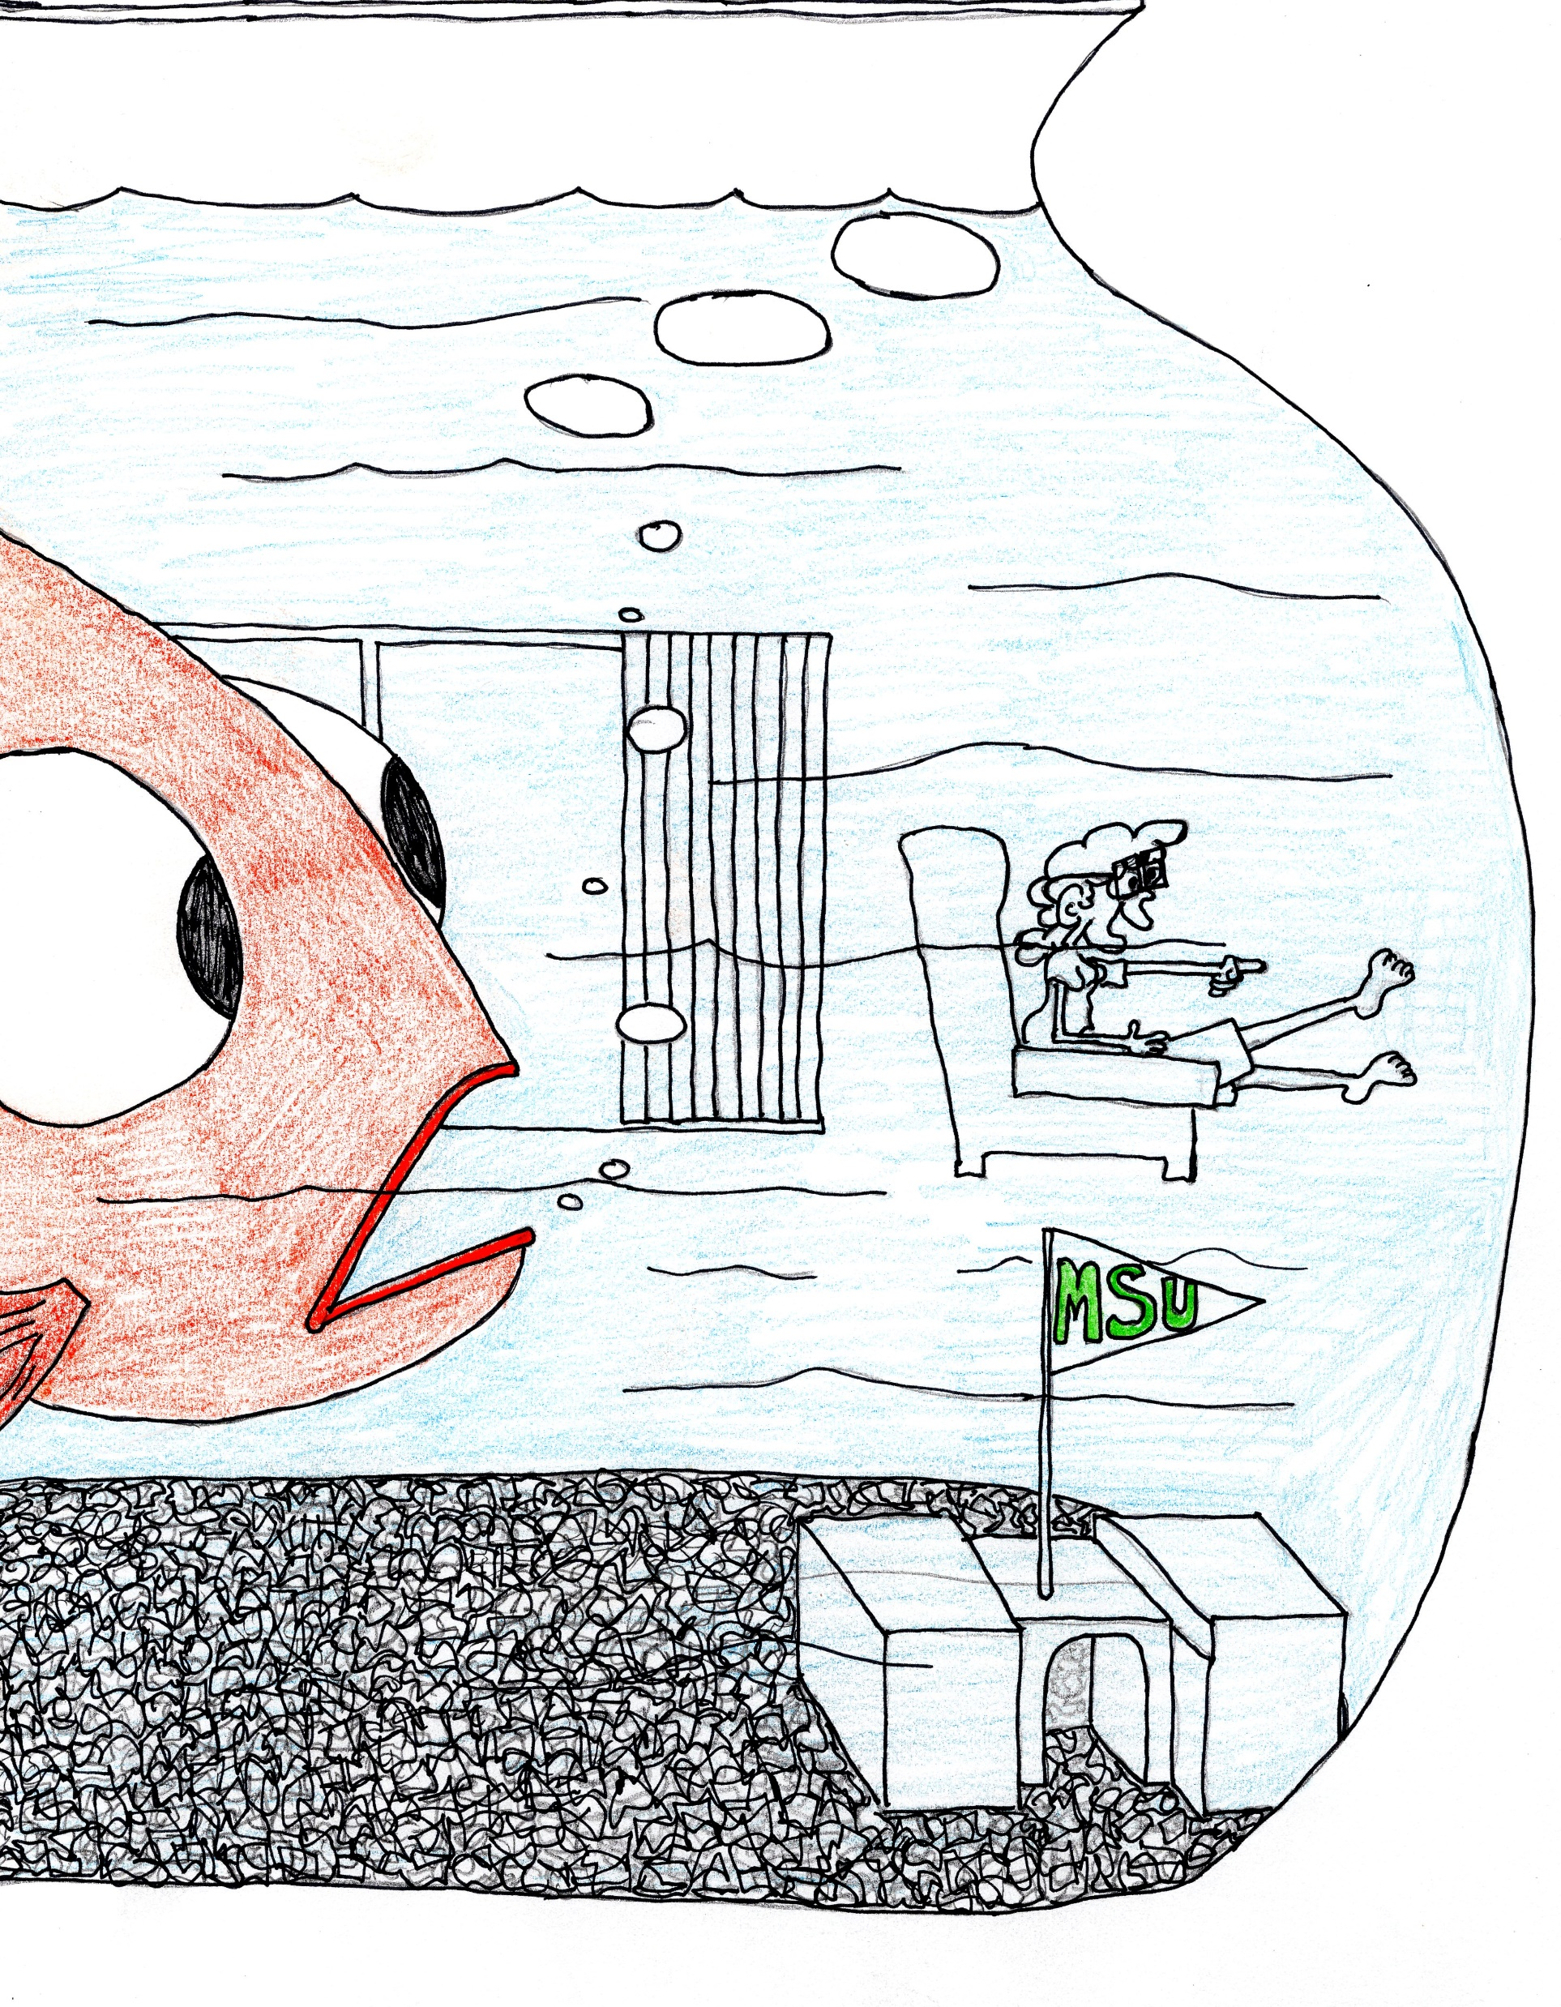
We forget that
Others have a
Different View
-frustration
-isolation
-failure
-Not a place of success for them

Slide 8
Learning Disability:
-Disorder in one or more of the central nervous system processes involved in perceiving, understanding and/or using concepts through verbal or nonverbal means
-Can be genetic or acquired and may accompany other disabilities such as deficits in sight and hearing

Slide 9
Get a piece of paper and pen or pencil

Slide 10
With your non-dominant hand write the following passage….
The assignment will not be accepted if it is illegible
You have 1 minute and 30 seconds
When I go to the next slide the timer starts…..

Slide 11
“The moon shone brightly through the window and cast light on all of the various objects the old woman had collected throughout her life.”

Slide 12
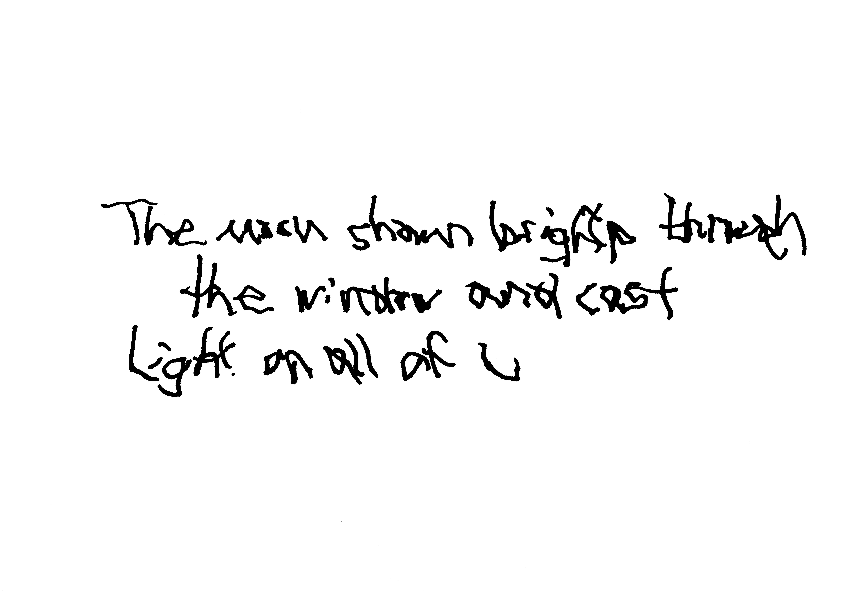

Slide 13
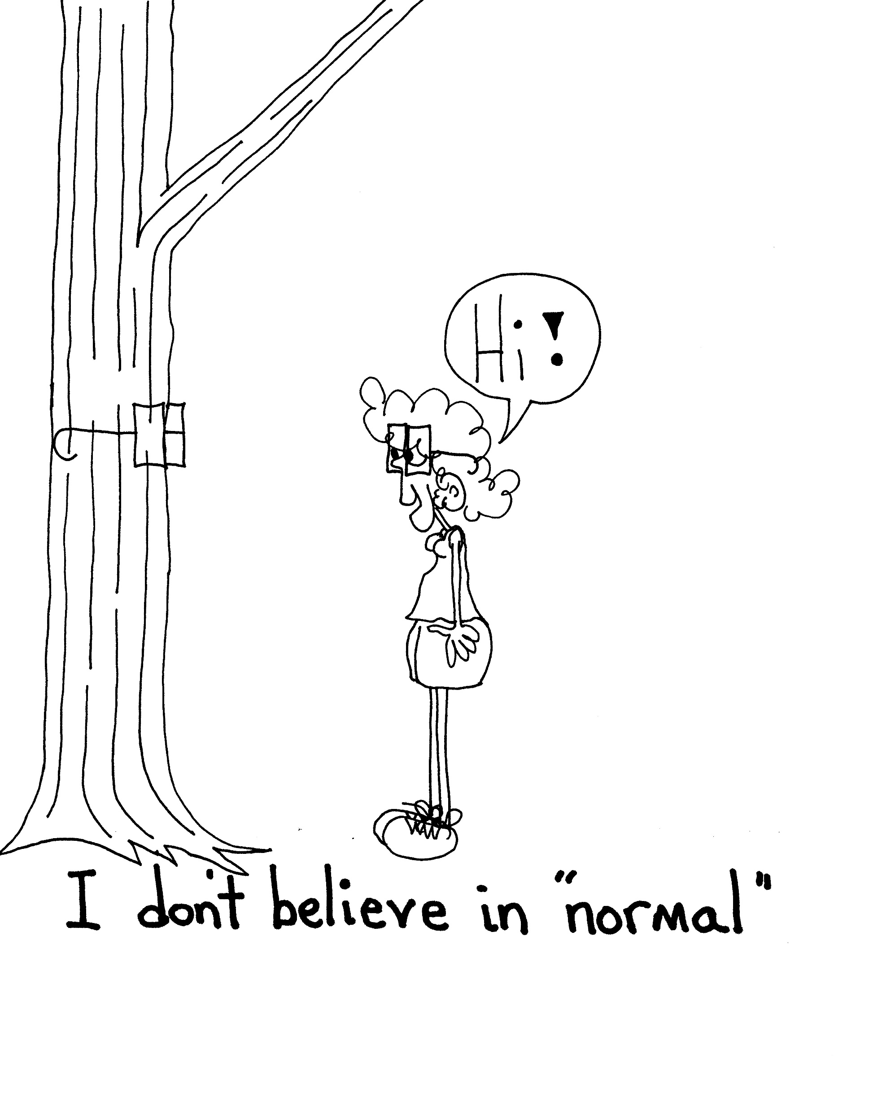
The challenge in an inclusive classroom is the removal of categorical certainties. As a Trans teacher I feel this one personally.
They have spent a lot of time in hallways and rooms that were designated “special” in a noncomplimentary way.

Slide 14
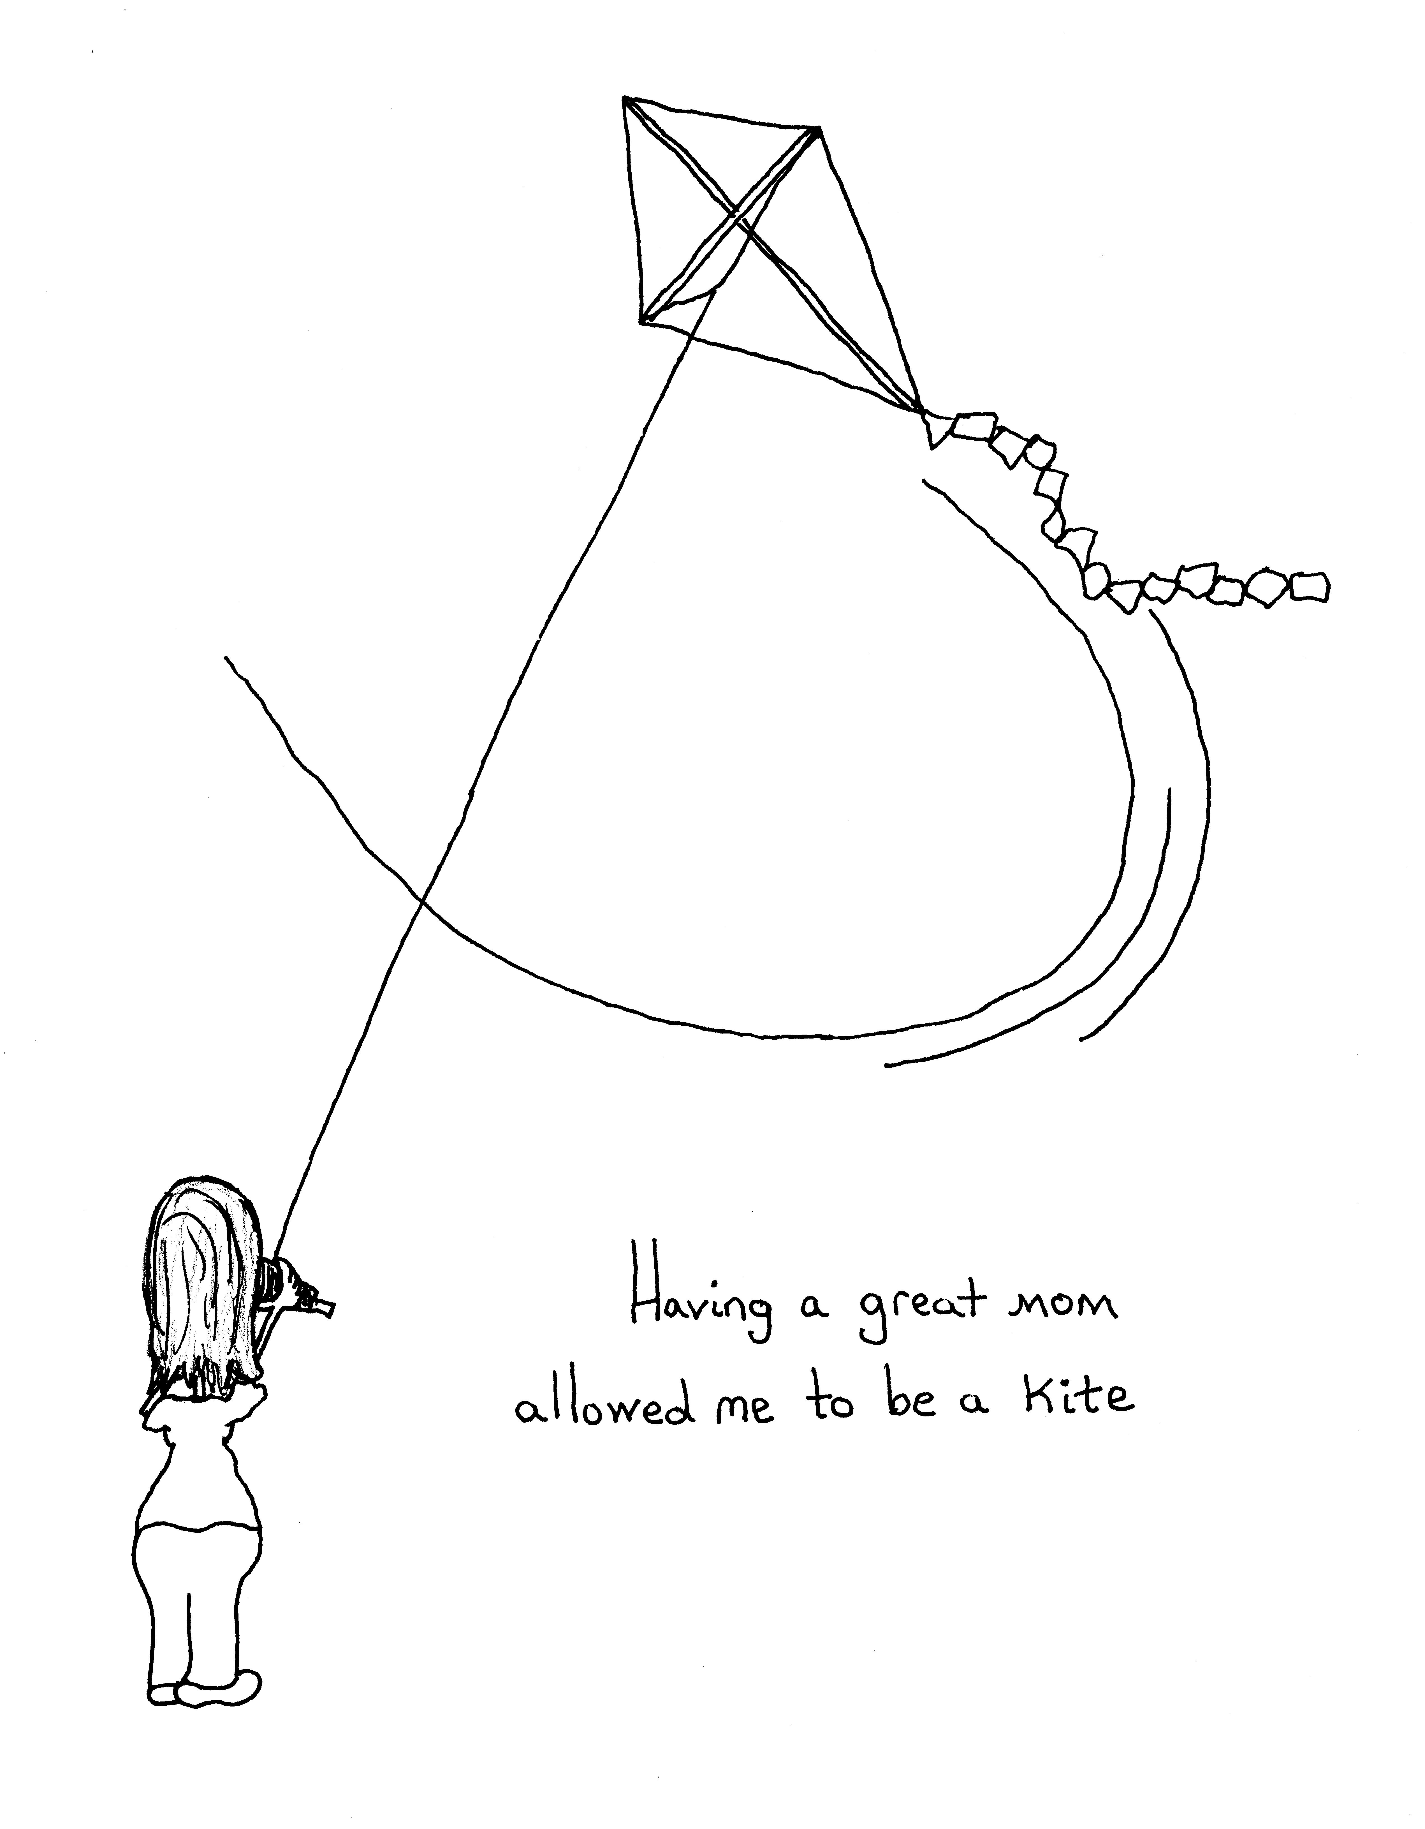
Lose these words:
Common
Normal
Typical
Average
Standard
Do not assume they have been allowed to be a kite

Slide 15
A learning Disability
Manifests itself with a deficit in the following areas: attention, reasoning, processing, memory, calculation, coordination, social competence, and emotional maturity
(IEPs are written for math, English, and writing with secondary goals for behavior and self advocacy)

Slide 16
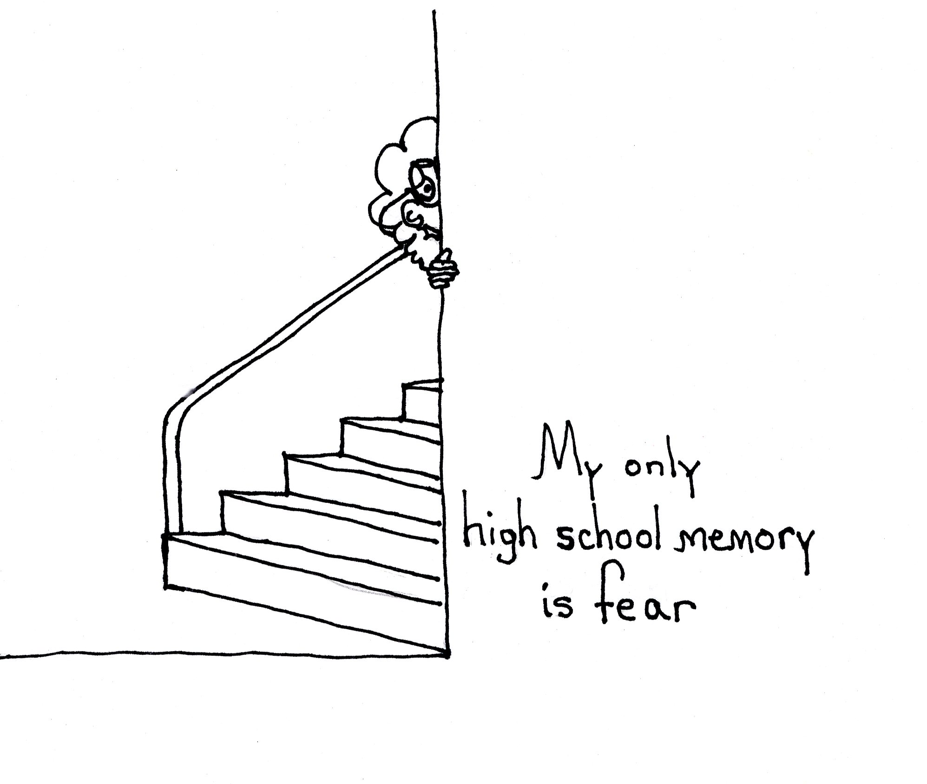
How things are:
33 % of LD students have repeated a grade
Kids that have learning disabilities are 31% more likely to be bullied than general education peers
Students with learning disabilities are twice as likely to dropout as their general education peers
Chronic absenteeism is nearly 20% higher with students that have learning disabilities, and absenteeism is the #1 predictor of dropping out of school.

Slide 17
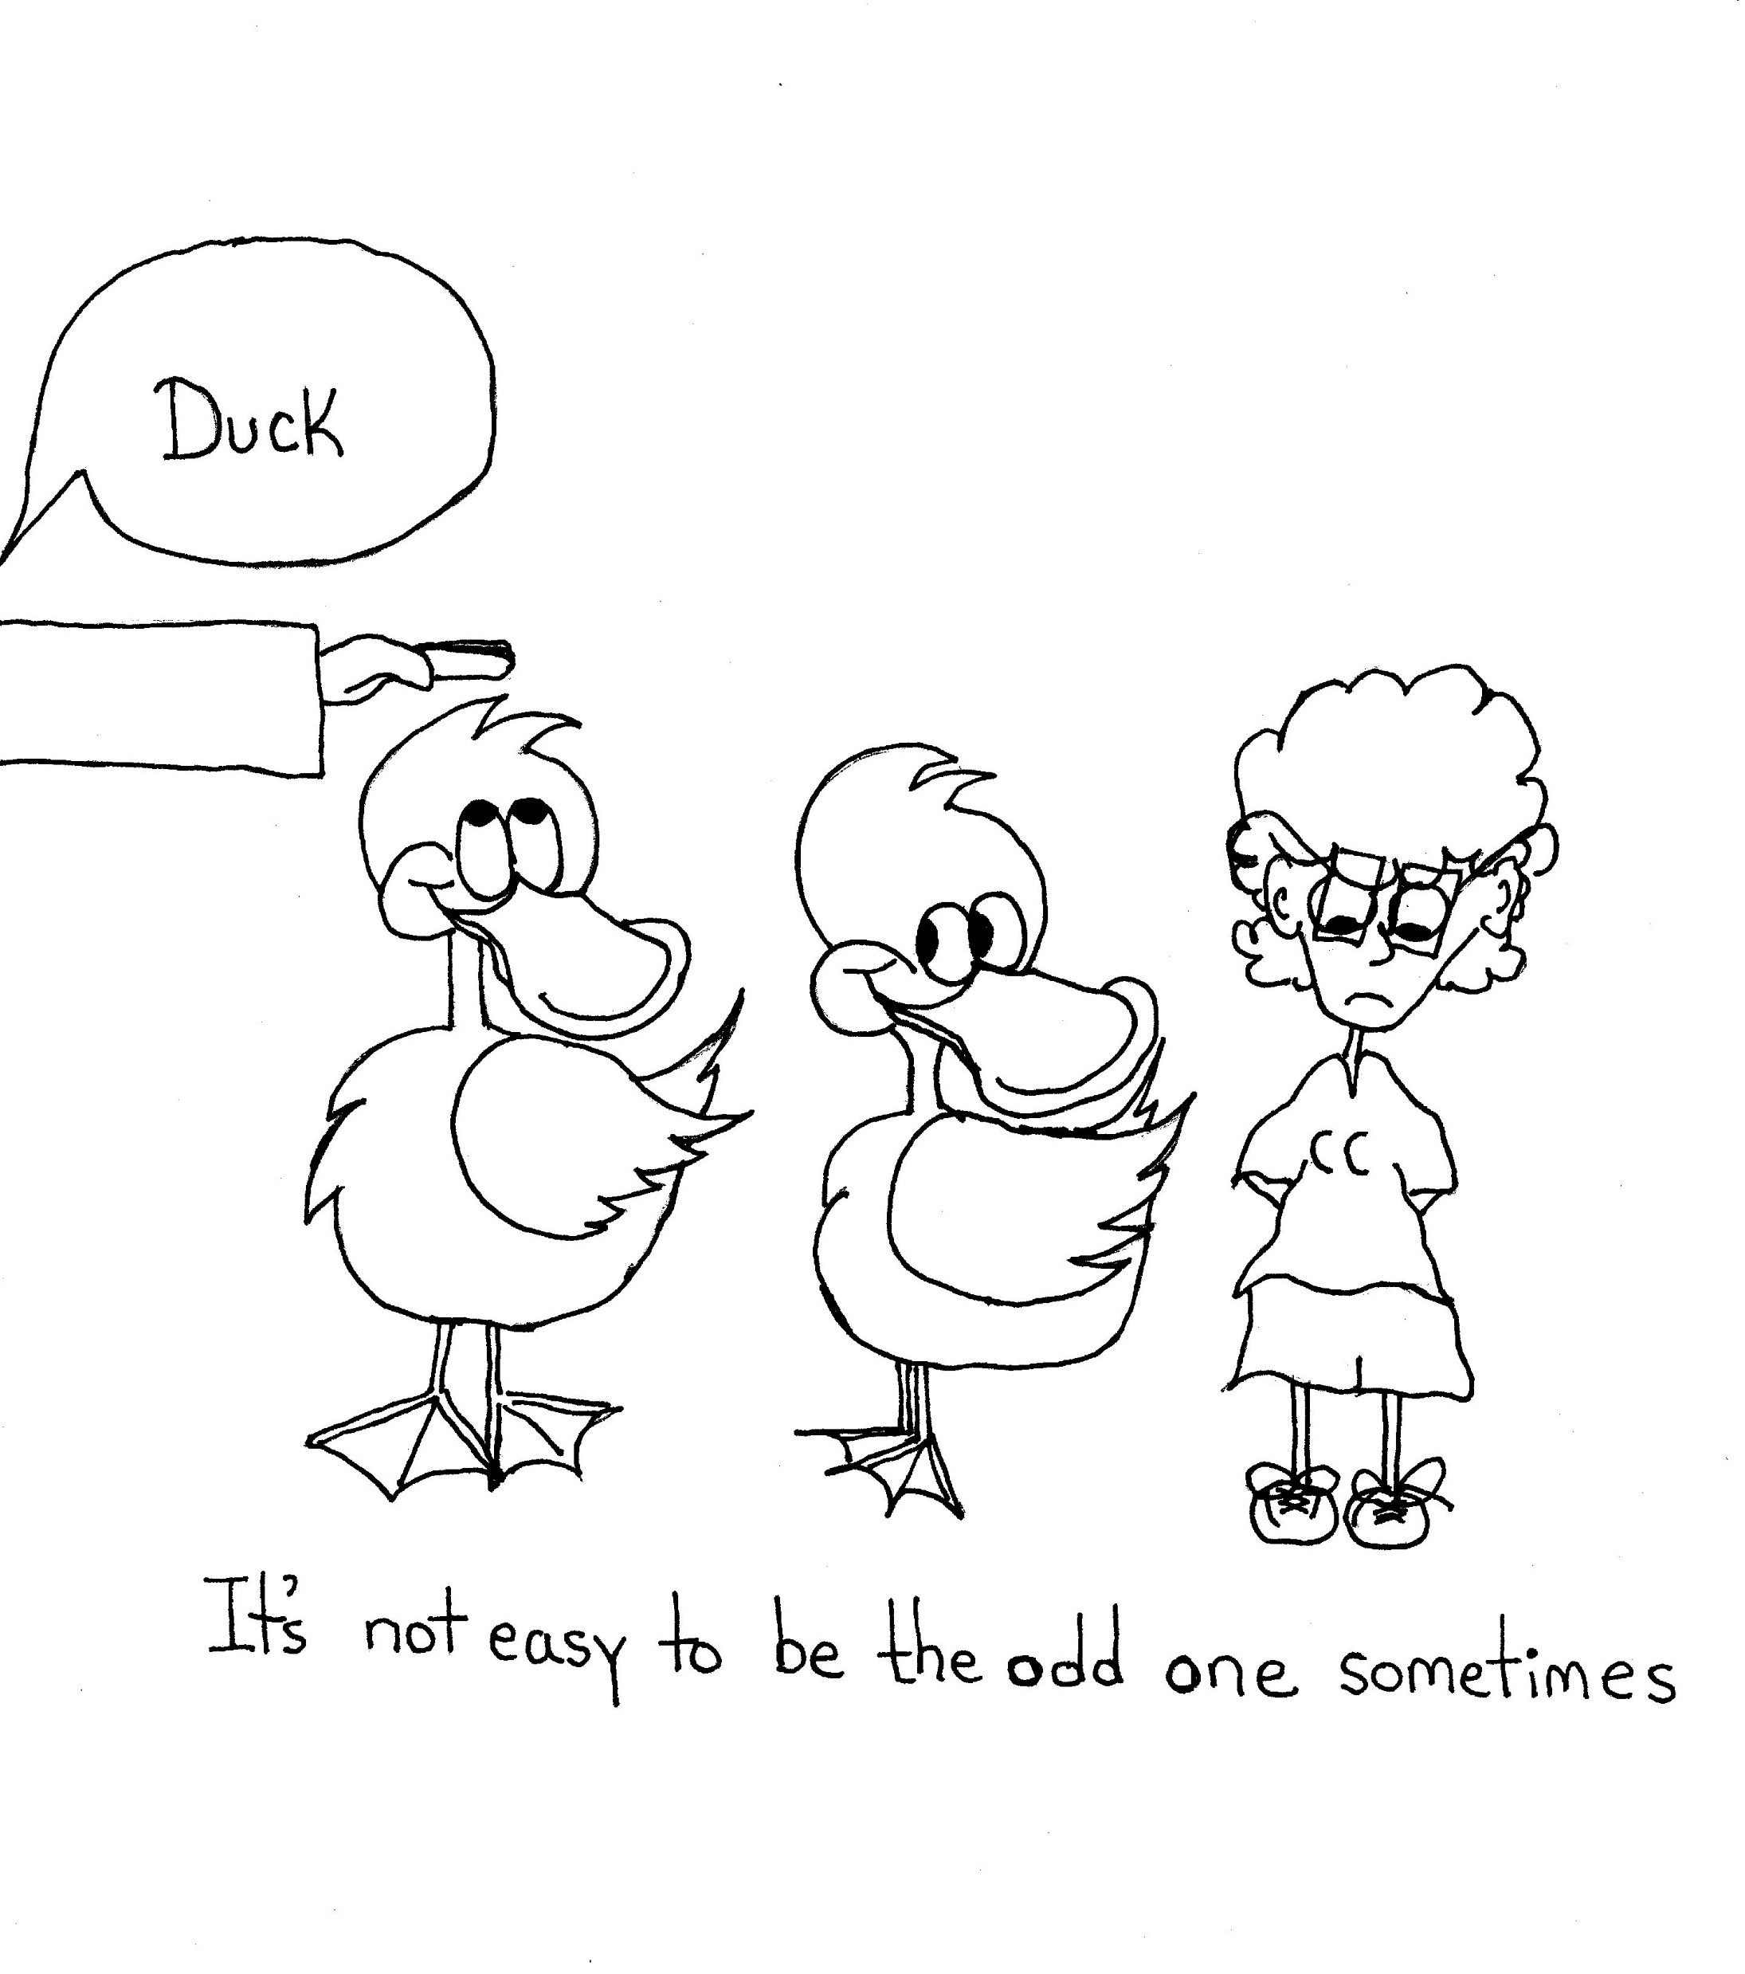
Identifiers
Fidget
Restlessness
Distraction
Short term attention to task
Interrupts or off track
Losing of items needed
Excessive talk
Difficulty concentrating

Slide 18
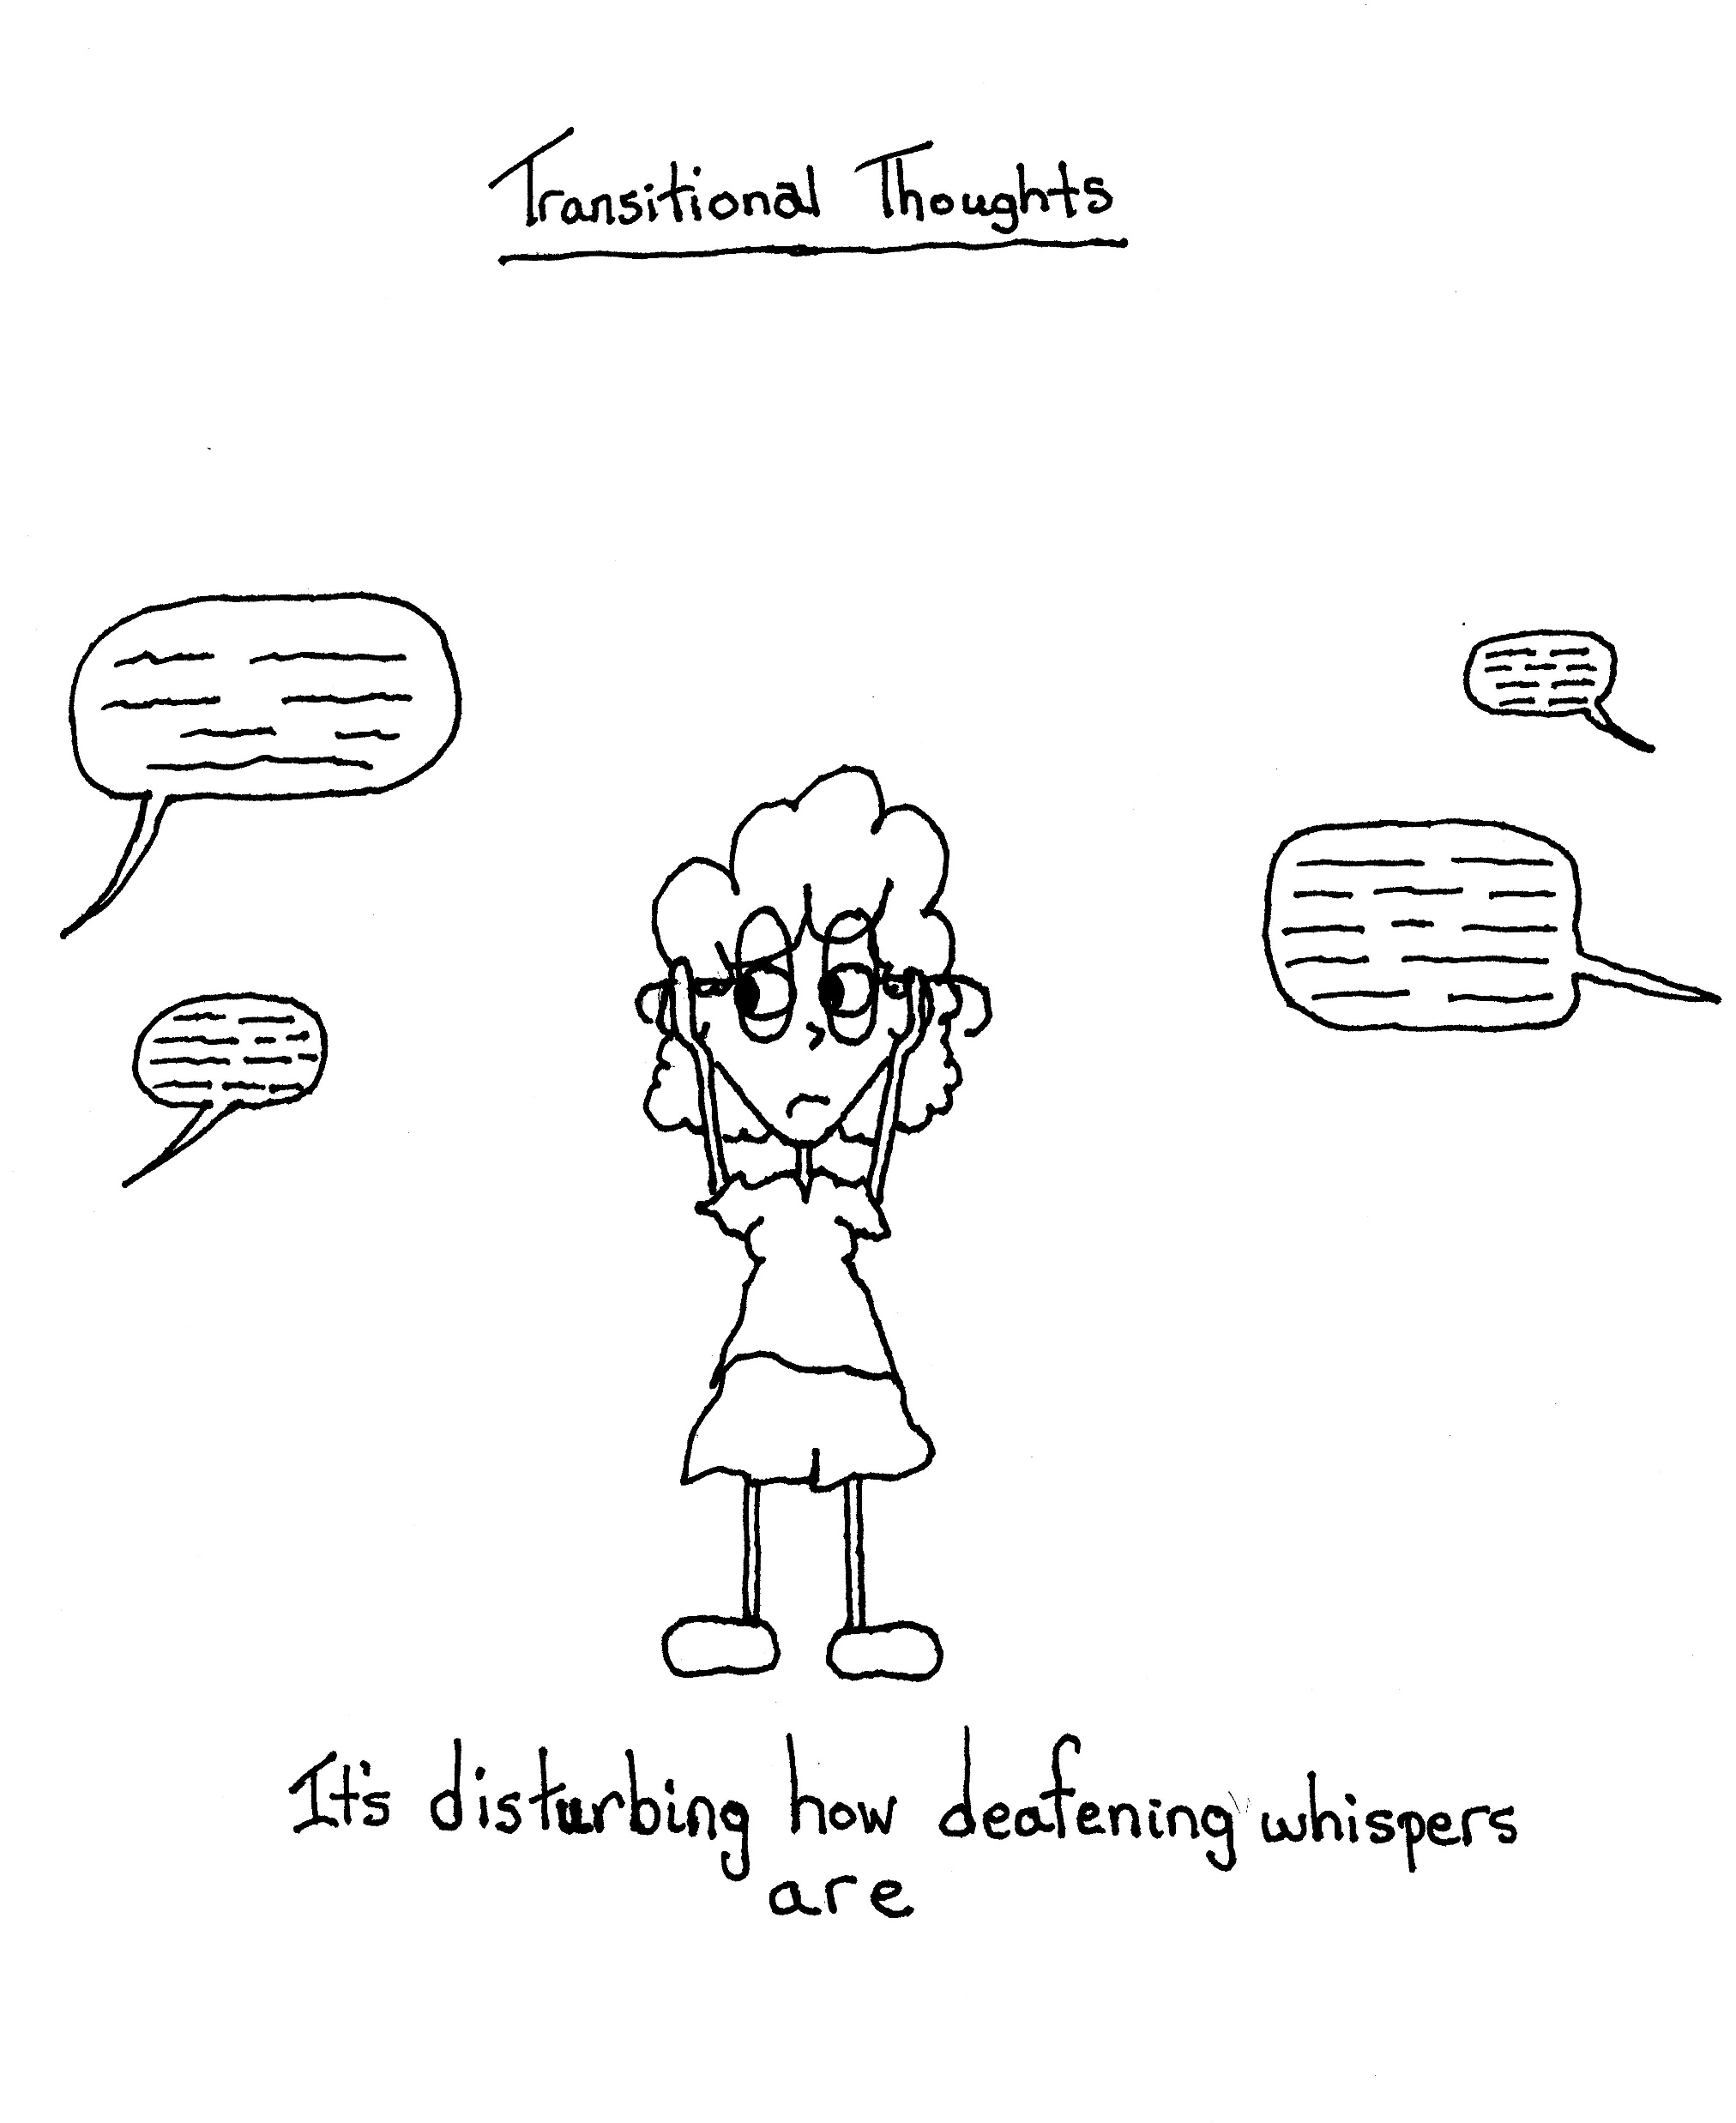
The goal is just not to be
Noticed

Slide 19
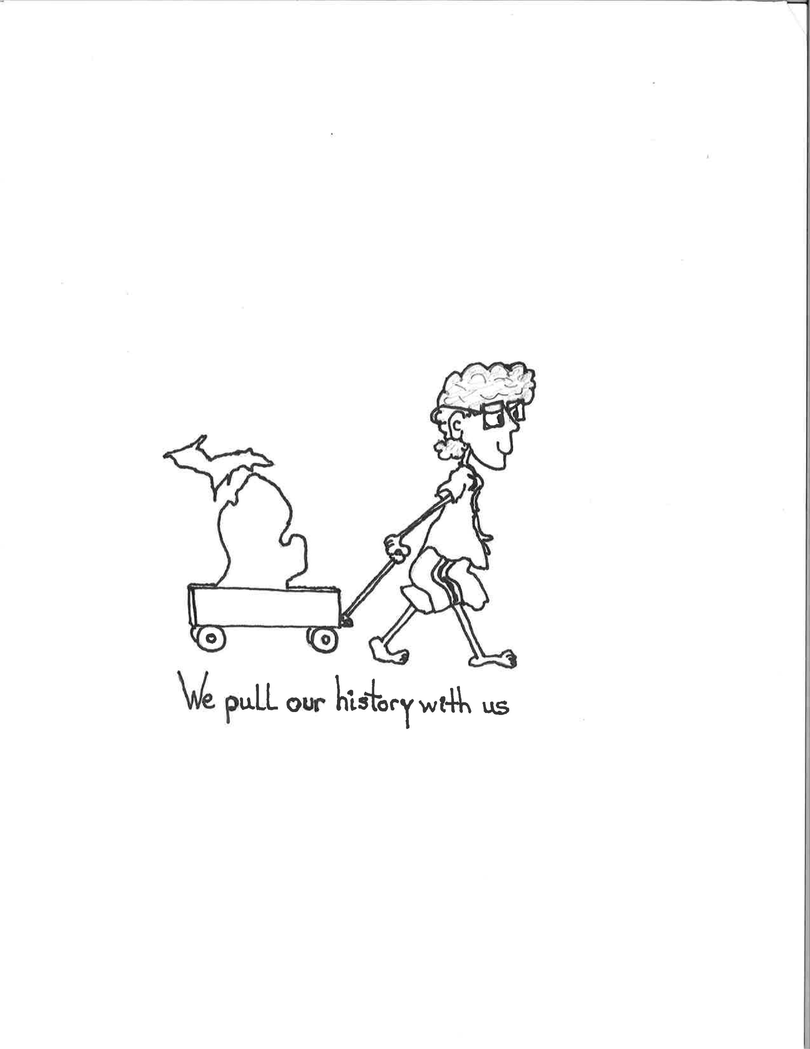
History is against them
Years of poor decision making in the classroom
Difficulty relating past to present
(and learning from past mistakes)
Delayed verbal responses (need time to respond….unwilling to risk being wrong)
Difficulty transferring learned information to practice
Trouble comprehending new information
(especially unrelated to their experience)

Slide 20
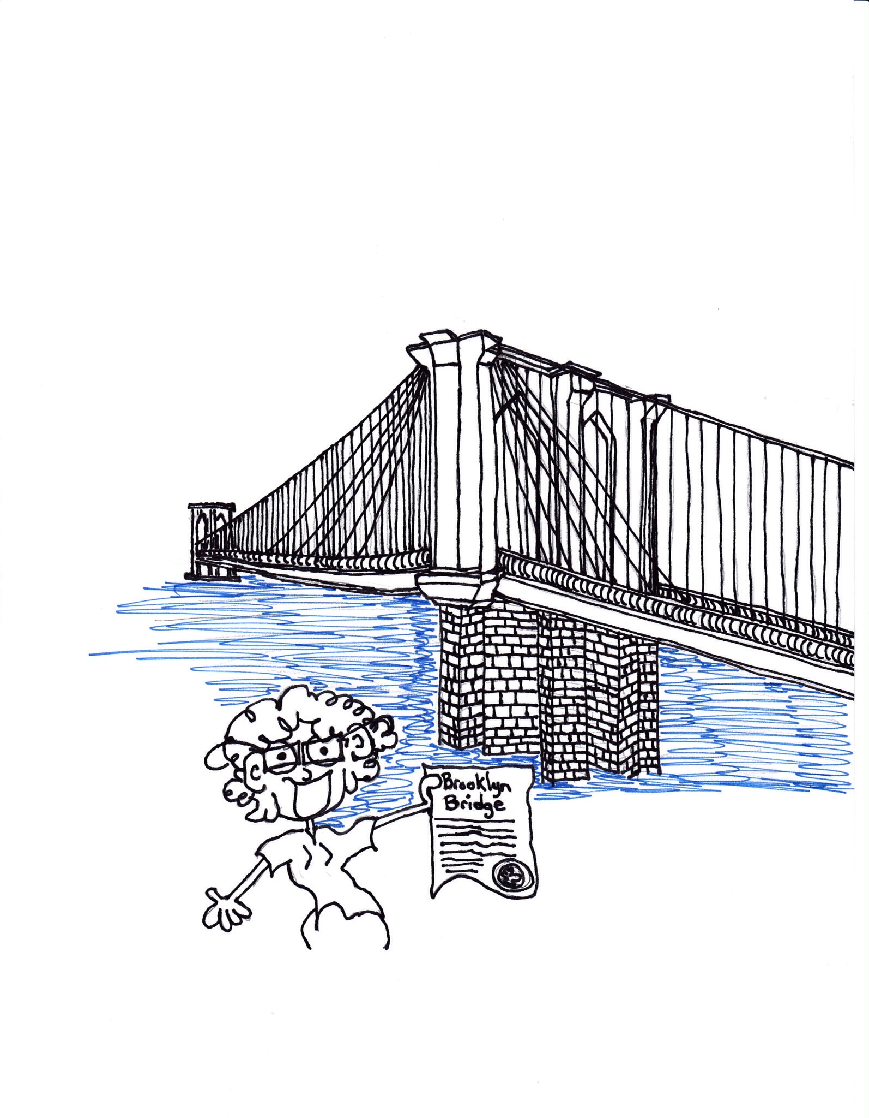
We have Sold
Them this
Bridge Before
Hard to win trust
Hard to get them to buy in
And without these there is no hope

Slide 21
Further Issues
Trouble responding to questions relating to their past (classes taken, academic successes, highlights in school, and generally all the moments we could list in detail)
Problems repeating or synthesizing information heard (as with ELL students visuals are critical)
Differences sequencing events
Difficulty remembering information from reading

Slide 22
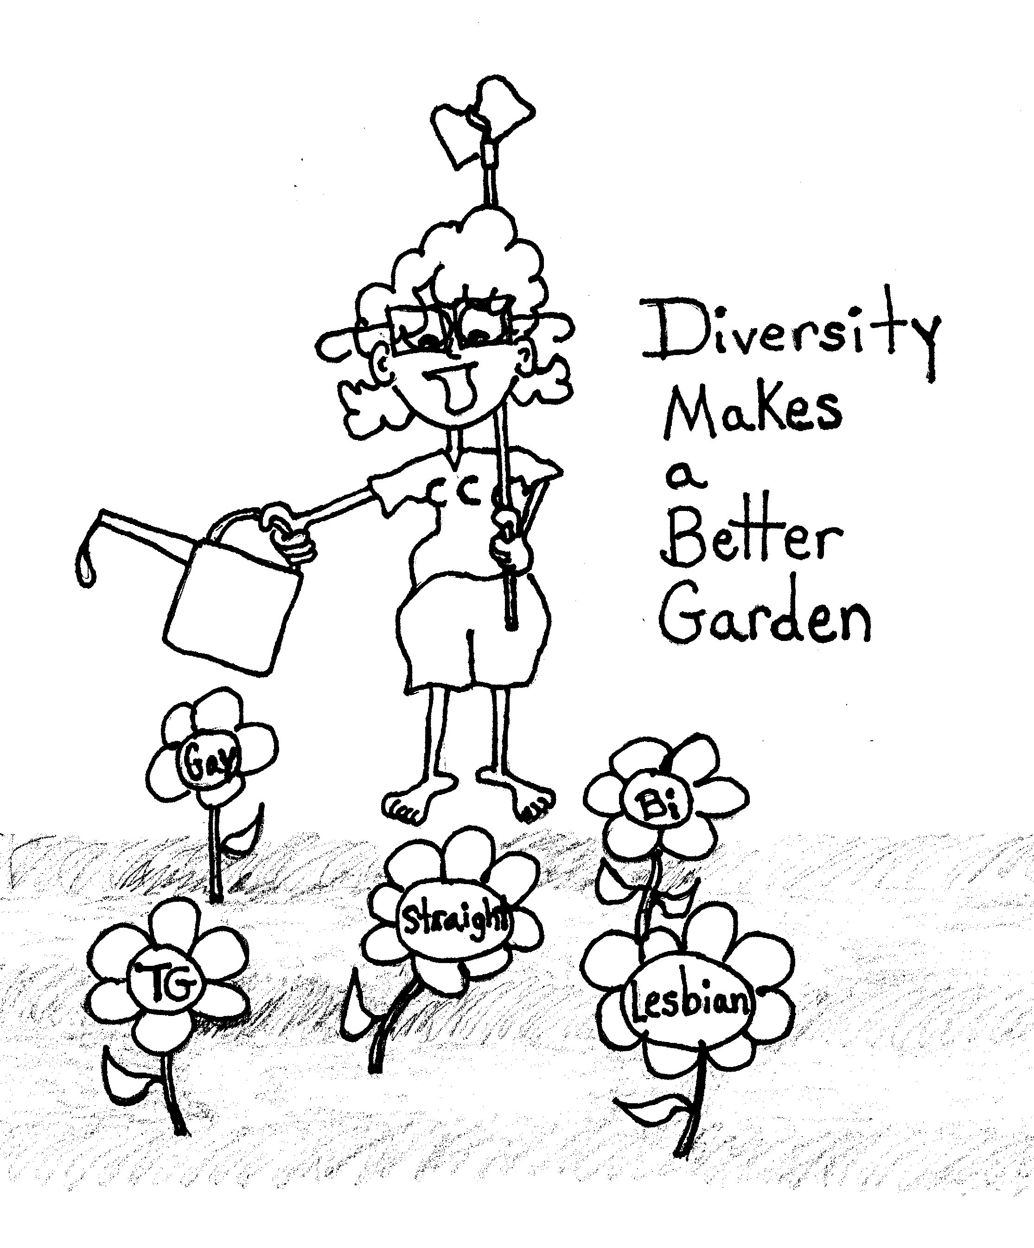
New surroundings are difficult due to history of isolation
The strengths of a diverse classroom of which they are an integral part may be unknown to them
Consider the effects of that…

Slide 23
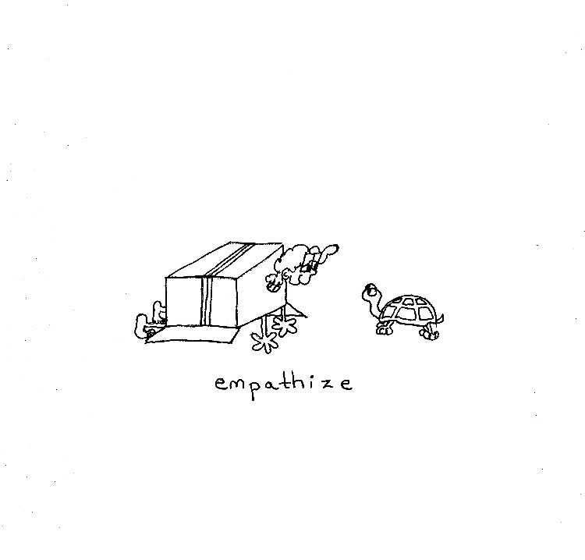
Teach, model, and live
EMPATHY
It is a vanishing skill

Slide 24
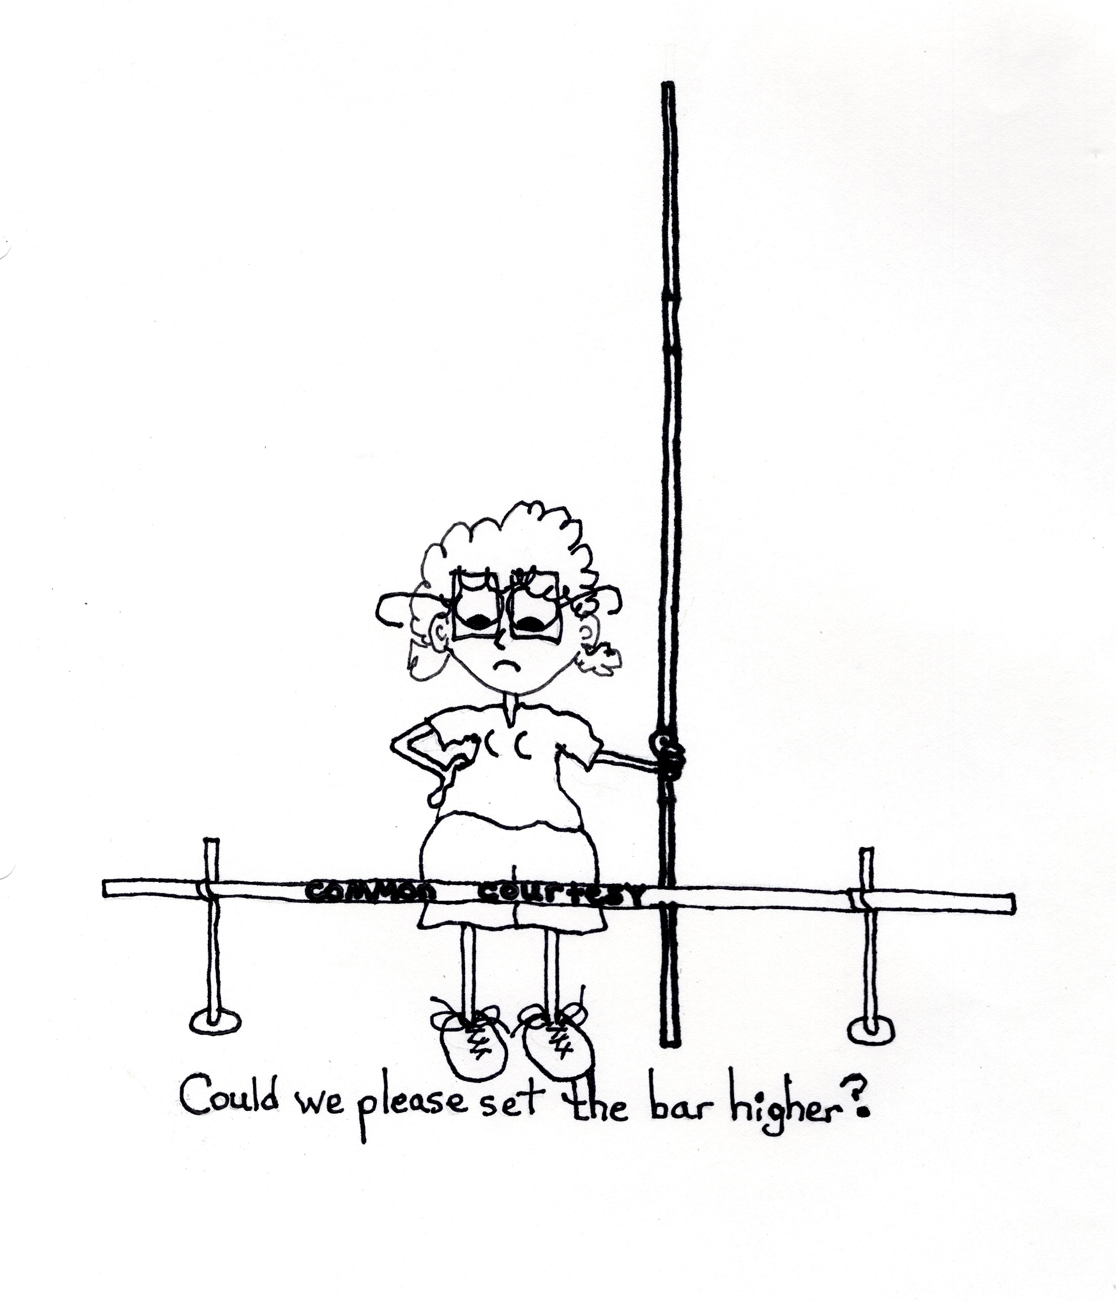
Expect (Demand)
Respect for all is clear
Safe environment for risk taking (questions, opinions, and sharing…remember where they were)
Praise on par with peers (exaggerated praise is not helpful)

Slide 25
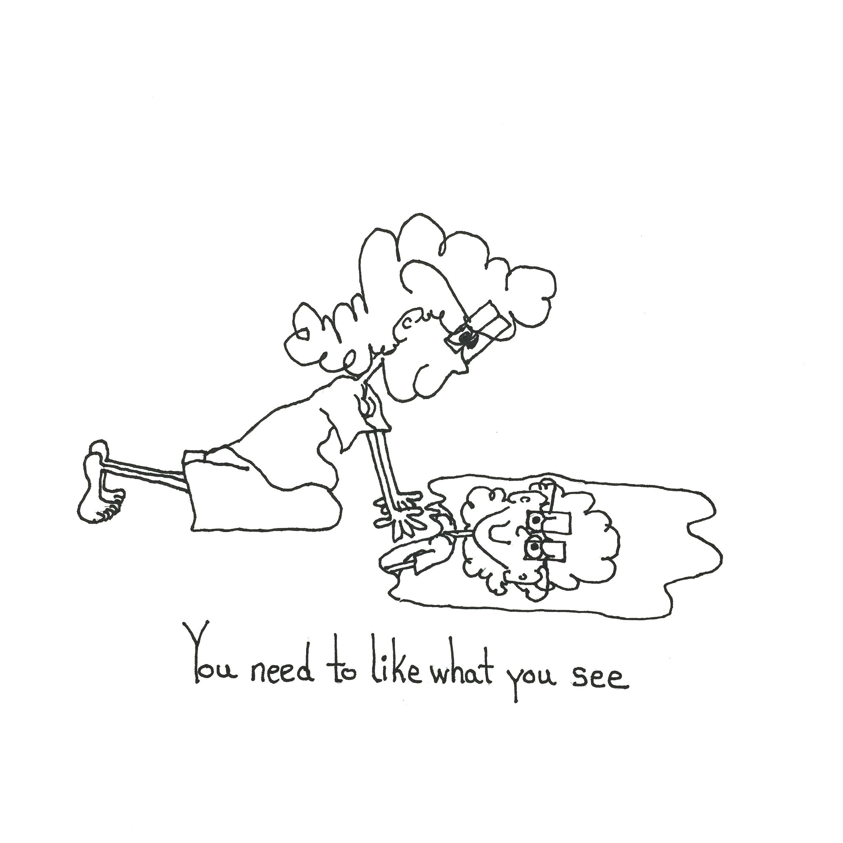
The Simple not Really
Simple
Terrible to feel “simple”
-Note taking
-Study habits
-Working in a team
-Leadership
-Sharing opinions appropriately
-Accepting even constructive correction
-Not “Giving up” at the first sign of difficulty

Slide 26
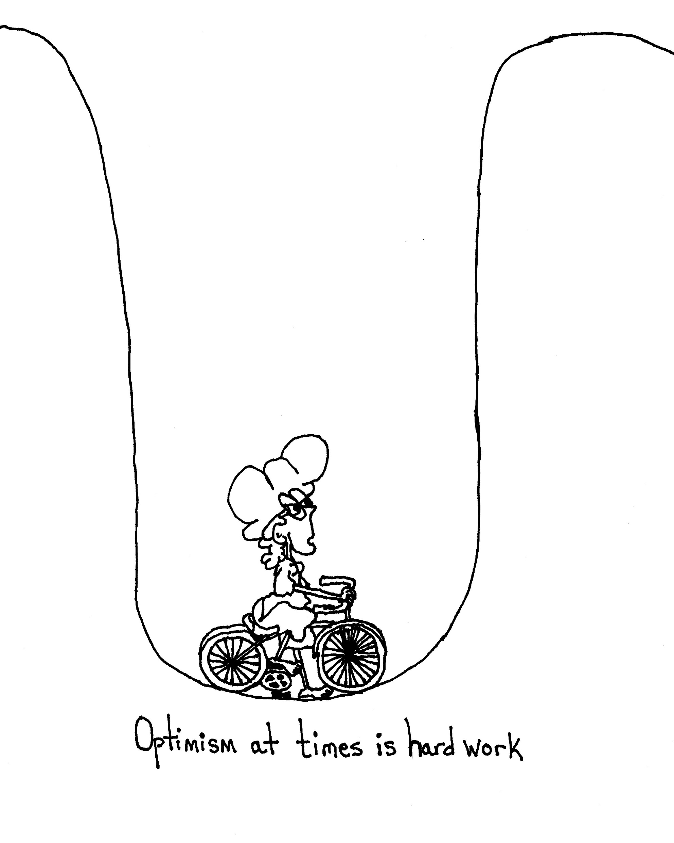
Remember……
Optimism in the Face of
Endless
Failure is
Difficult

Slide 27
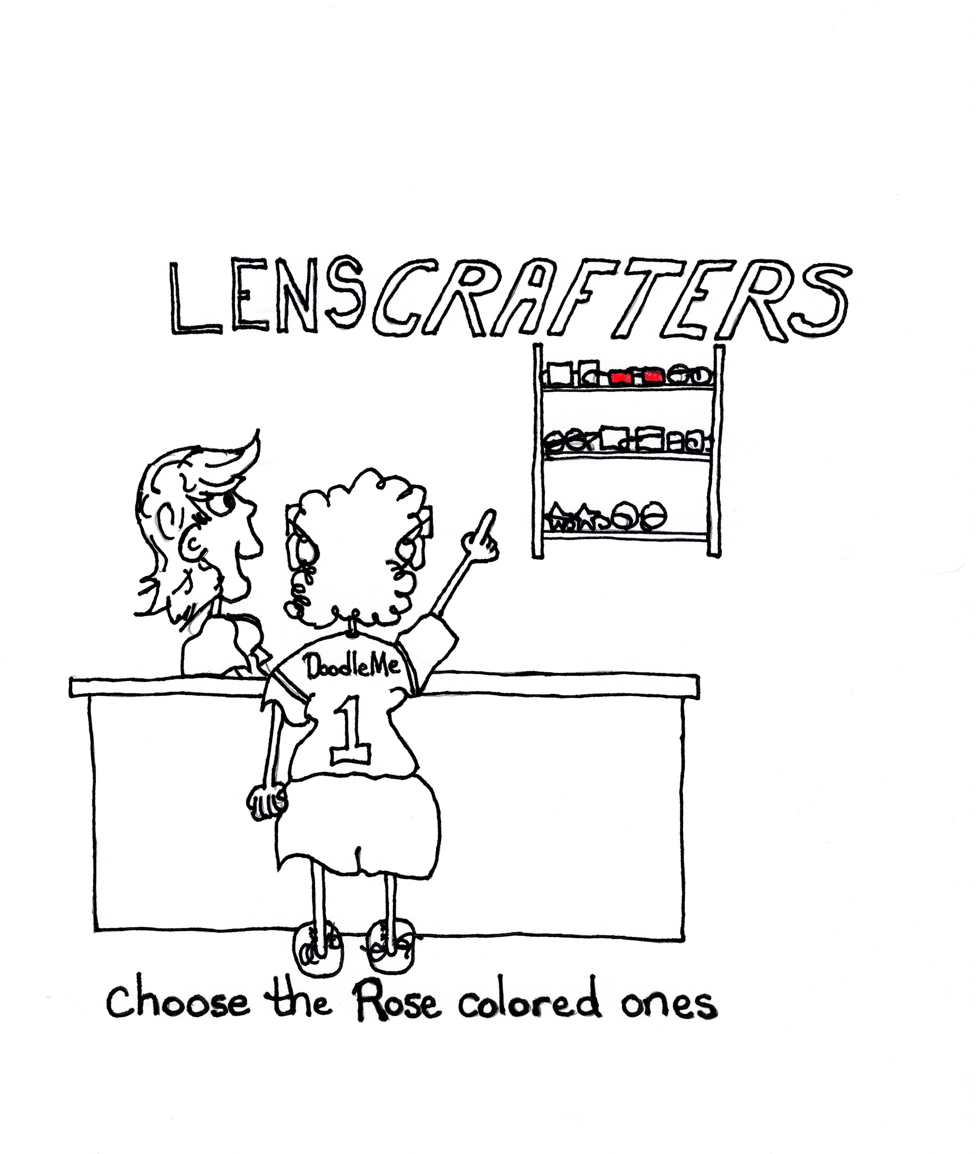
Being
“simple” becomes the disability……
We are in the business of
OPTIMISM!!!

Slide 28

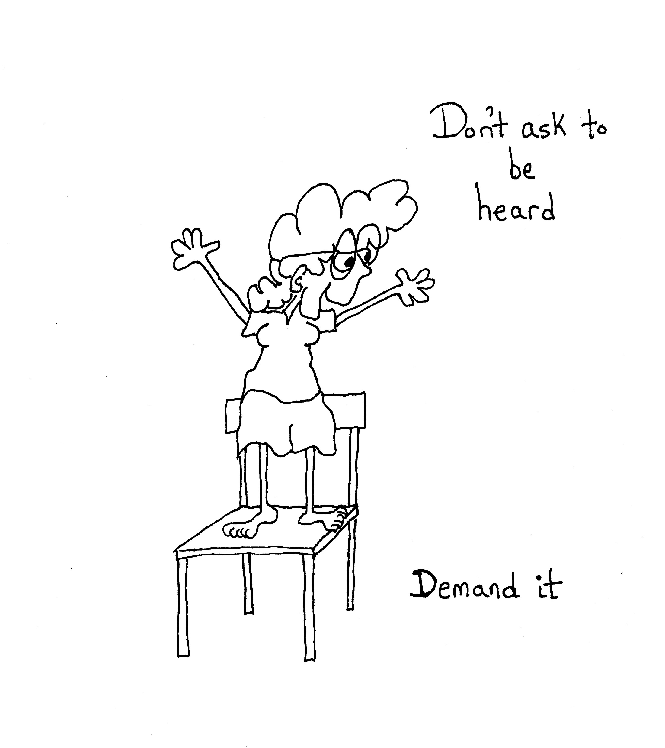
Self Advocacy
Perhaps nothing more important for the adult student than the ability to speak up for themselves.
To formulate an opinion they believe in, express it, and defend it.

Slide 29
Challenge of Self Advocacy
Students tend to speak in short and incomplete sentences
(they have been allowed to by supportive staff that plays the roll of interpreter)
Struggle with forming logical basis for statements
Difficulty participating in groups larger than 1 or 2 (again often due to learning in small groups with the same teachers)

Slide 30
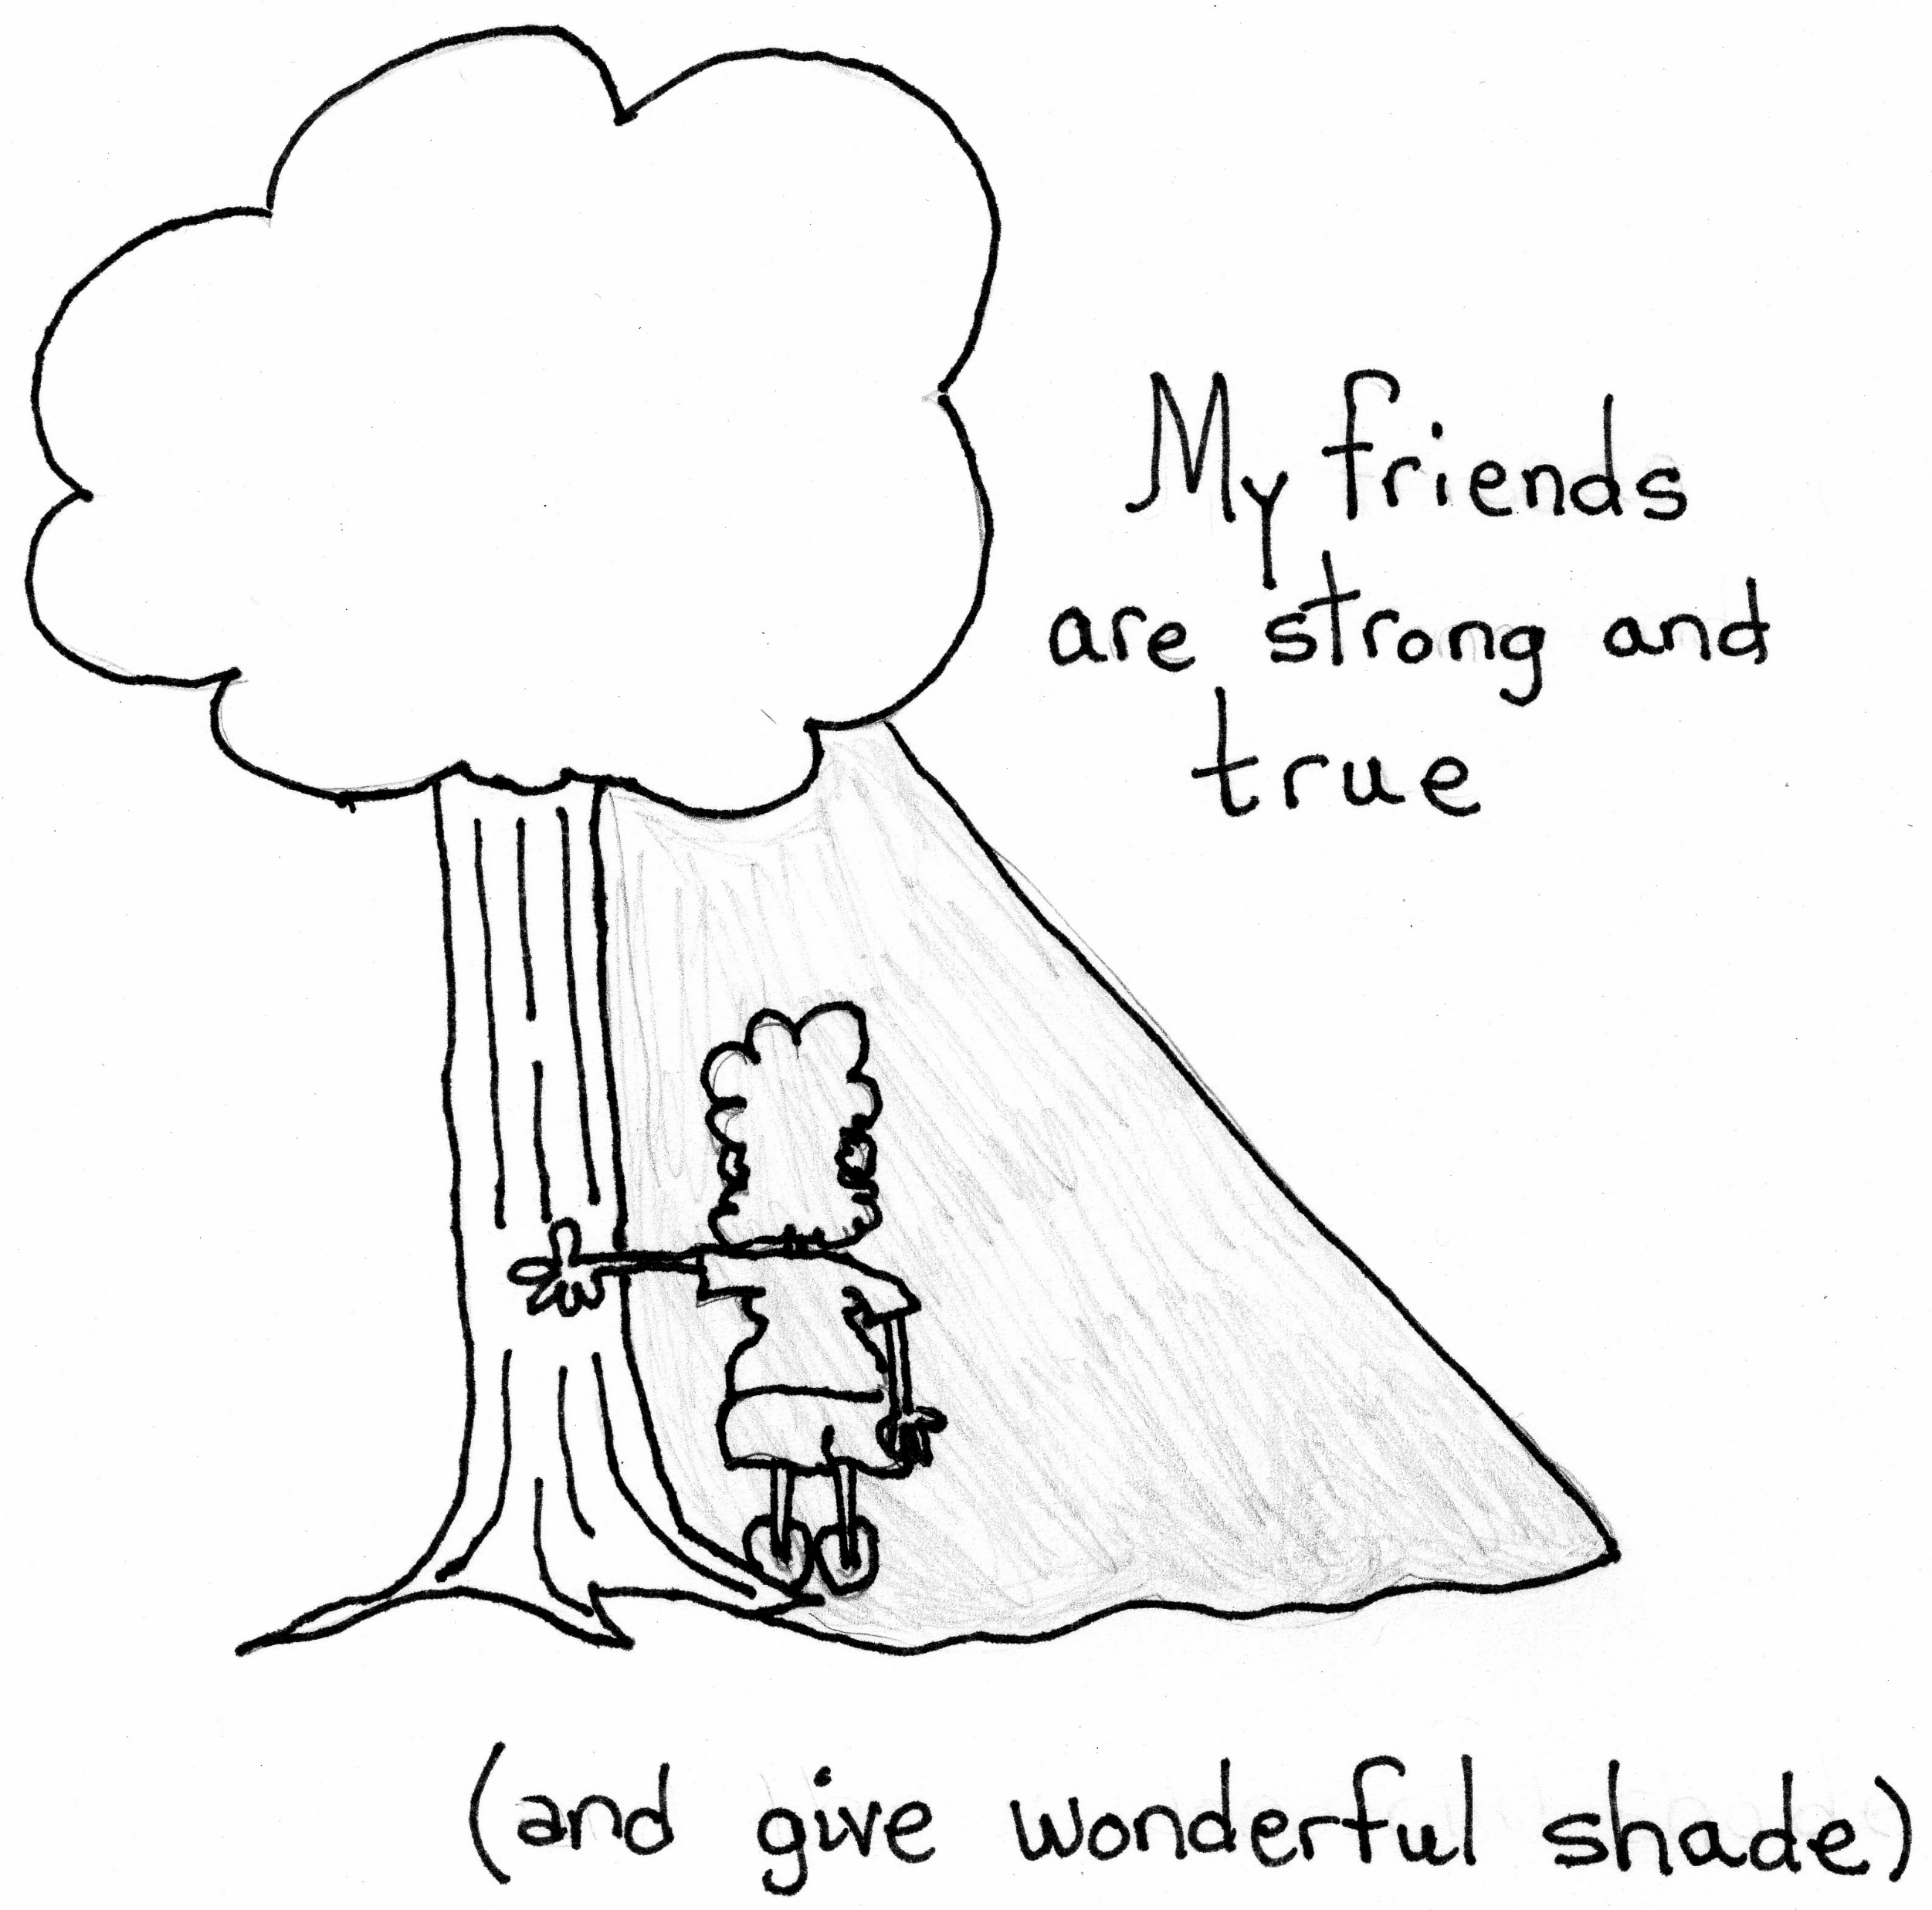
Social Impact
They generally run with kids “like them”
Run with kids that also “fail” a lot
Failure or disability become a shared trait that is safe. But it is not the world they will live in
They need friendships based on more than shared shortcomings

Slide 31
Real World Problems
Difficulty with applications
Difficulty reading “specialized” material
Poor spelling (push common words correction)
Inability to deal with abstract ideas or concepts (money)
What we consider “basics” may not be to them

Slide 32
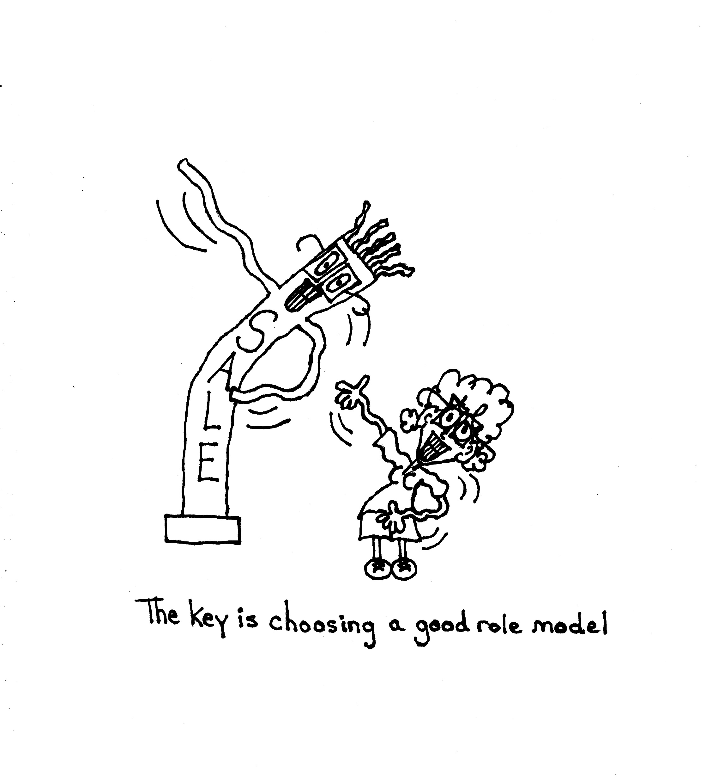
Need a model that is not what they see as “special education”
Intentionally model skills you wish to see

Slide 33
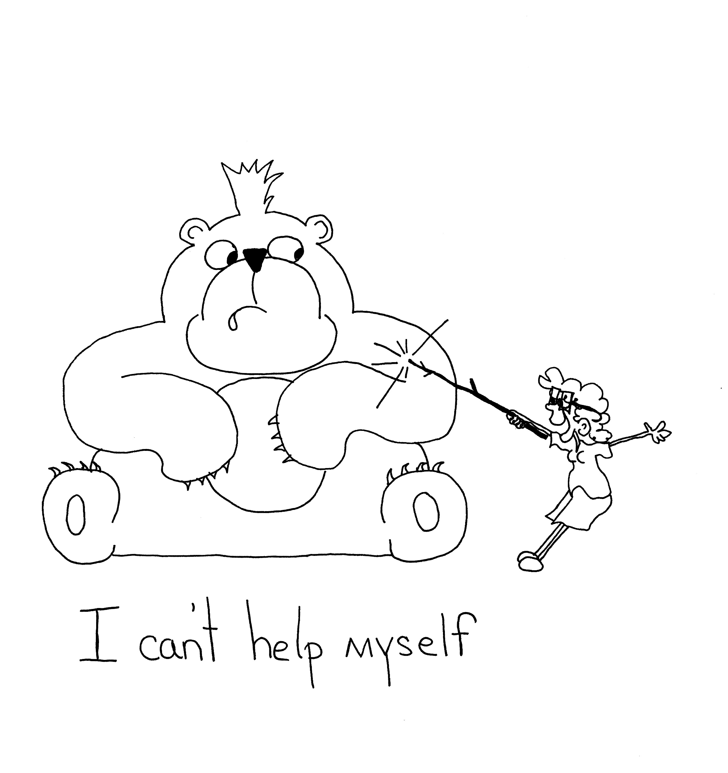
Try not to be annoyed…..
They may struggle with organizing and prioritizing information
Difficulties identifying and planning the next step
May struggle with punctuality
They are NOT trying to poke the bear…

Slide 34
IEPs are in place until the age of 22
Recently rule change allows the student to retain services for school year even if they age out during the year

Slide 35
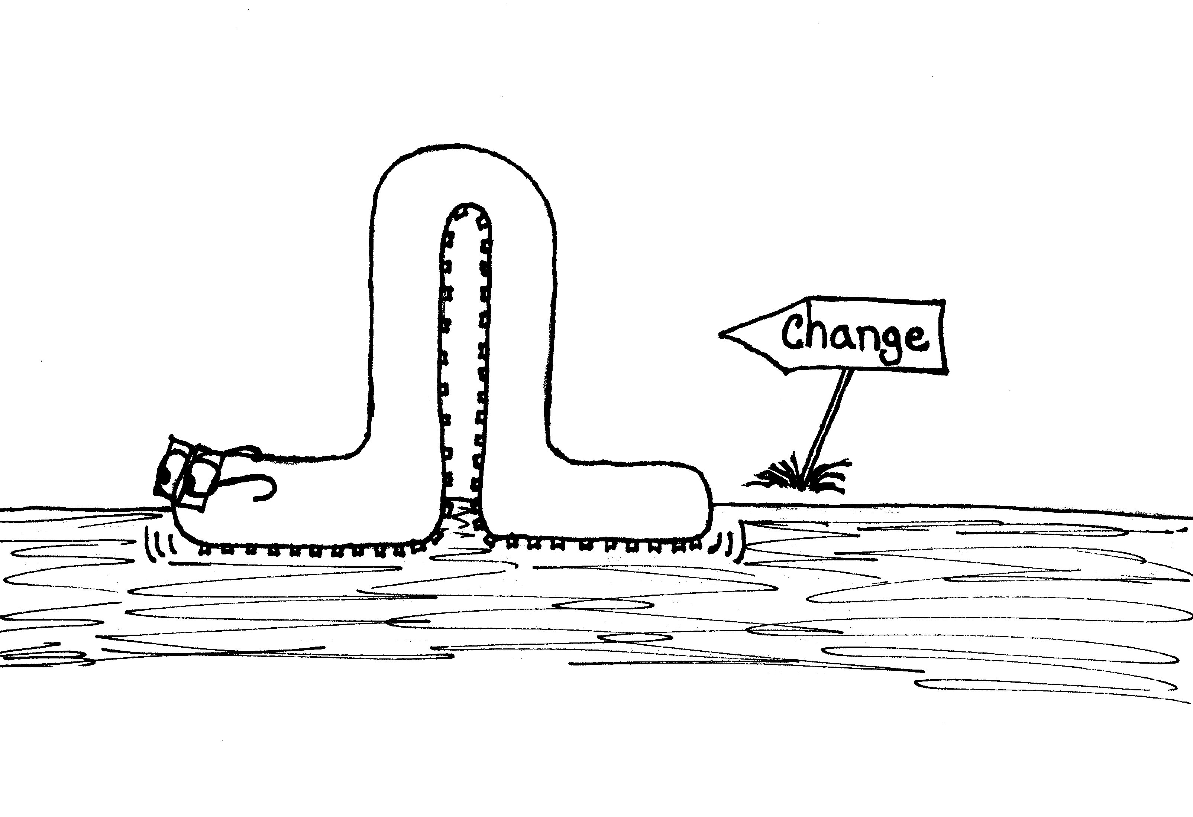
Long term change will come with:
Adult students recognize their disability and have the tools to express what they need
Move the focus from their faults to their strengths
Have the social confidence to work (and lead) diverse groups of people

Slide 36
Department of Education’s tips for adult special needs student success
- inclusive school environment with access to general education curriculum to the highest degree possible
- support students in developing self- determination, leadership, and self-advocacy skills

Slide 37
- teach communication and social skills in a variety of settings
- be willing to adjust the pace of instruction
(more review, multiple modes of instruction, and prepping students for success with study skills they may not possess)
- success may be unfamiliar make it clear it is not a fluke or luck. They can do the work.

Slide 38
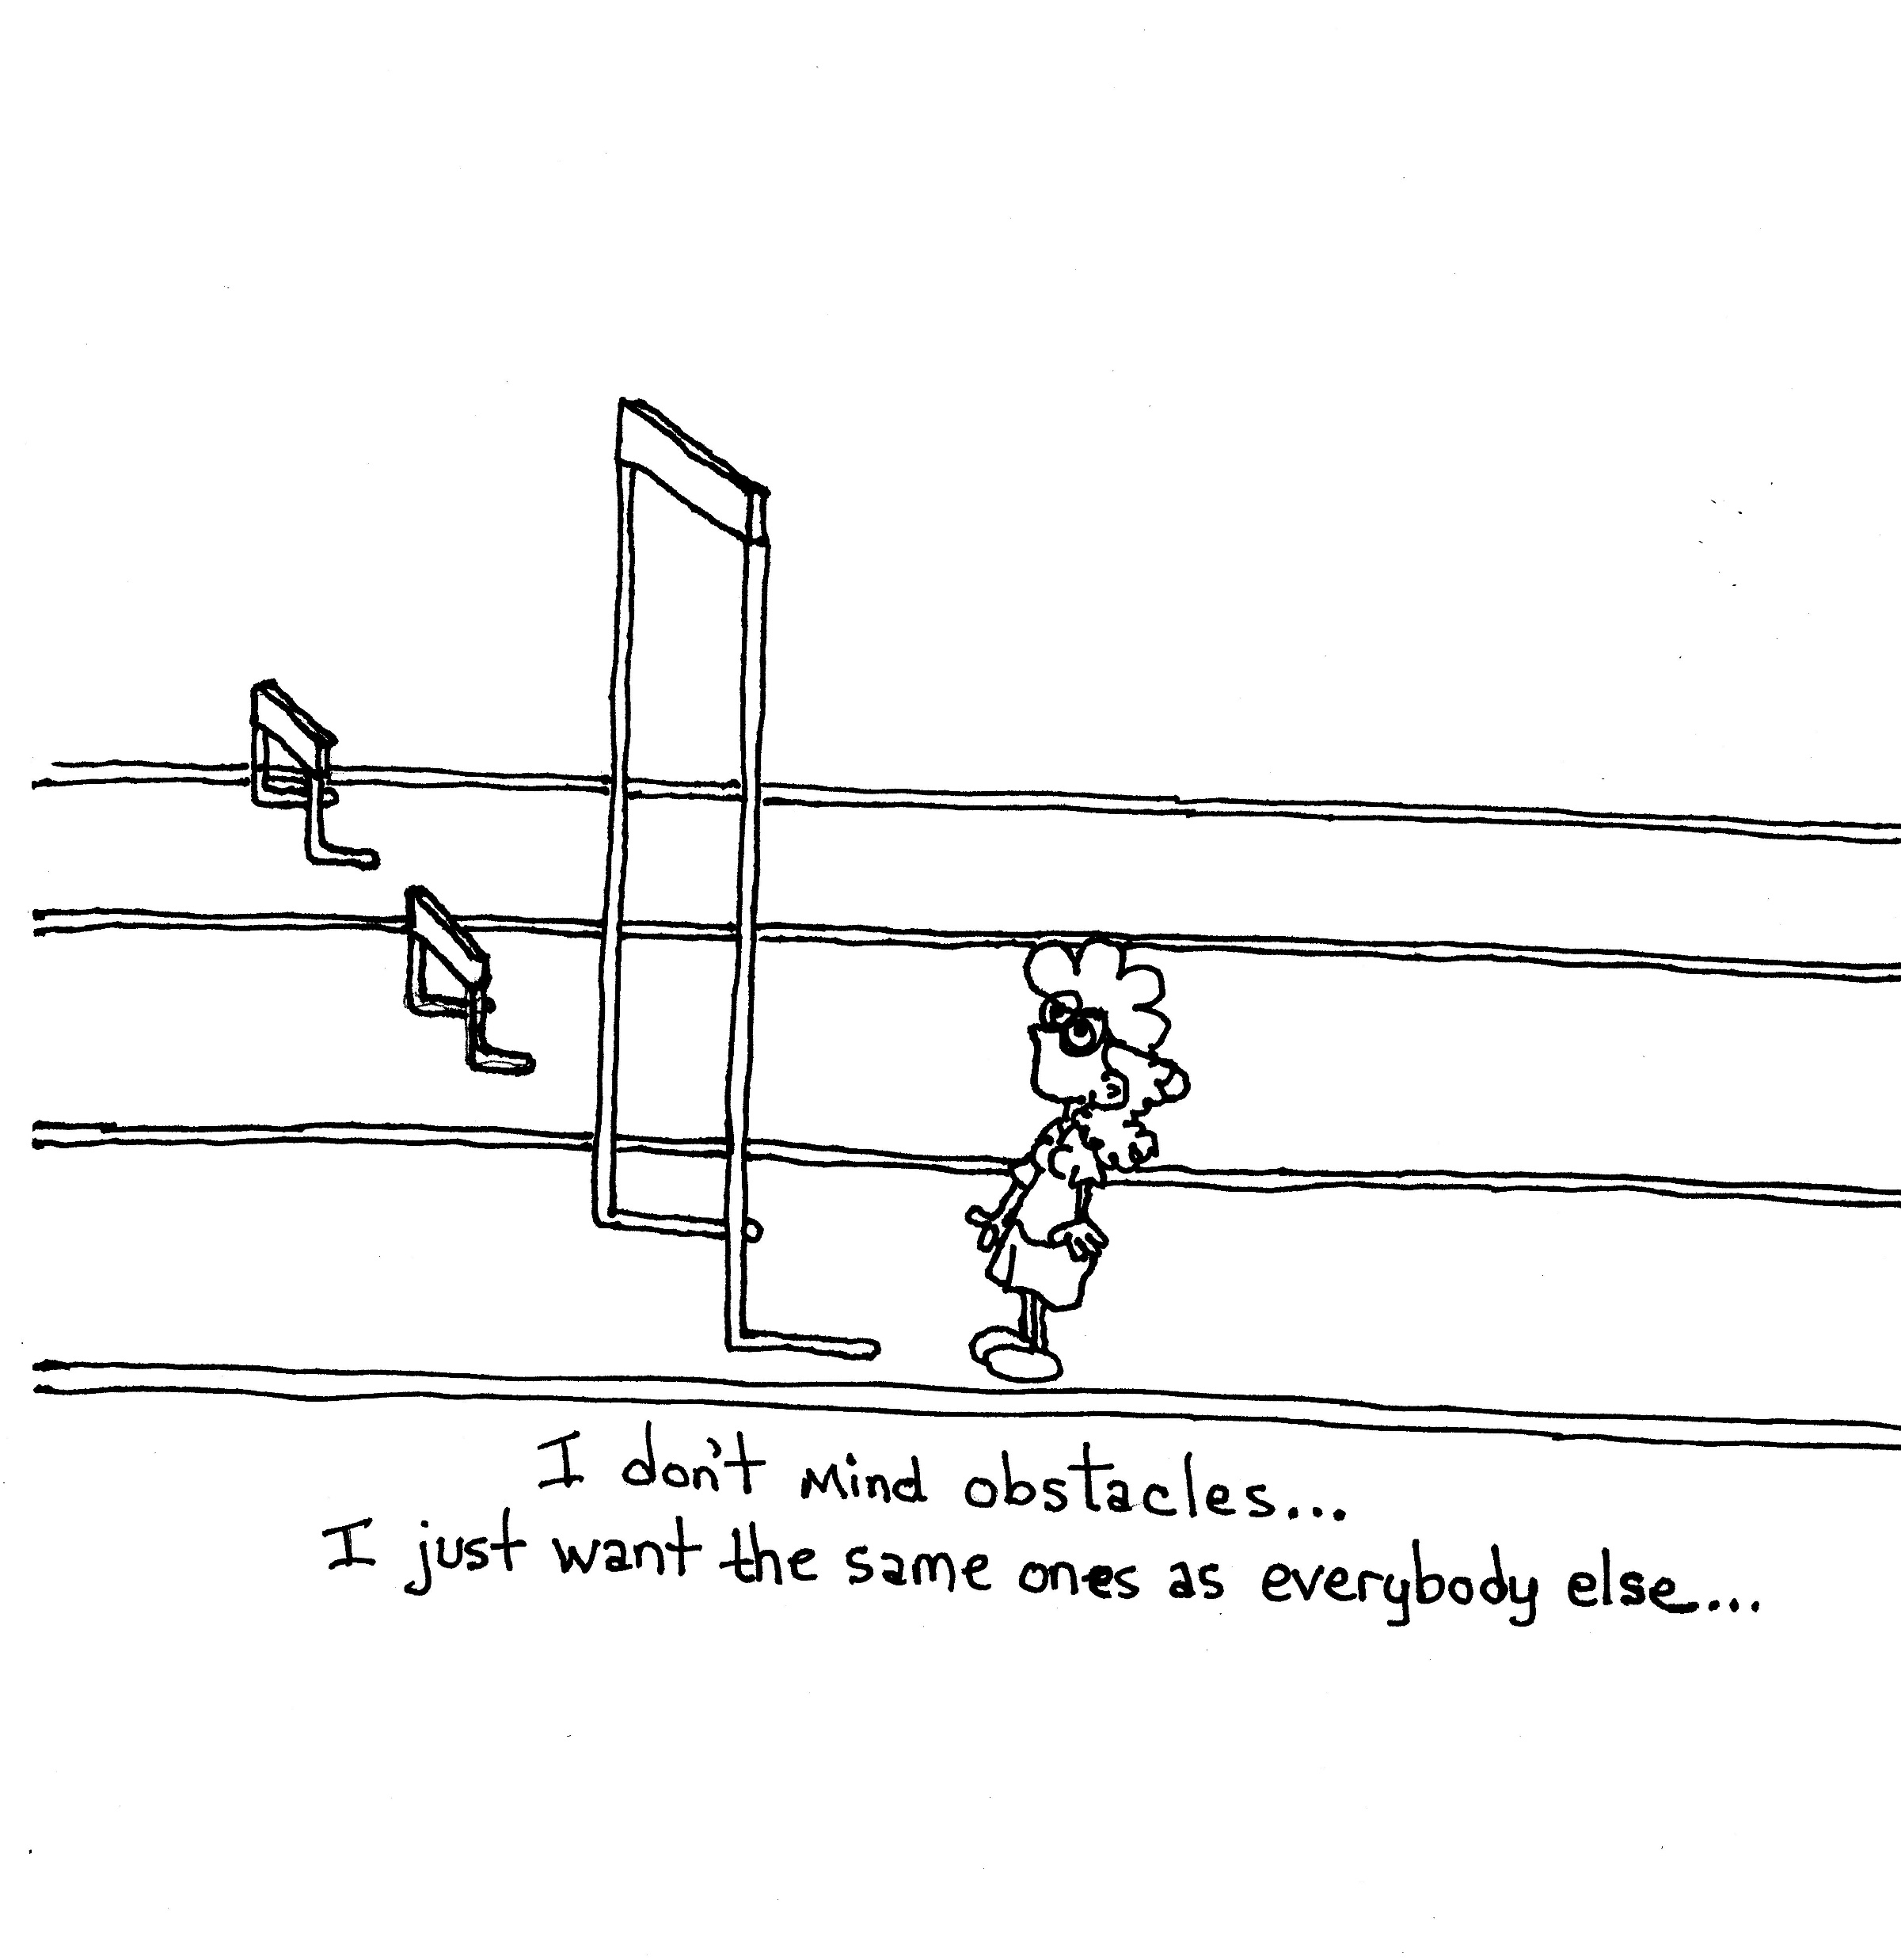
- break the goals down into shorter and more manageable pieces that build upon each other
- match the pace of more difficult lessons with greater amounts of review and reinforcement
- within the lessons build in components that facilitate choices and self-direction

Slide 39
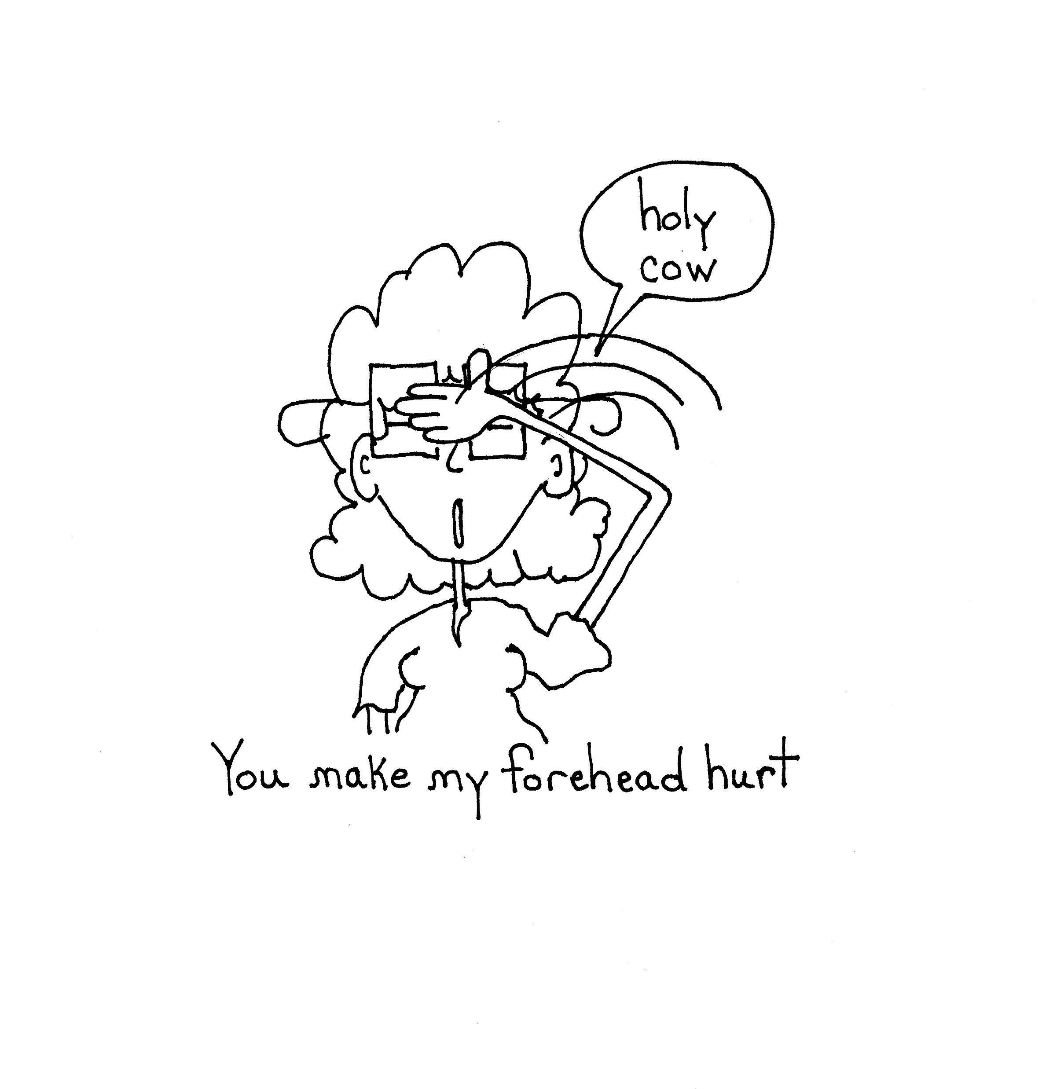
I will check with the teacher about progress, but I will
NEVER use a name with other students present (you will not either it can be a problem) (FERPA)

Slide 40
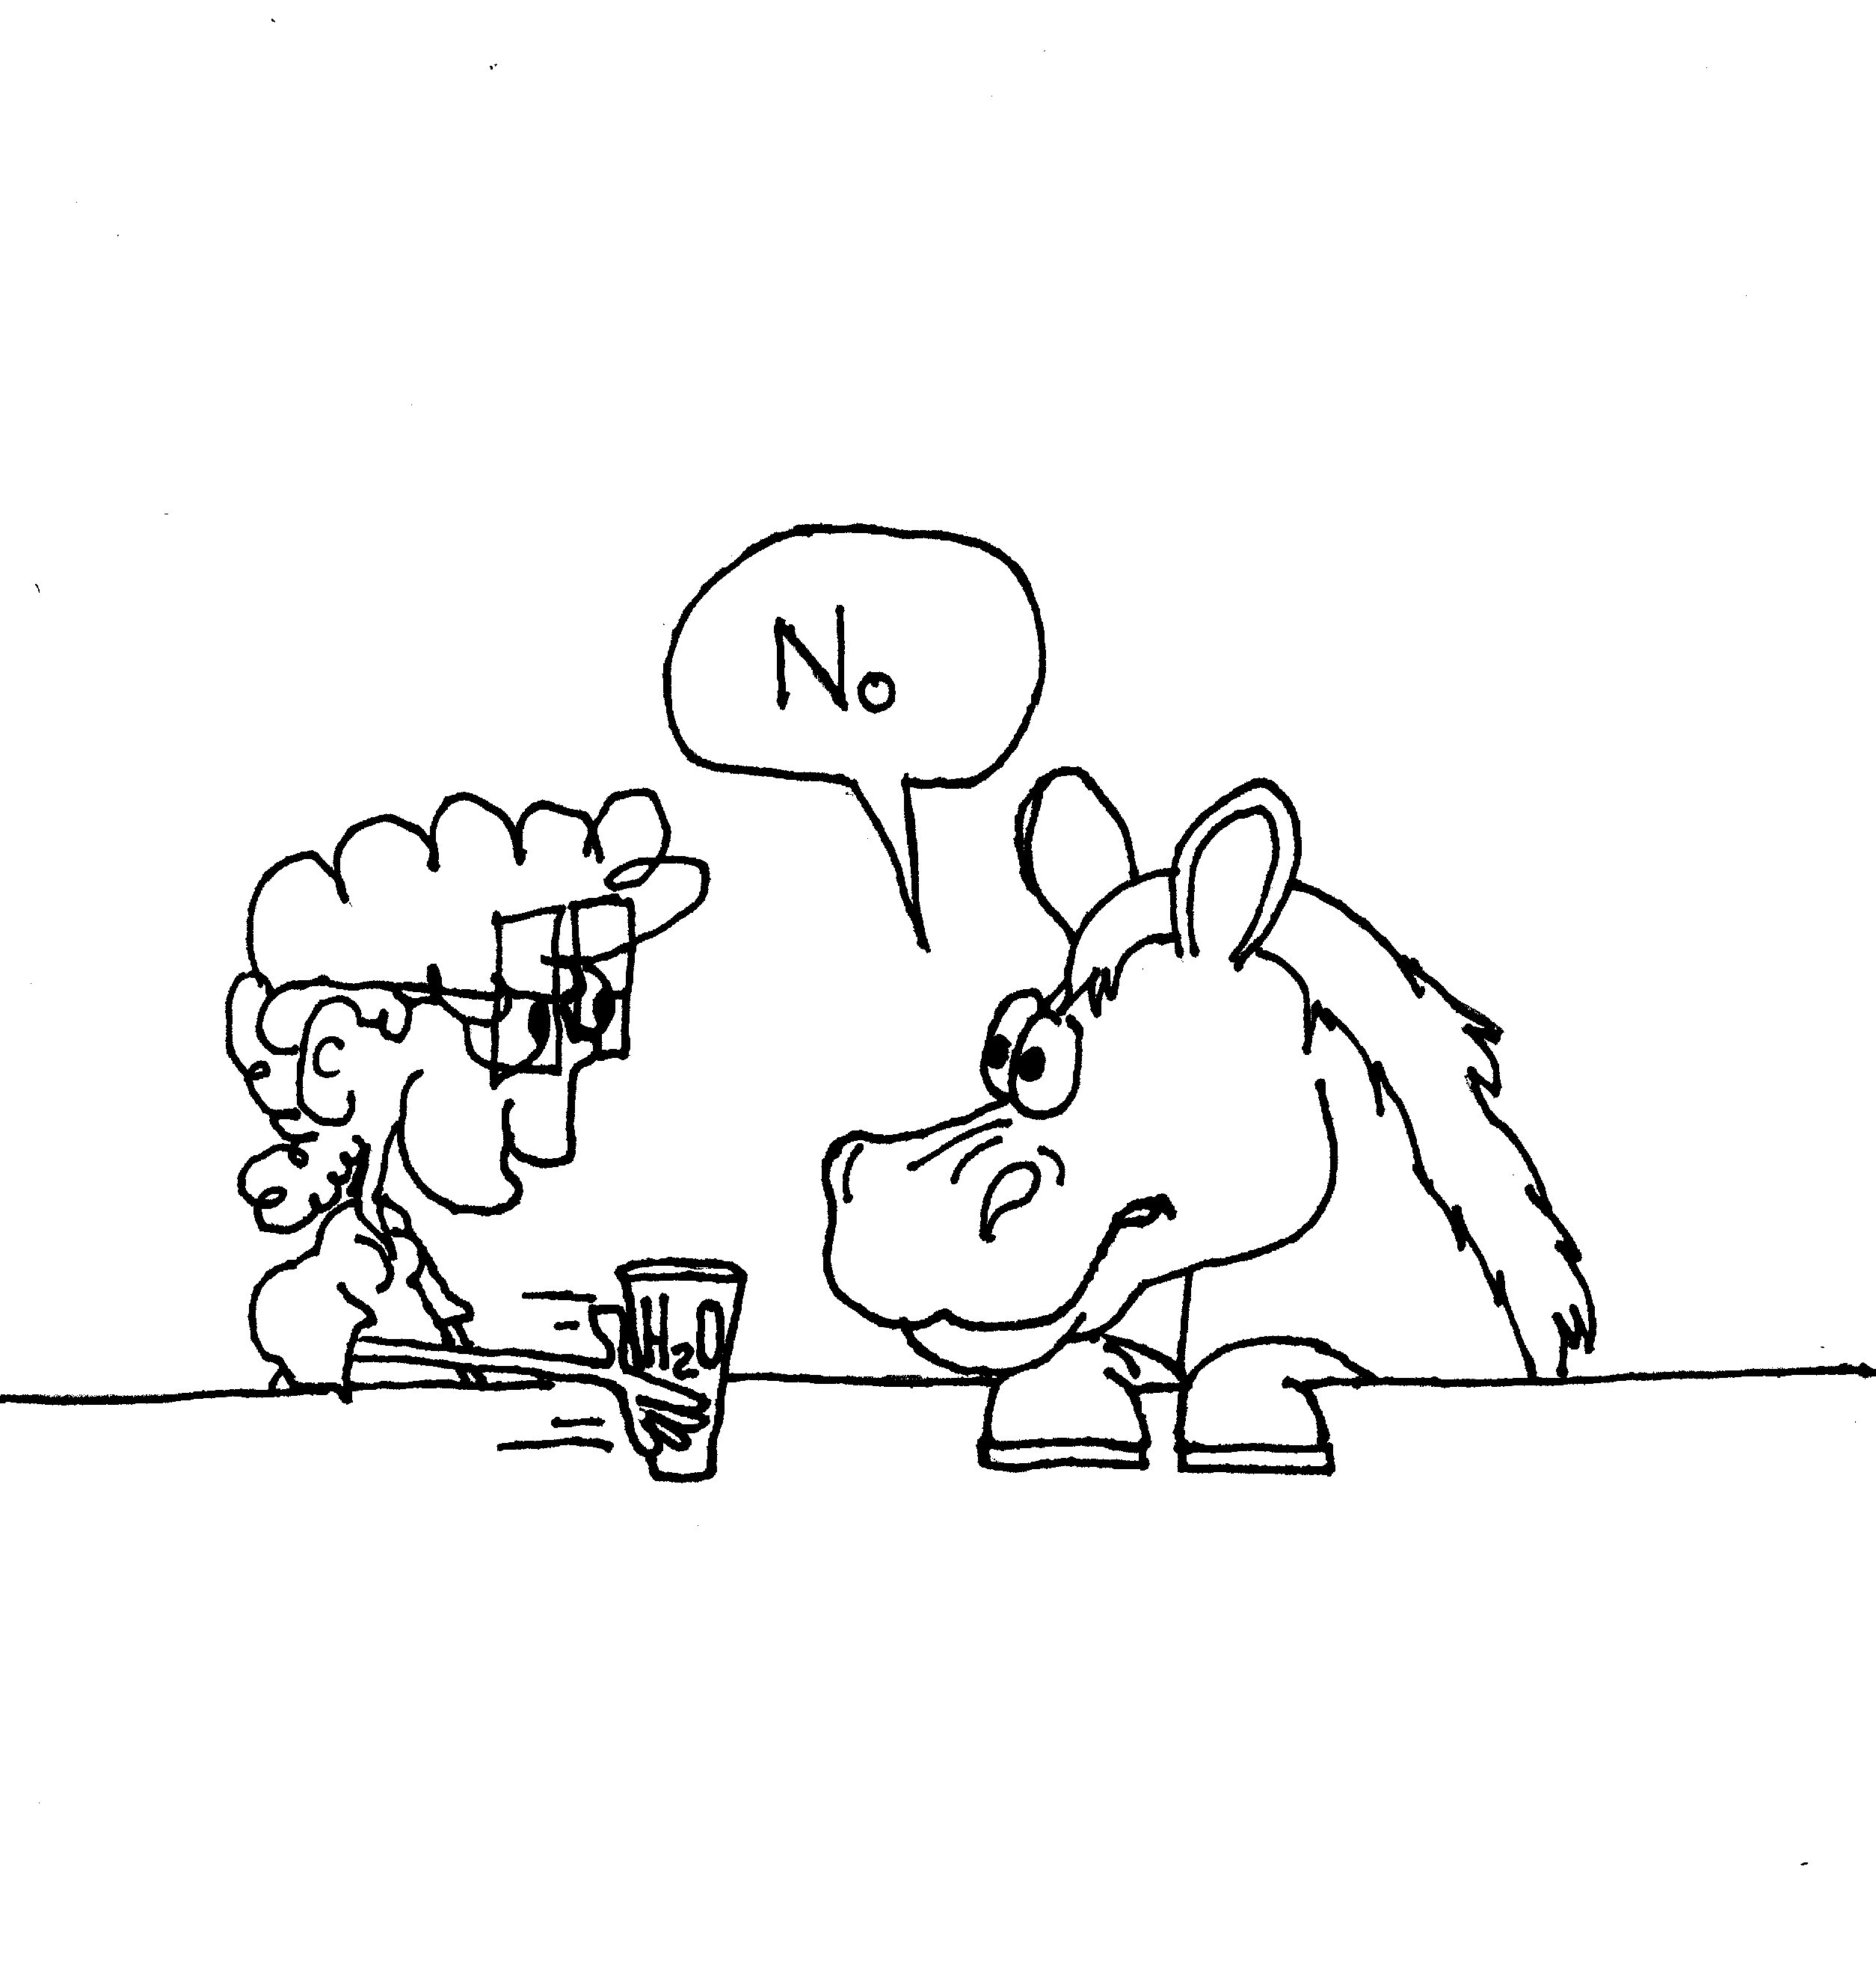
We need to not just give access to the water….
We need to convince them to drink

Slide 41
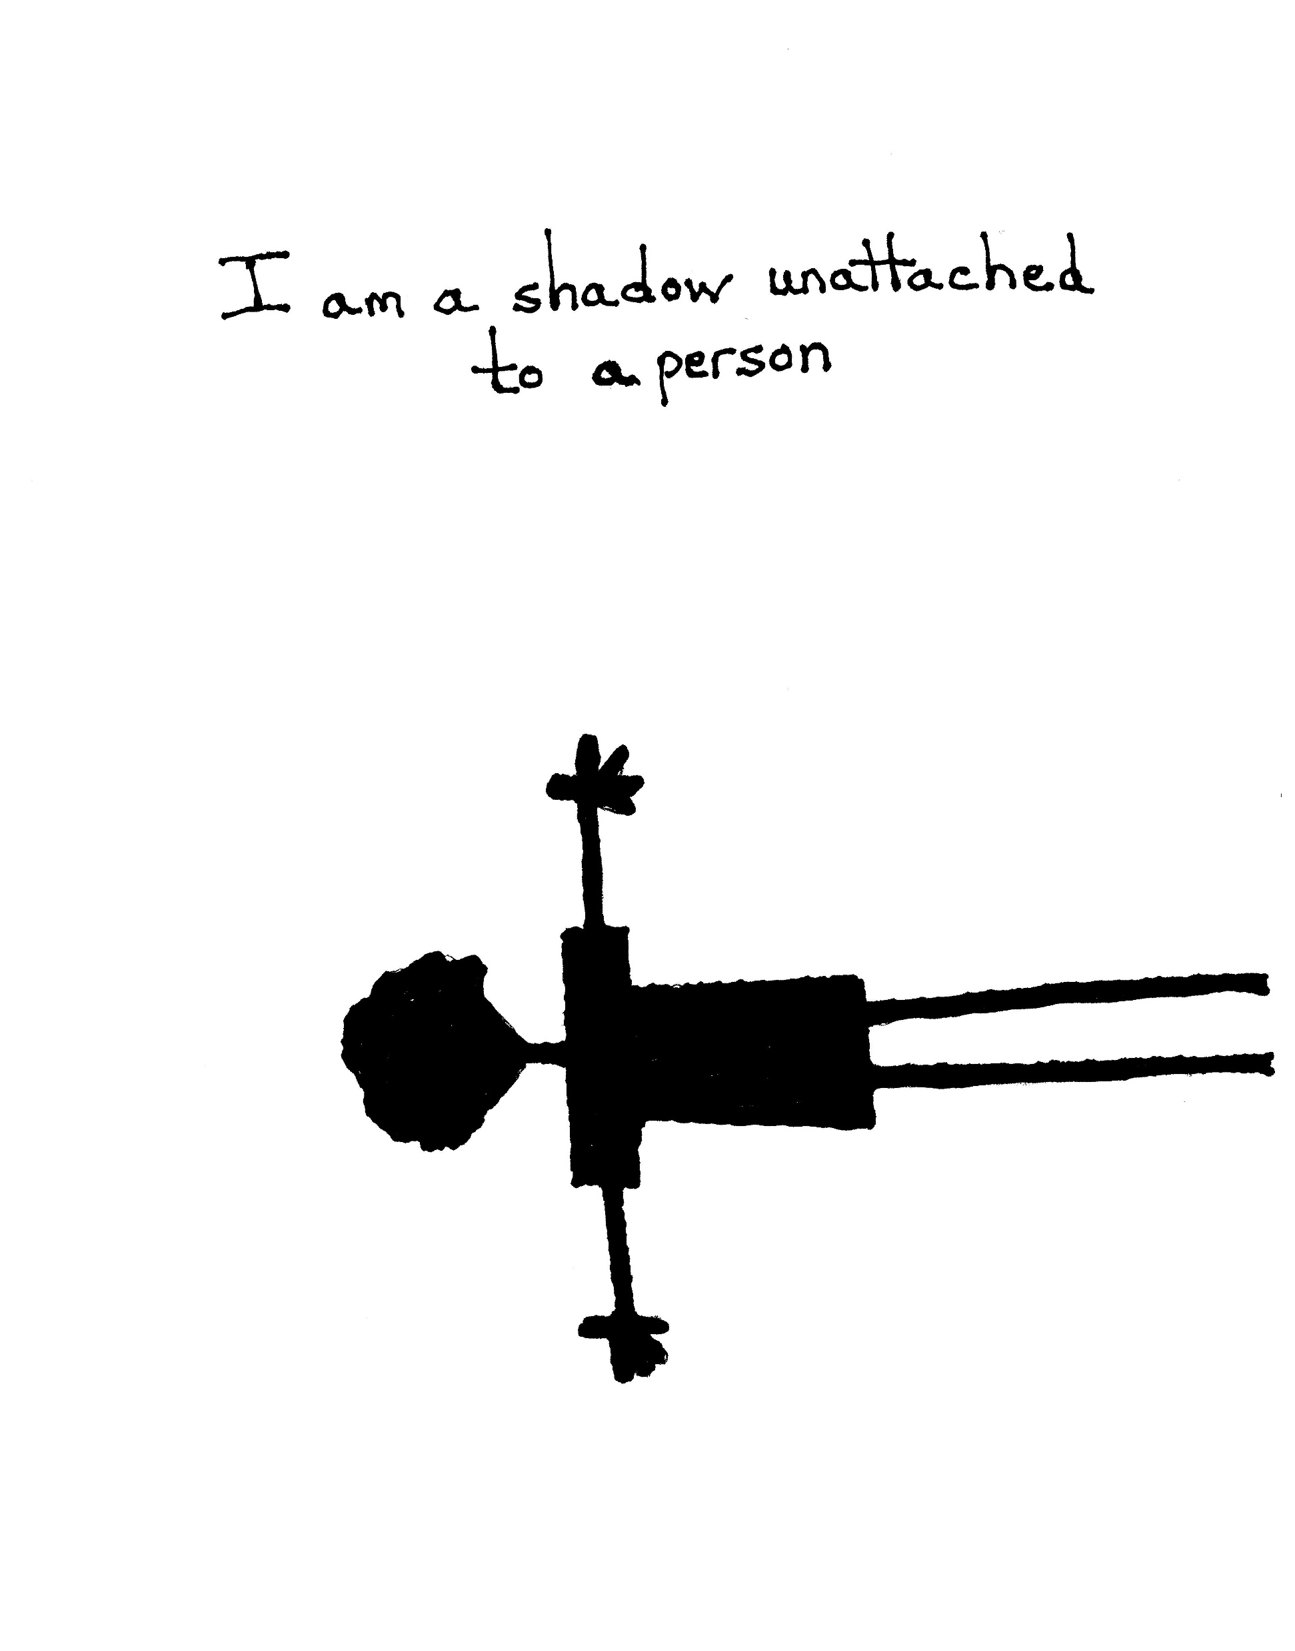
We need to see them
Include them
And advocate for them until they can for themselves

Slide 42
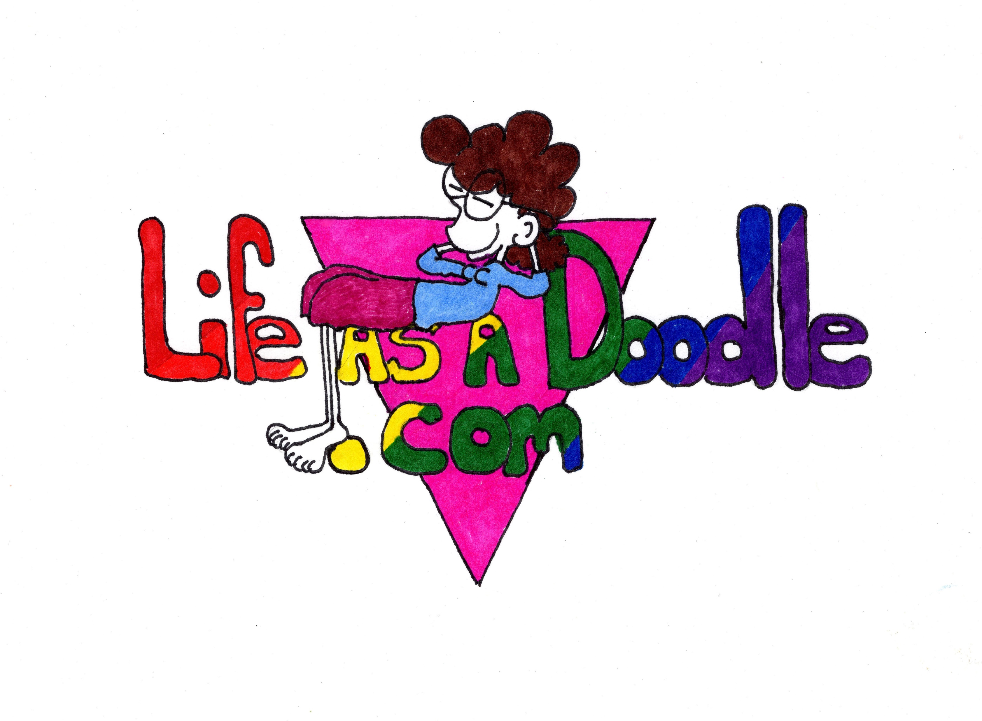
My Website:
My Books &
My Story
But if you know a trans student or any student in trouble that needs to know they are not alone email me at: nulfha@nv.ccsd.net
I will send them the Kindle version on me.

