Slide 1
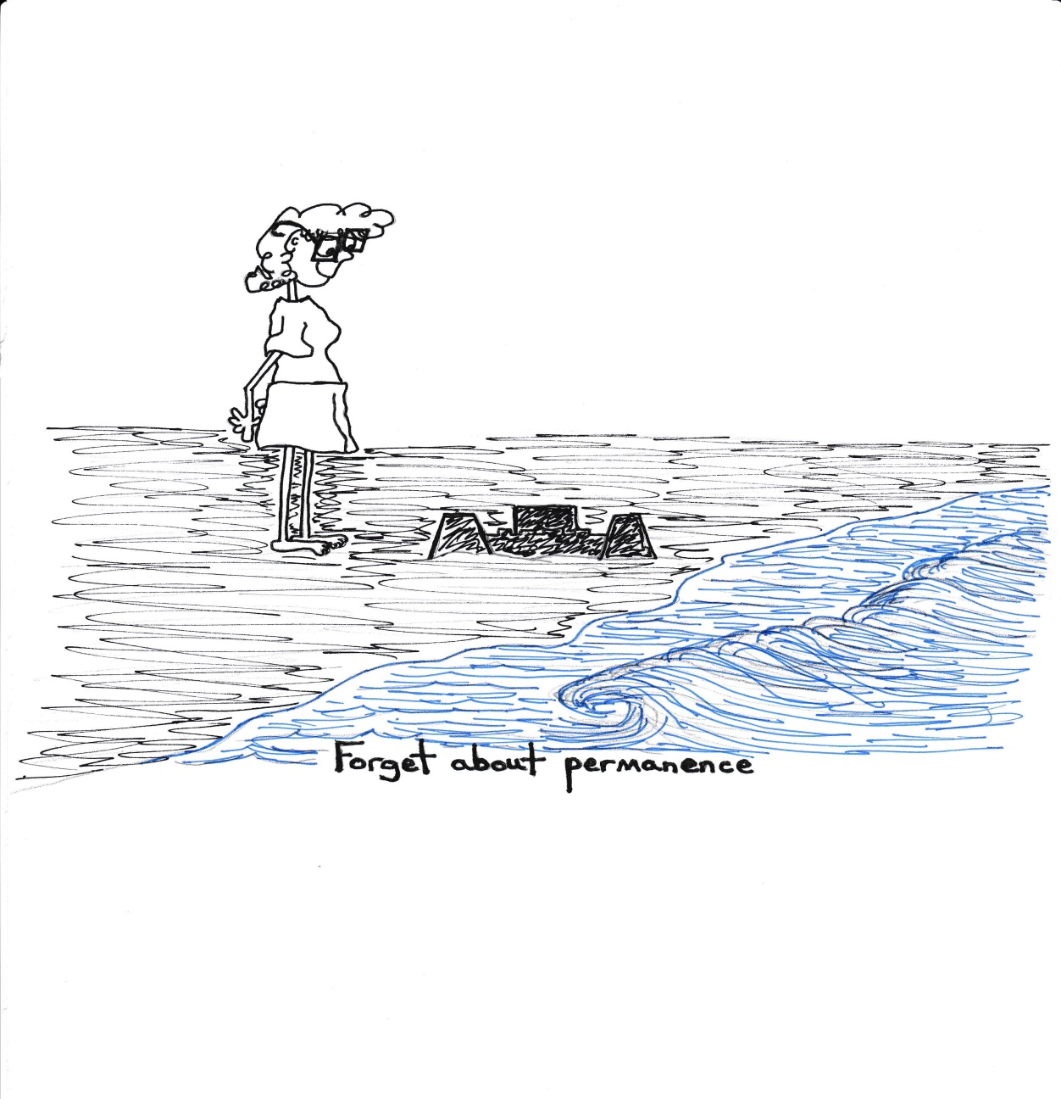
My Shoes:
A Time to Stop Running
My Name is Hope Abbigail Nulf and I teach Special Education for CCSD
This is a Day I have been dreading since I met my friends from the Dept. of Equity and Diversity
Problem with working with kids is they can illuminate your cowardice
- “Passing” as Gay
-Using “I have friends” instead of a direct role with kids

Slide 2
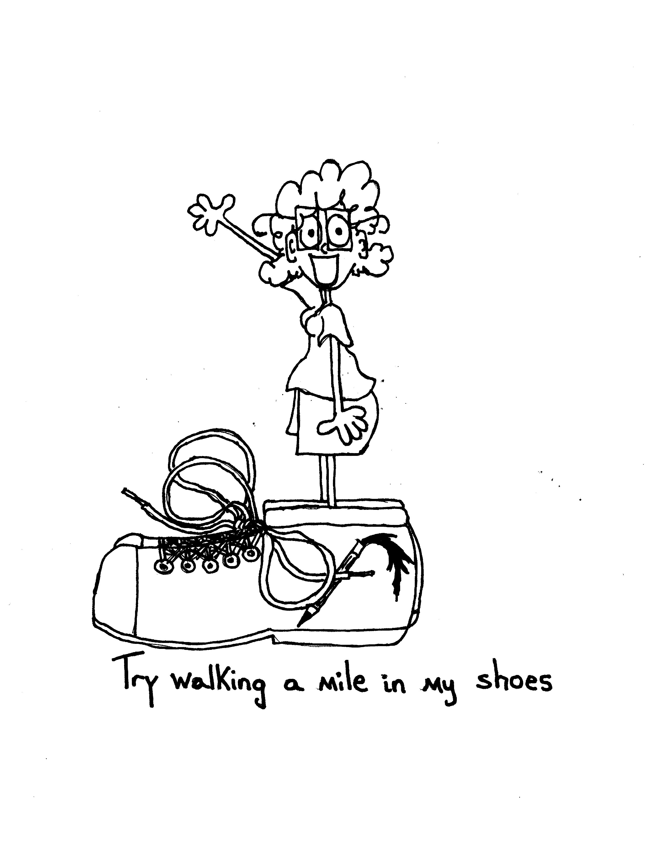
My Starting PLace
There are few things harder than high school but one them has to be being in high school and hating yourself
Not superficial things but the very nature of who you are
My experience as a transgender person can’t be generalized to all TG people. But my early experience was marked by profound unhappiness with myself and self loathing. I hated being me.
My parents sent me to 9 different types of therapists and there was no solution to my misery. My inability to forgive them would mark the next first 50 years of my life, but in looking back they did not have the information parents have now.
The problem of course was that no one was talking about transgender people in 1966.

Slide 4
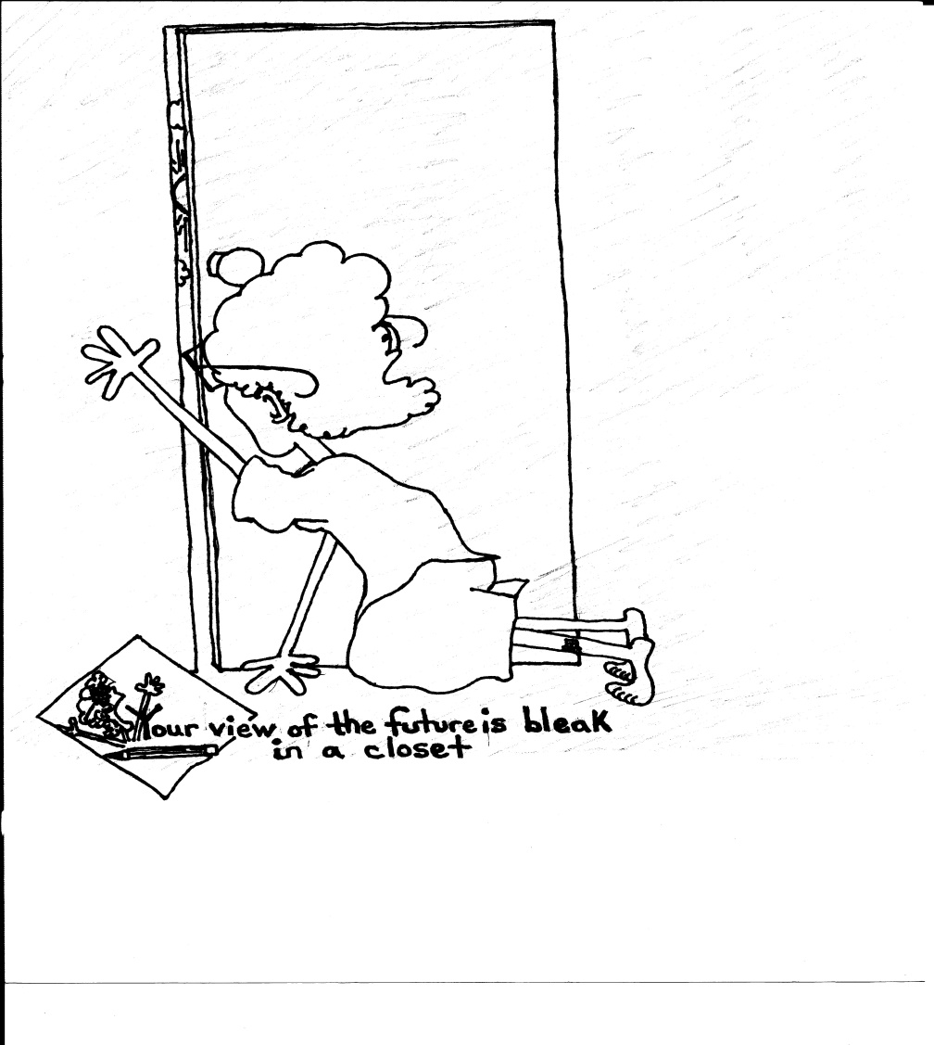
In a hospital bed I met my first friend
I owe my life to a night nurse in 1977
Pad + Pen = 1st Friend
Doodle Me and I have been together since 1977 and until 2000 she was a boy
I am here only because I stumbled upon a creative way to find a place I could live in. Not all kids are going to be that lucky.

Slide 5
There is no way to quantify the anger
Everything before 2000 is a bad dream
Misery without understanding
Constant state of hatred of myself and everyone determined to love me
Unworthy
In a Prison
No Mirrors
Freak (“Faggot?”)

Slide 6
Why not me?
Happy people are hard to watch
Having no one say you are like anyone in your family is confusing
Disappointing everyone becomes a skill

Slide 7
College
The only thing worse than not being happy is being surrounded by happy people
Misery + My Gene Pool = Alcohol
Lived in a Bottle
The DWI Incident
A Coward Looking for a Way Out

Slide 8
Using hiding places.
Sports and the public persona
(The General)
In the Absence of Freedom and Safety young people will follow gender stereotypes and norms even at the expense of their happiness

Slide 9
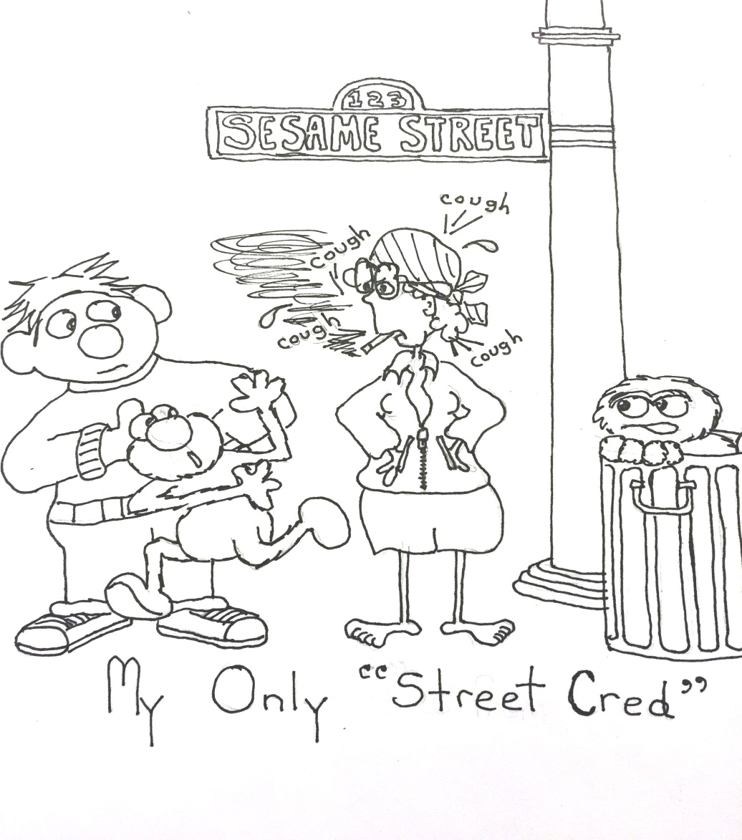
Doodle was my therapist before I knew I needed one

Slide 10
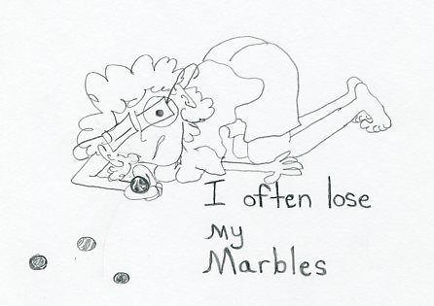
Self deprecating but still humor

Slide 11
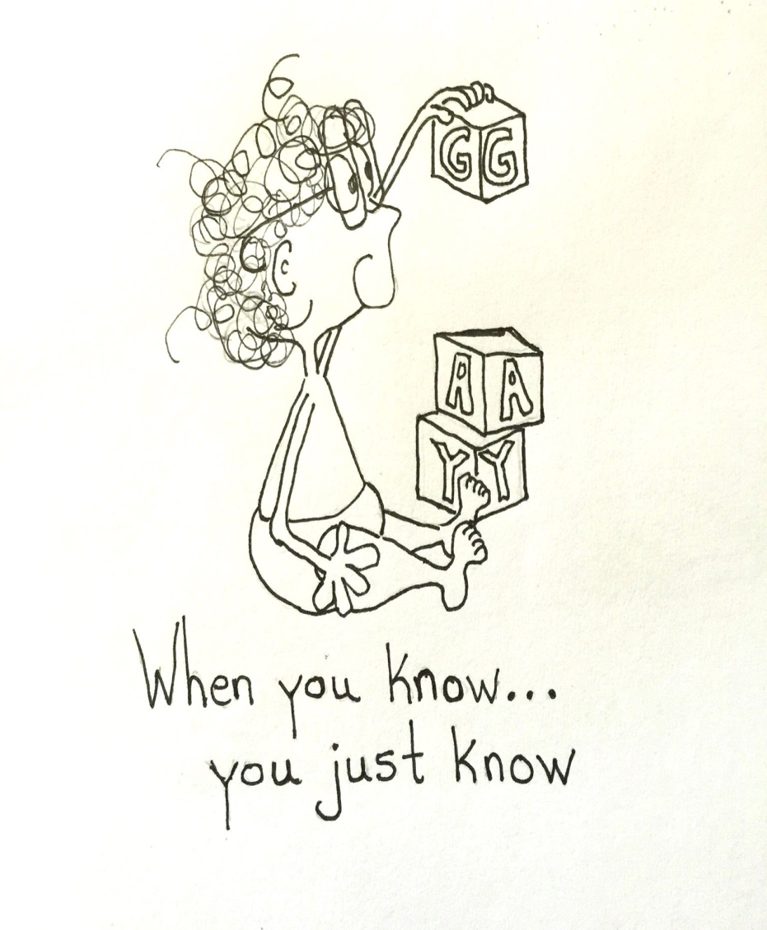
I didn’t know and there weren’t any people yet that should have
I wouldn’t know this until the age of 40

Slide 12
In the Middle
My Therapist’s Measure
“Are you willing to be alone the rest of your life to do this? Because we can assume you will be.”

Slide 13
Losses are long-term
I’ve Lost my Youth in Memories Changed or Suppressed
Hatred of Self
Hatred of Family
Blame
Guilt
Memories that are in any way Positive are Impossible for me to Find

Slide 14
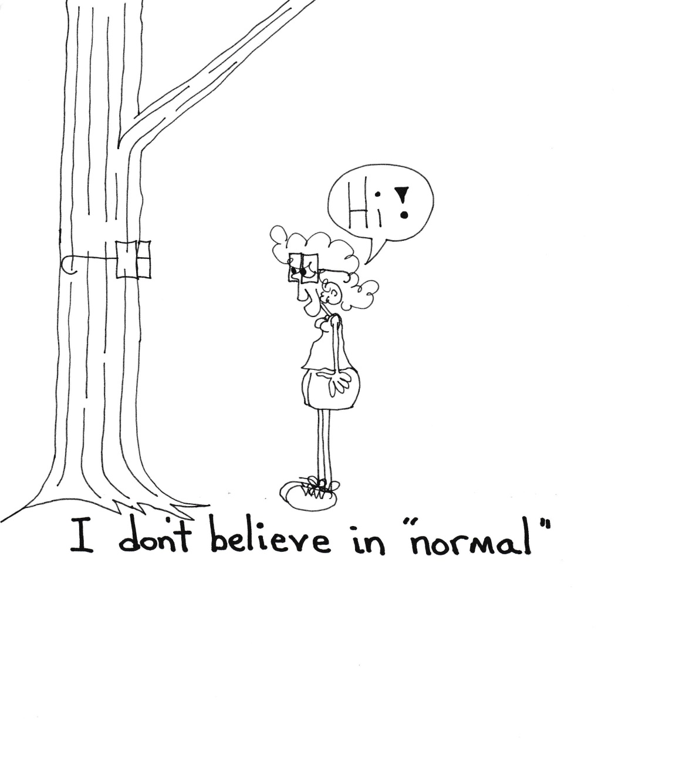
Pretending I didn’t want to be “normal” wasn’t the same as being happy
Who Are You Fooling?

Slide 15
Difficult thing to explain
“Why in the world would you do that?”
Why Surrender Advantages
-voice
-status
-pay
But Stop Saying it’s a Trend
-therapy
-surgery
-public humiliation
-adjustments to not offend “regular people”
-Unending pronoun war

Slide 16
Learning to be you
No one talks about this in relation to TG people but have you considered what you “know”
about being you? What you know and have come to understand about your gender?
While grappling with the questions of who you are, the steps of transition, and the hostility of others…...think about learning “social norms,” behavior, and nuances of your true gender.

Slide 17
Differences most of you do not get to see
How I am seen
How I am heard
Changes In;
-How I Teach
-How Assertive I Am
-My Expectations
-Awareness of Where I Am

Slide 19
How can I be invisible
Tales of the Mall
The DMV
The Little Girl
My Life Becomes About Not Making You Uncomfortable (bathrooms not just about kids)

Slide 20
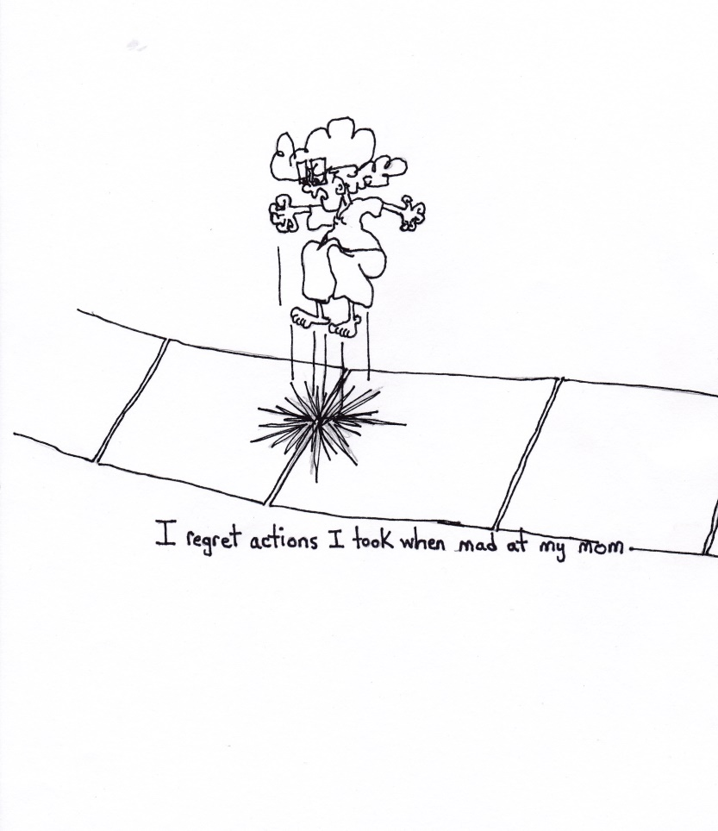
BLAME AND FEAR
MY TRAVELING COMPANIONS FOR YEARS

Slide 21
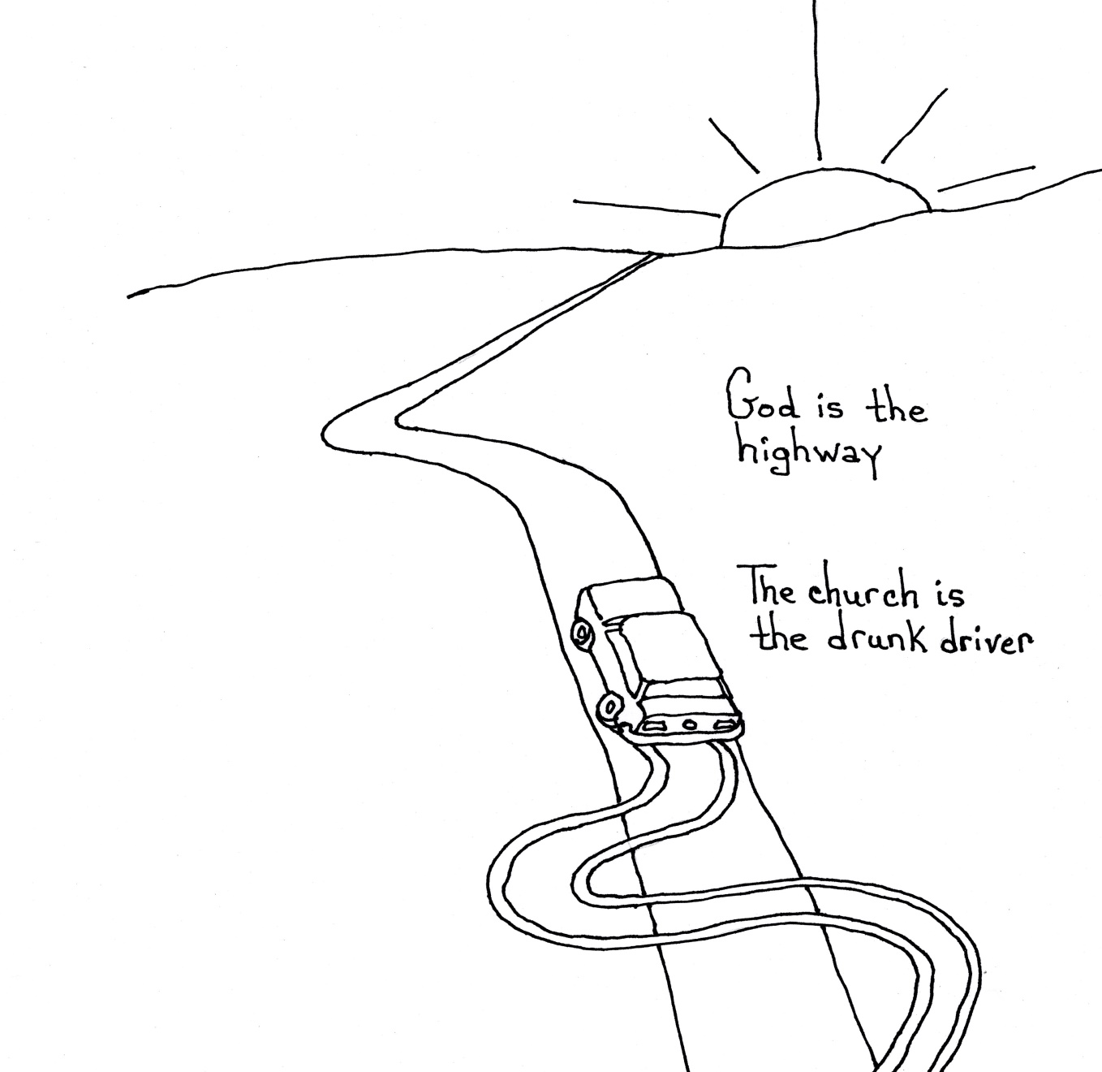
Therapy with a pencil
Emphasizing the Good Work Quiets the Voices……
Maybe it isn’t me that is crazy?
Maybe the world is wrong….

Slide 22
CCSD
People Have No Idea Who Is Listening Although they think they do

Slide 23
The pull of activism the shame in being afraid
Rationalizing Inactivity
The Job
The Students
The Safety of the Less Shocking
My Voice is Insignificant

Slide 24
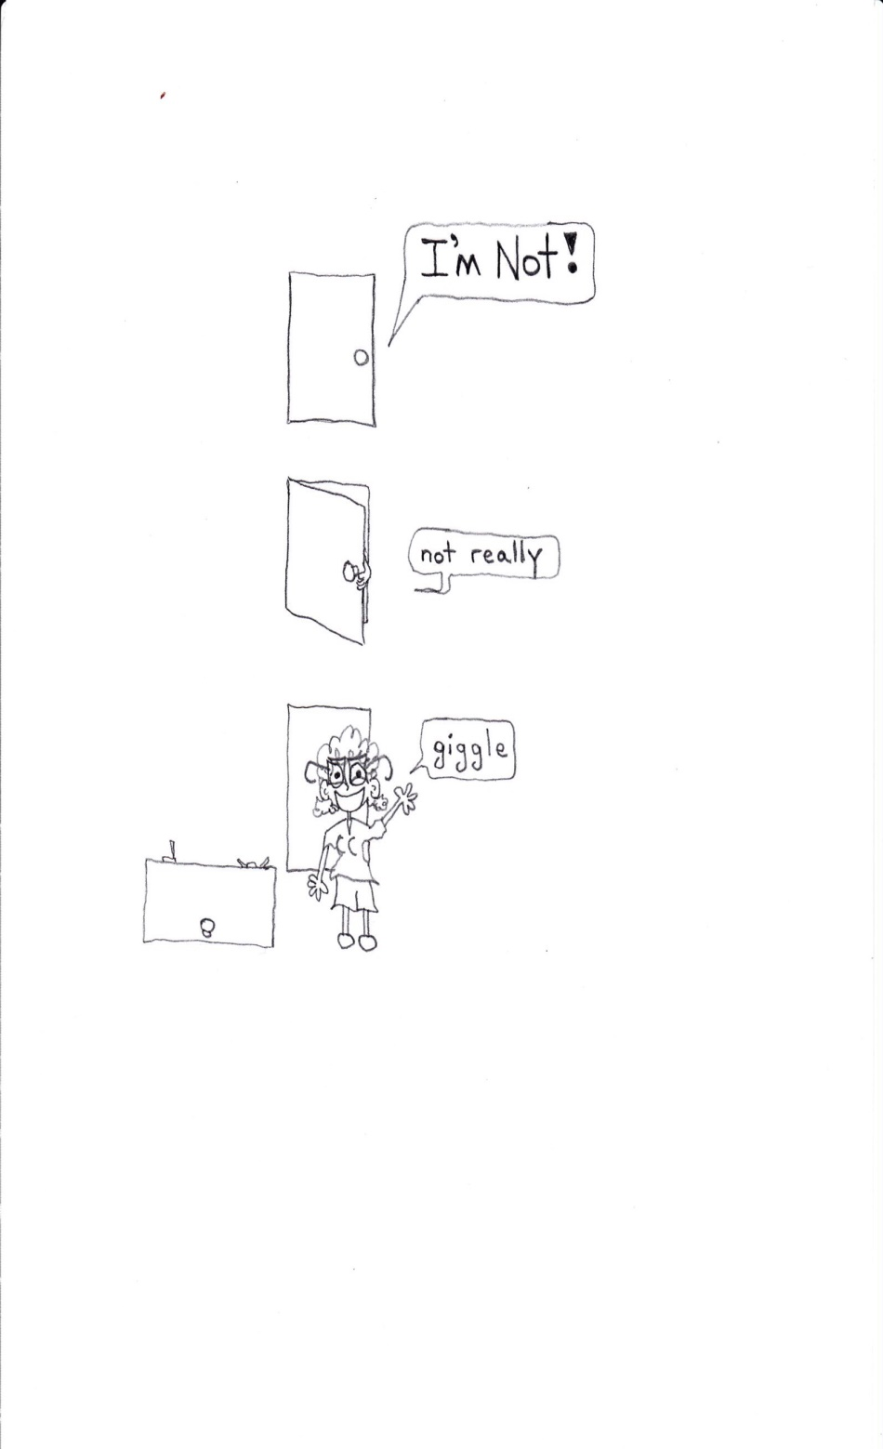
Half In
Half Out

Slide 25
A muffled message

Slide 26
Trying to make Sense of more than self
Nice not to be an island
Even if it hurts
But How Can I stay Only Half In?
Others Have Given So Much
What is My Obligation to My Community AND Myself

Slide 27
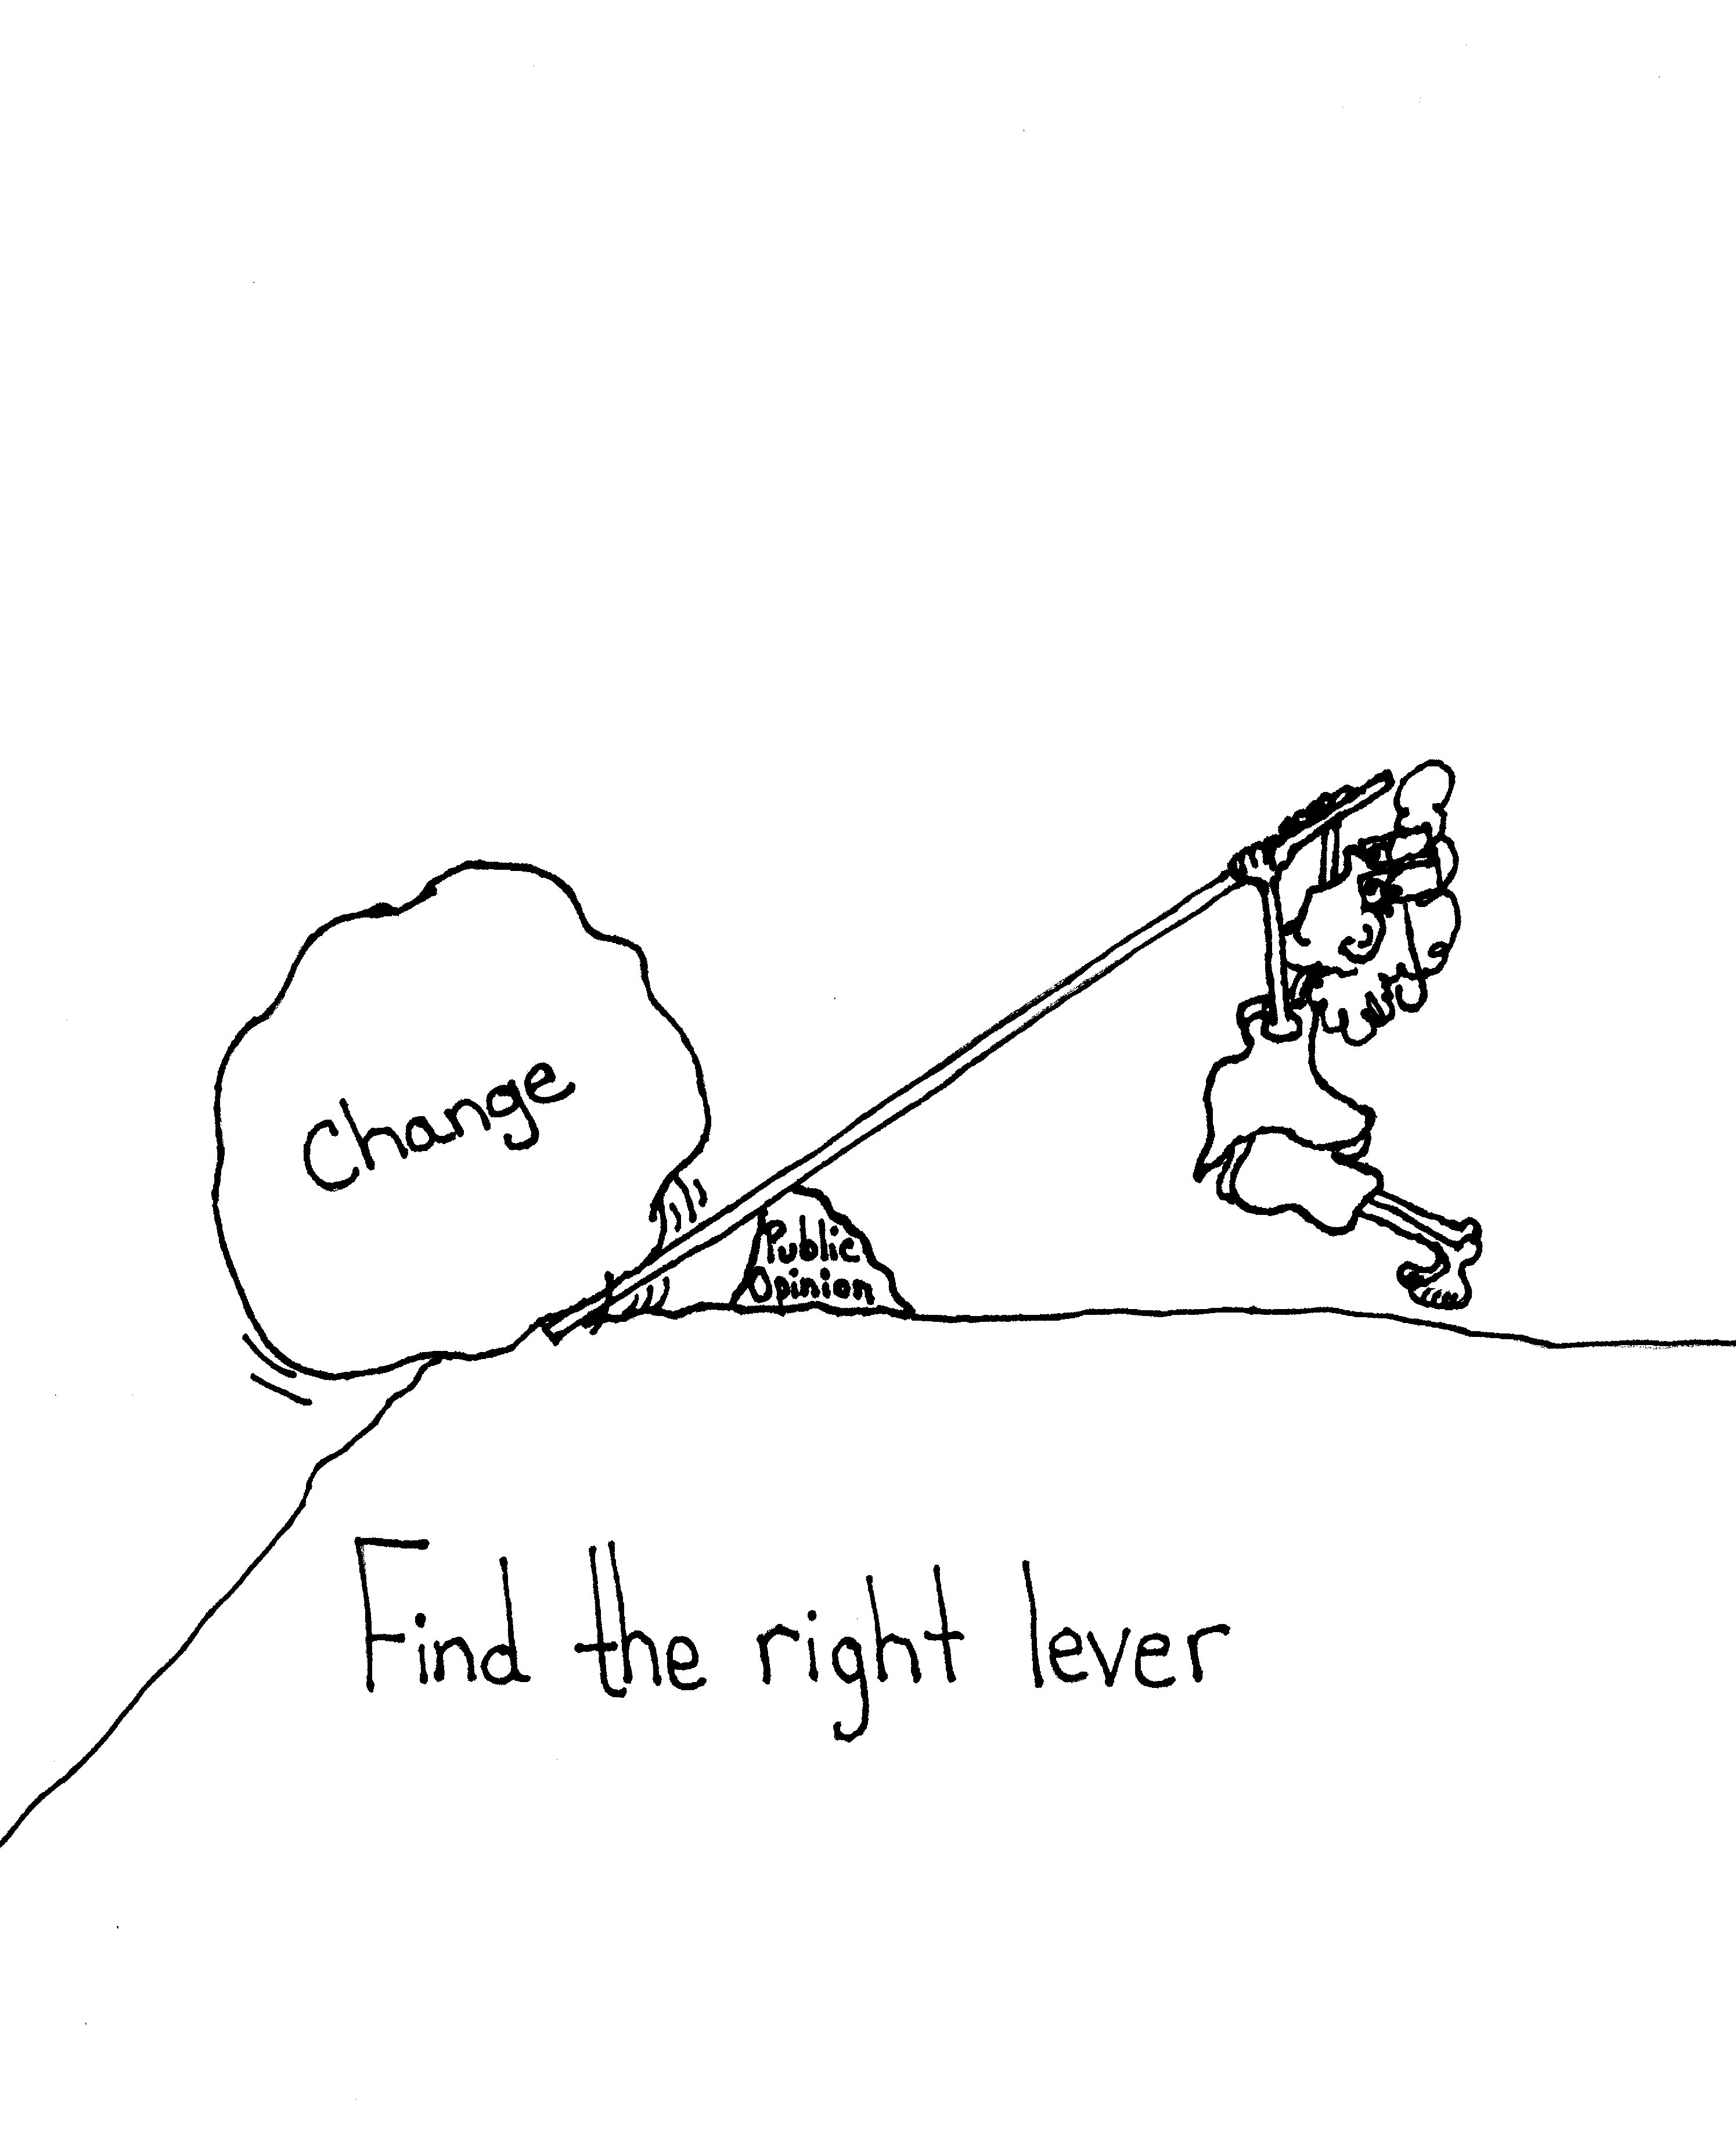
Pride vs fear

Slide 28
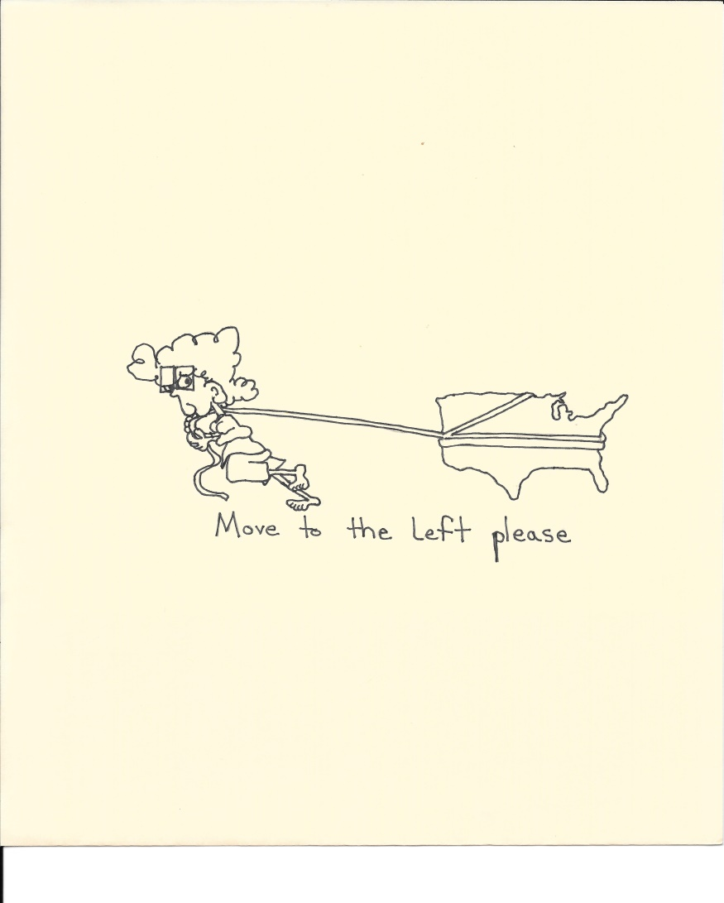
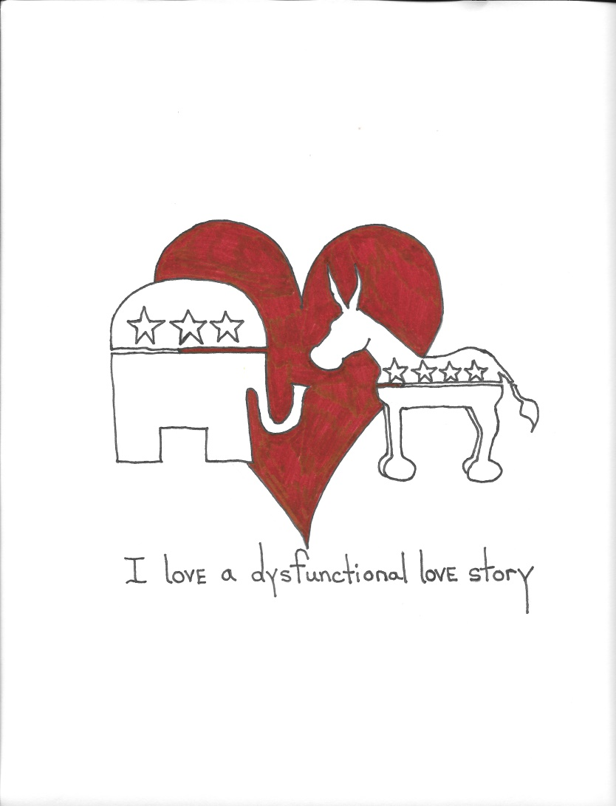
Opinions without risk & without investment

Slide 29
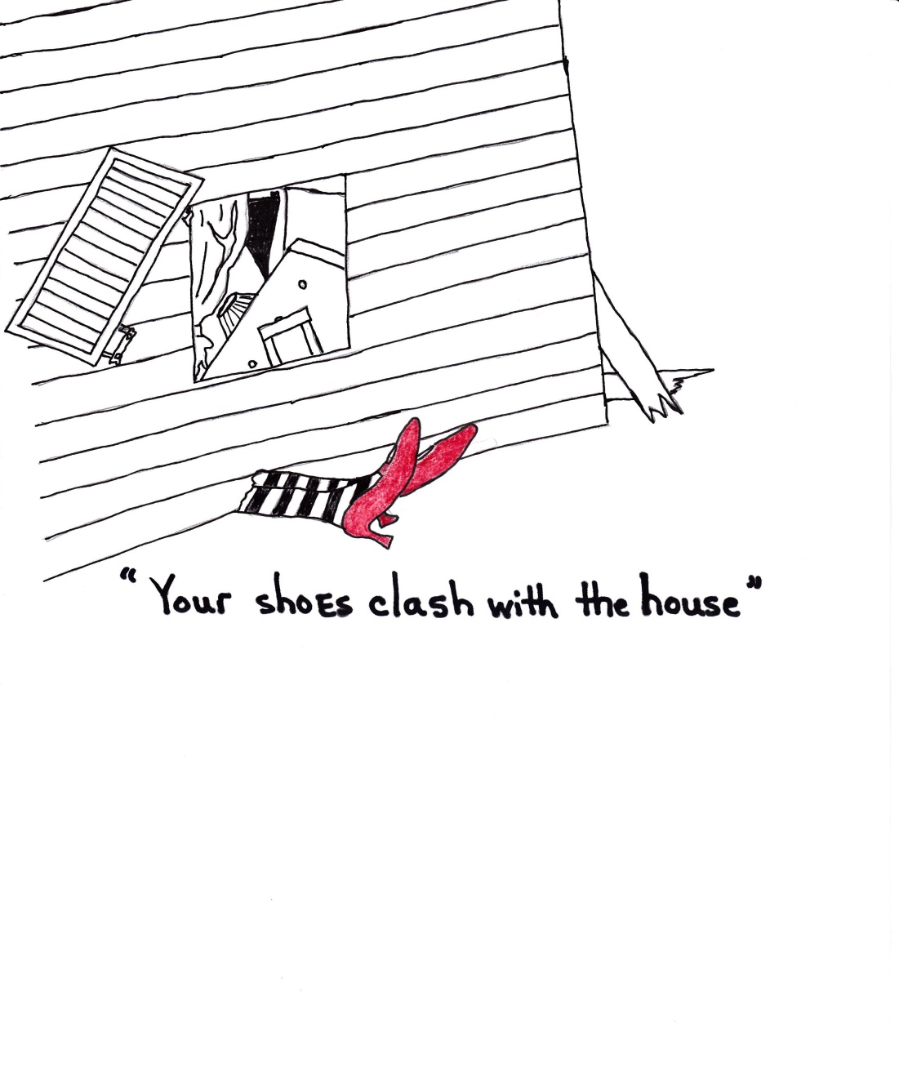
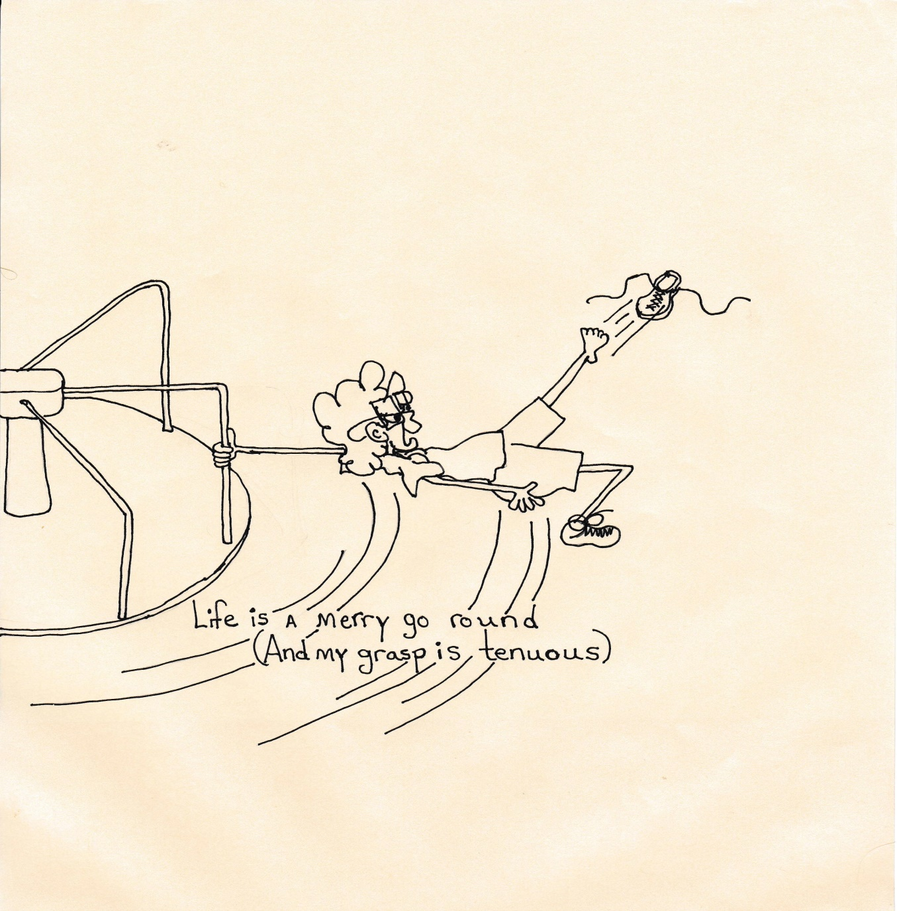
On going distraction
Be able to see the big picture

Slide 30
It is the little things
Every laugh
Every Whisper

Slide 31
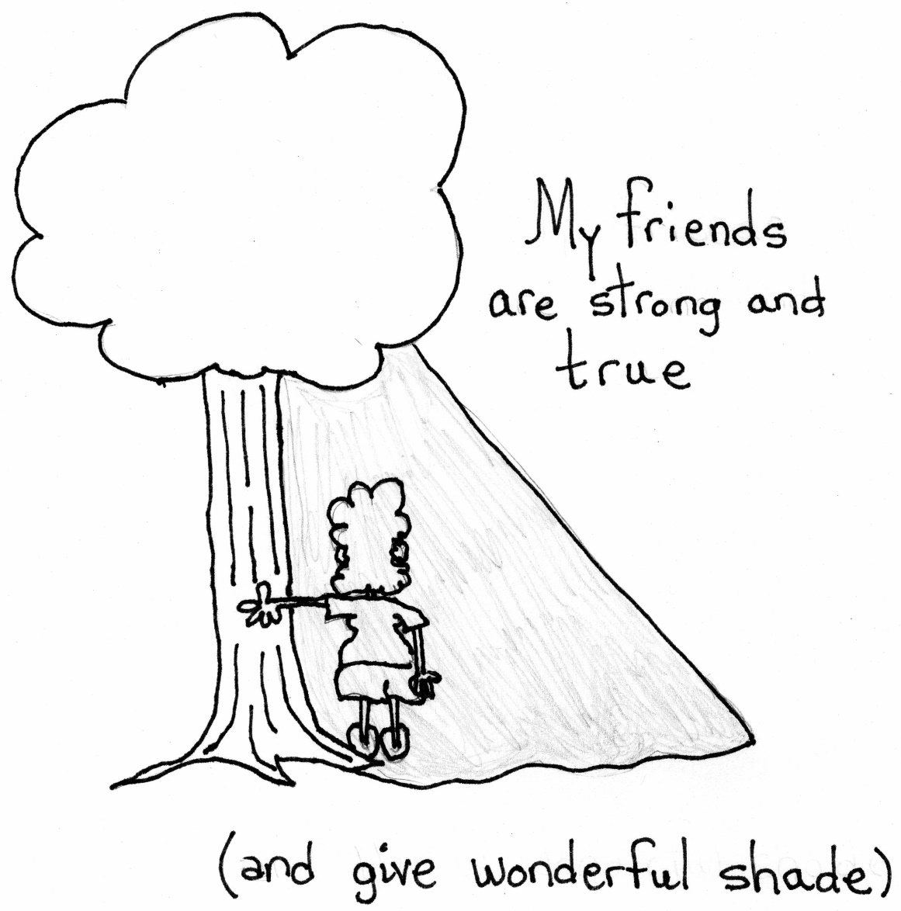
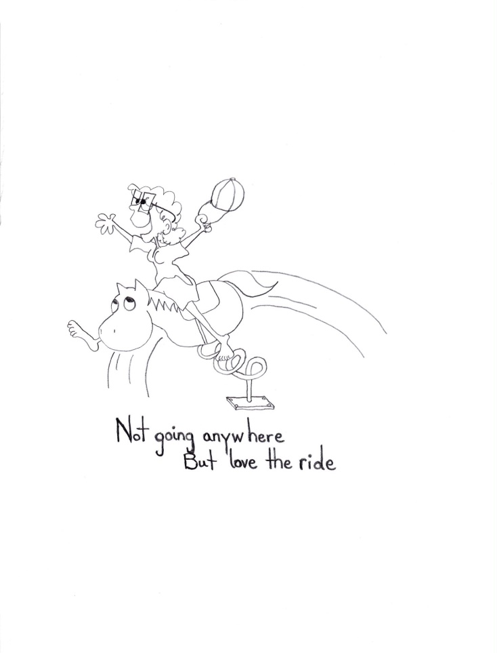
Moments good and bad

Slide 32
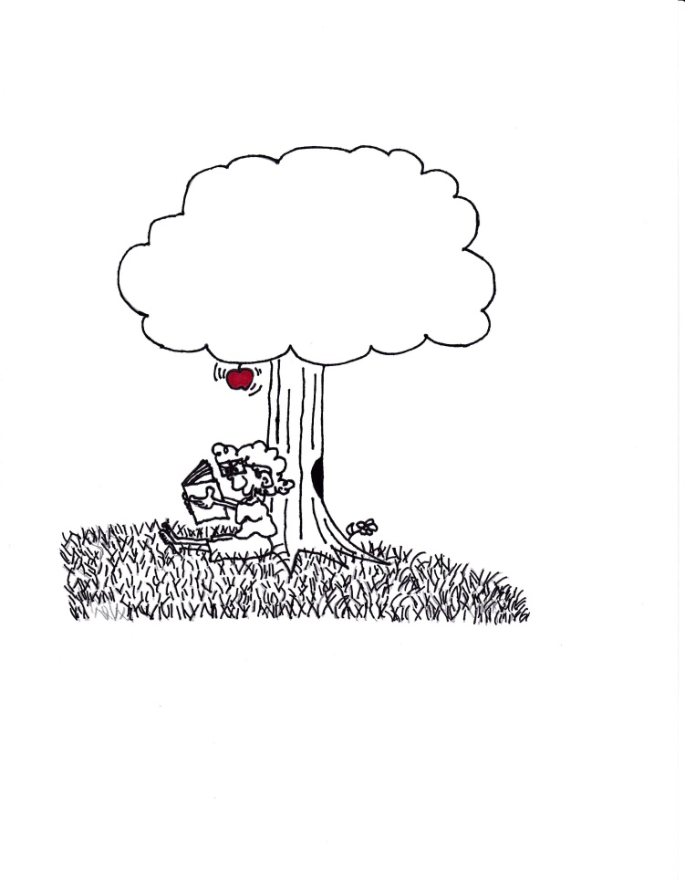
True happiness rests in honesty…..I forgot that

Slide 33
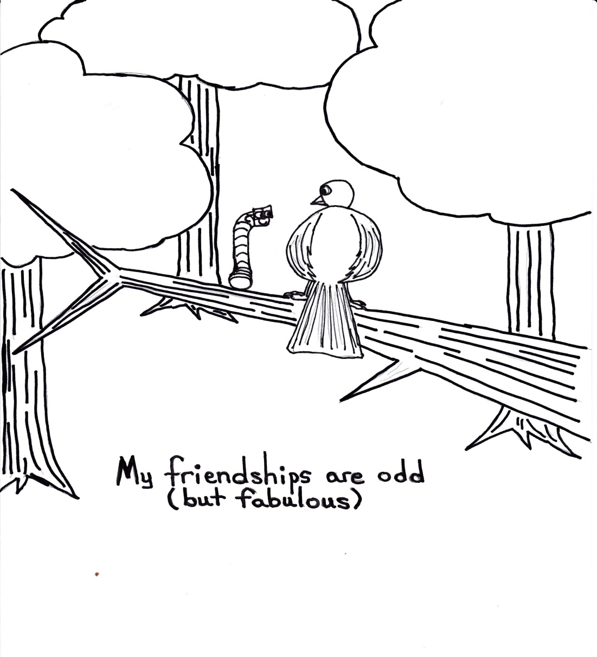
The value of things came in time

Slide 34
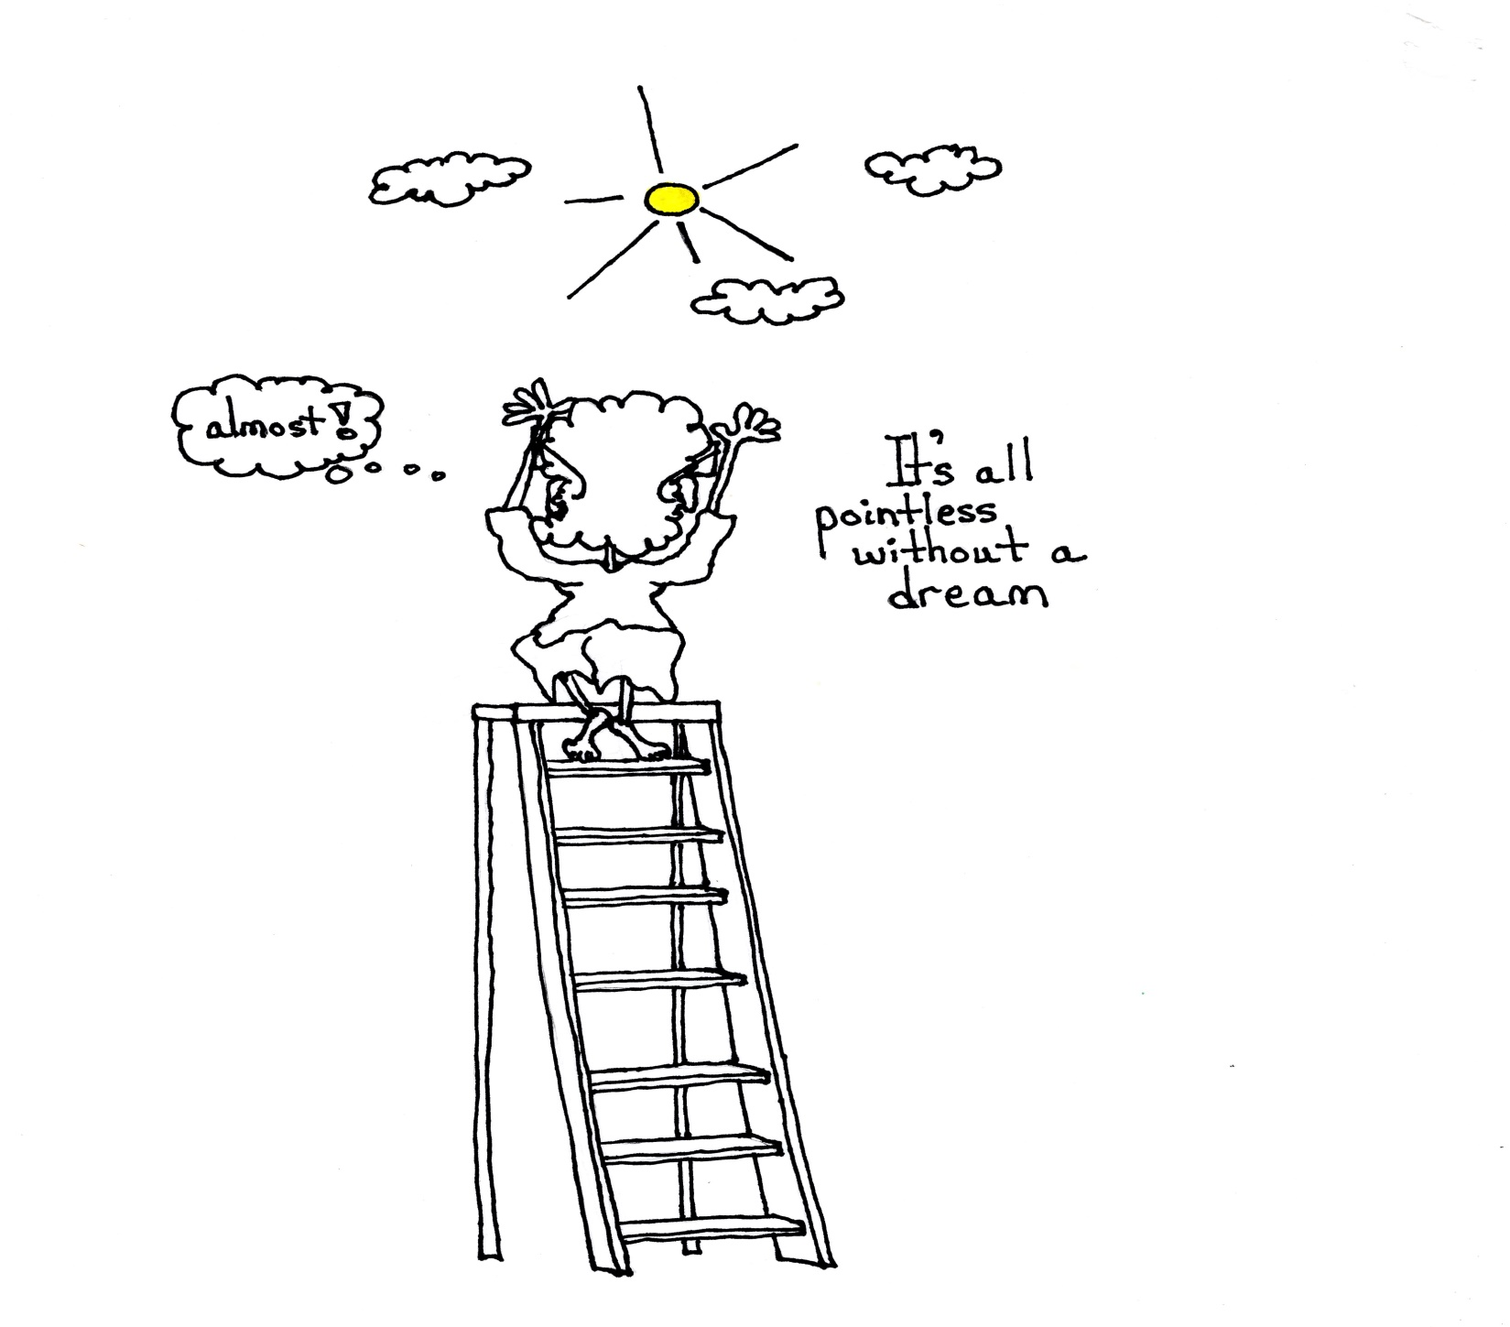
In the end my friends were my ladder
-Went to the store with me
-Supported my art
-Waited in the car for me as I did my first interview as a woman
-Fought fights for me when I left a room

Slide 35
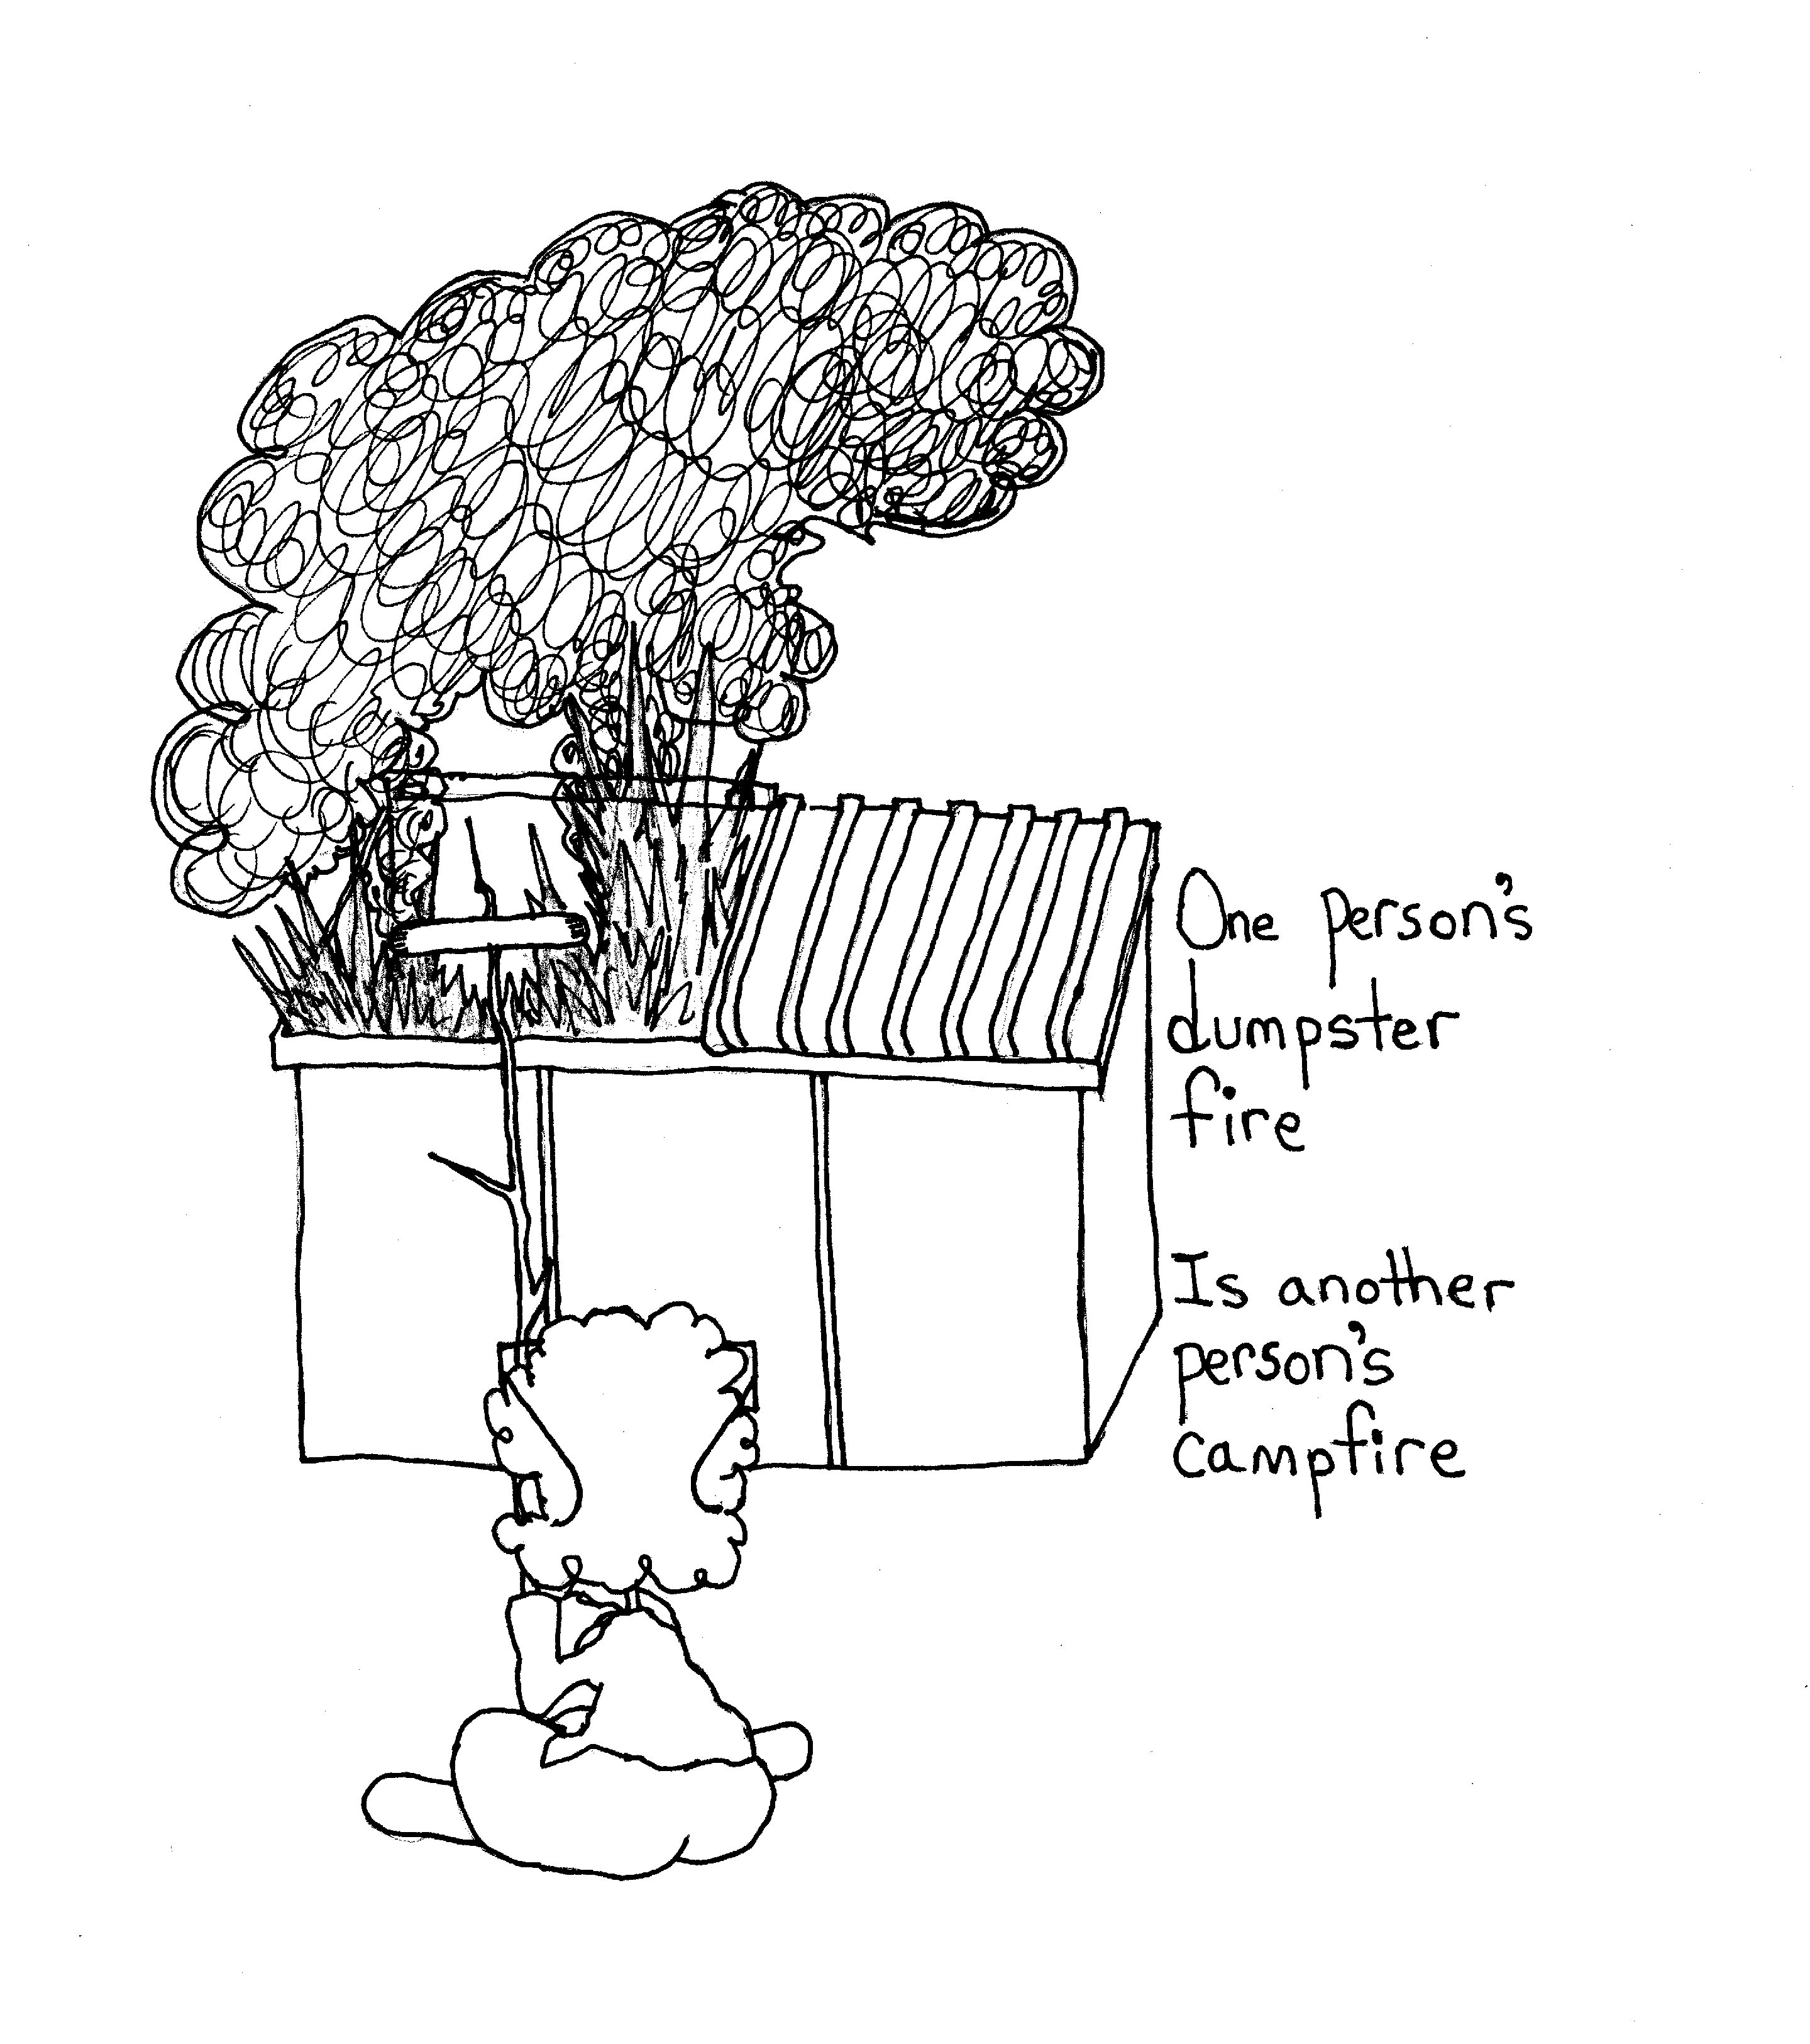
Our students
(I am the cautionary tale)

Slide 36
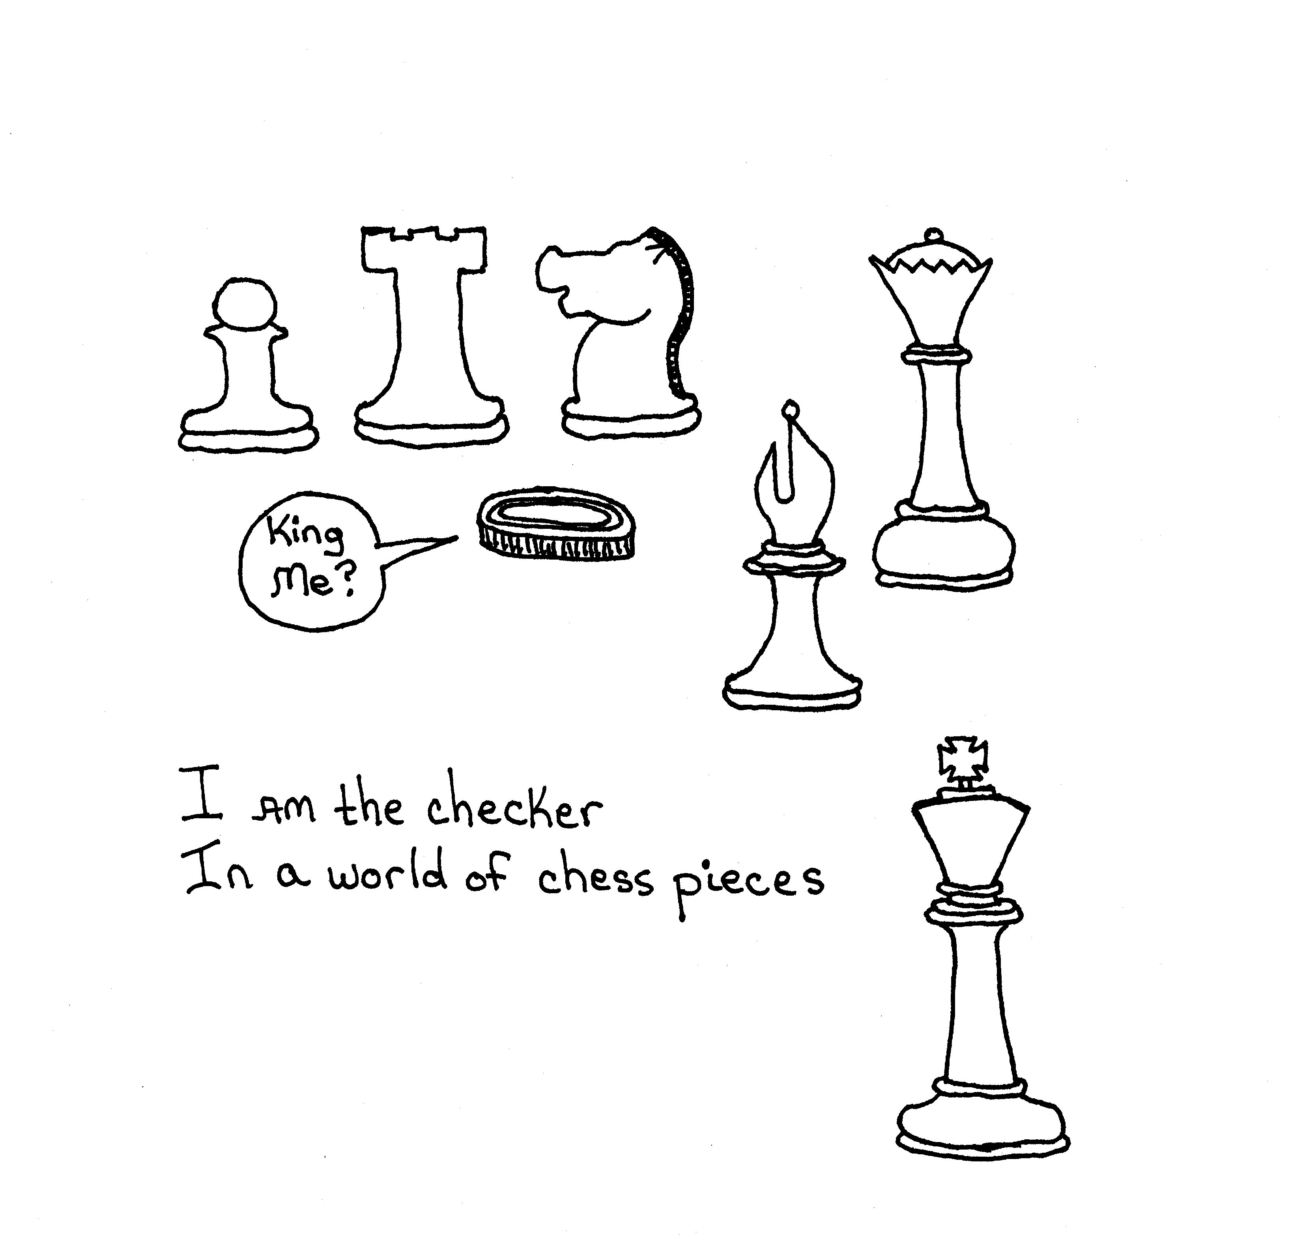
Today is better
Options not available to me in 1967 are available now
Communities are available now
There are no excuses for children to go through what I did
They don’t need to feel different!!

Slide 37
Very little good news
Gay teens are 8.4 times more likely to report having attempted suicide and 5.9 times more likely to report high levels of depression
LGBT youth who reported higher levels of family rejection during adolescence are three times more likely to use illegal drugs.
Studies indicate that between 25% and 50% of homeless youth are LGBT and on the streets because of their sexual orientation or gender identity.
Gender Justice of Nevada
An organization to be aware of

Slide 38
This is why we need to do better and why I need to stop being a coward
Suicide Attempts
18-24 19% 1099
25-44 52% 3051
45-54 17% 973
55-64 11% 648
65+ 2% 114
American Foundation for Suicide Prevention (2014)
“that 14% of trans people were sent to a professional by their family after disclosing their gender identity to their family in an attempt to prevent them from transitioning.”
10% also reported violence from a family member, and 8% said that they were kicked out because of their transgender status.
(Center for Transgender Equality)

Slide 39
Our students
Students need to be constantly reminded that we work for them
Self-Advocacy needs to higher on the list of skills were to our students
-it is a mandatory component on my IEPs
-it is the skill that follows them when they leave us
-without it they will live and succeed by random chance

Slide 40
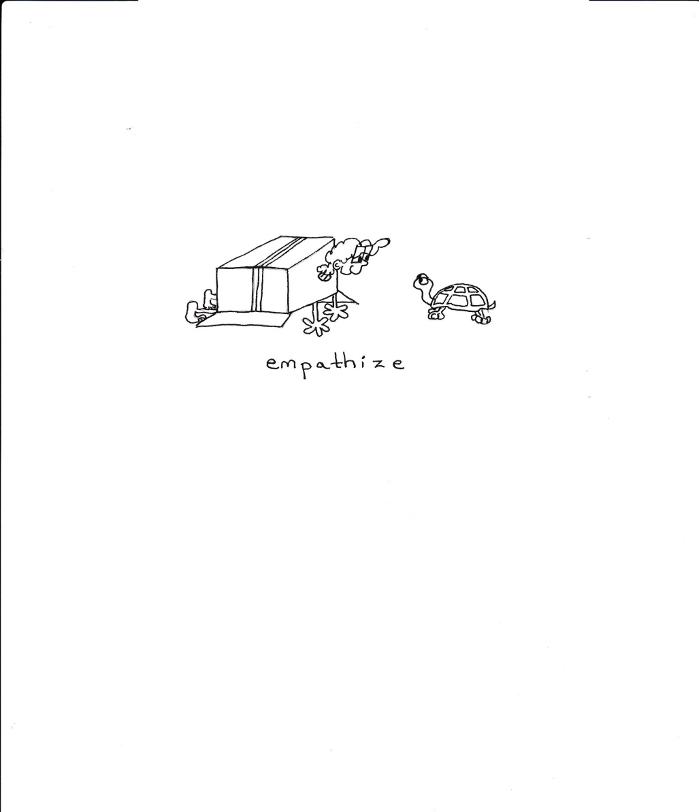
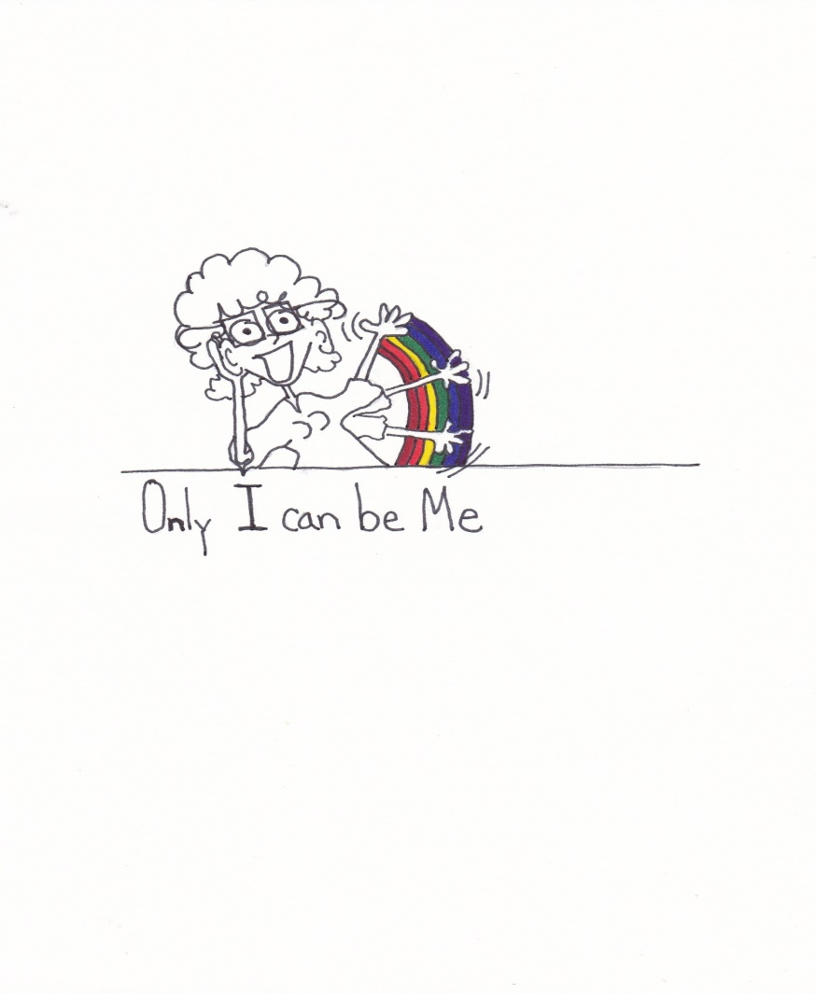
Teach empathy teach the value of self

Slide 41
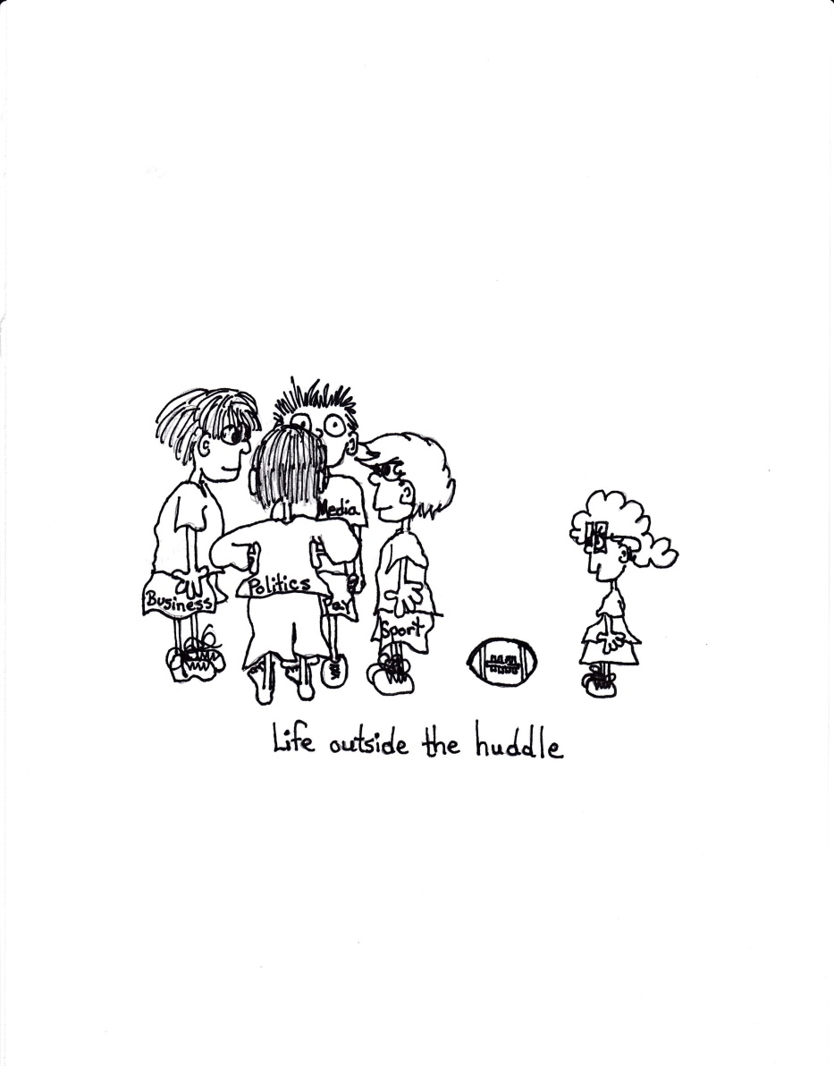
Look for the kids that are on the outside looking in

Slide 42
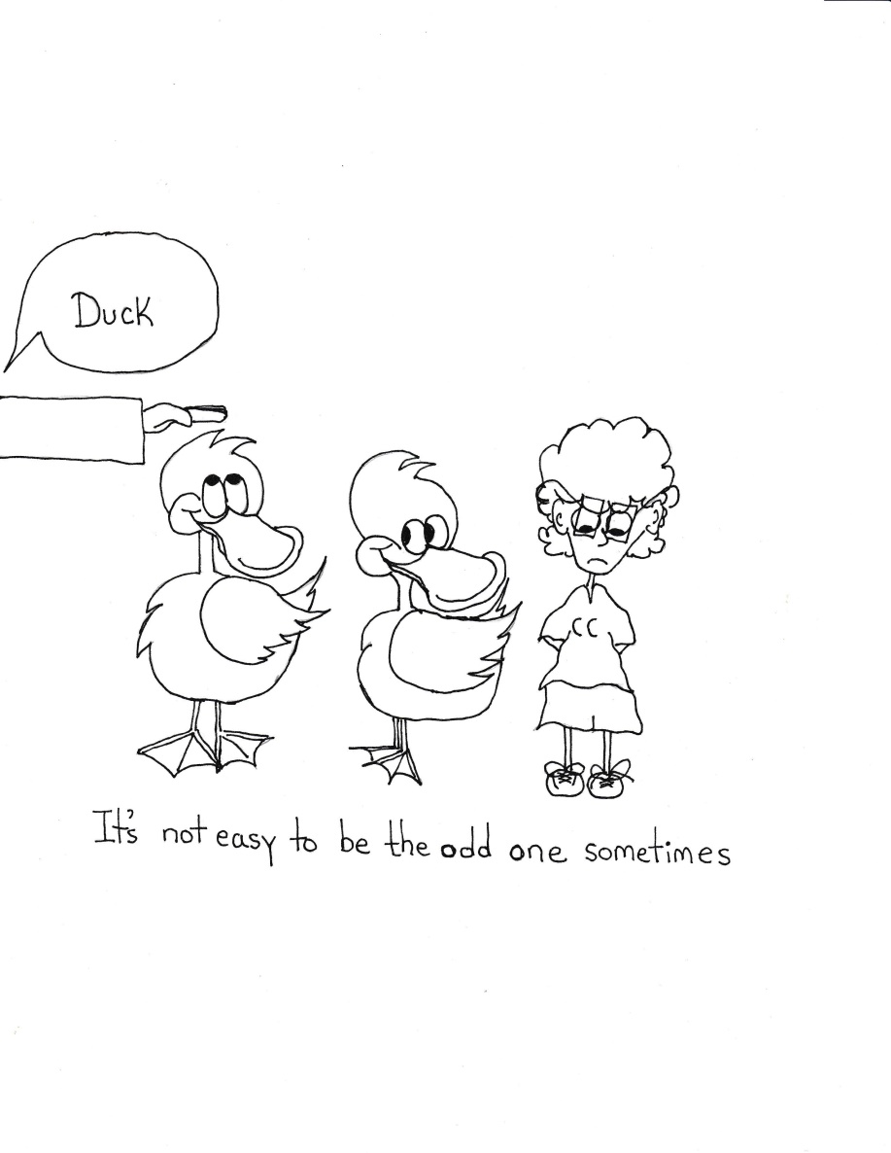
Look for the kids that are picked on

Slide 43
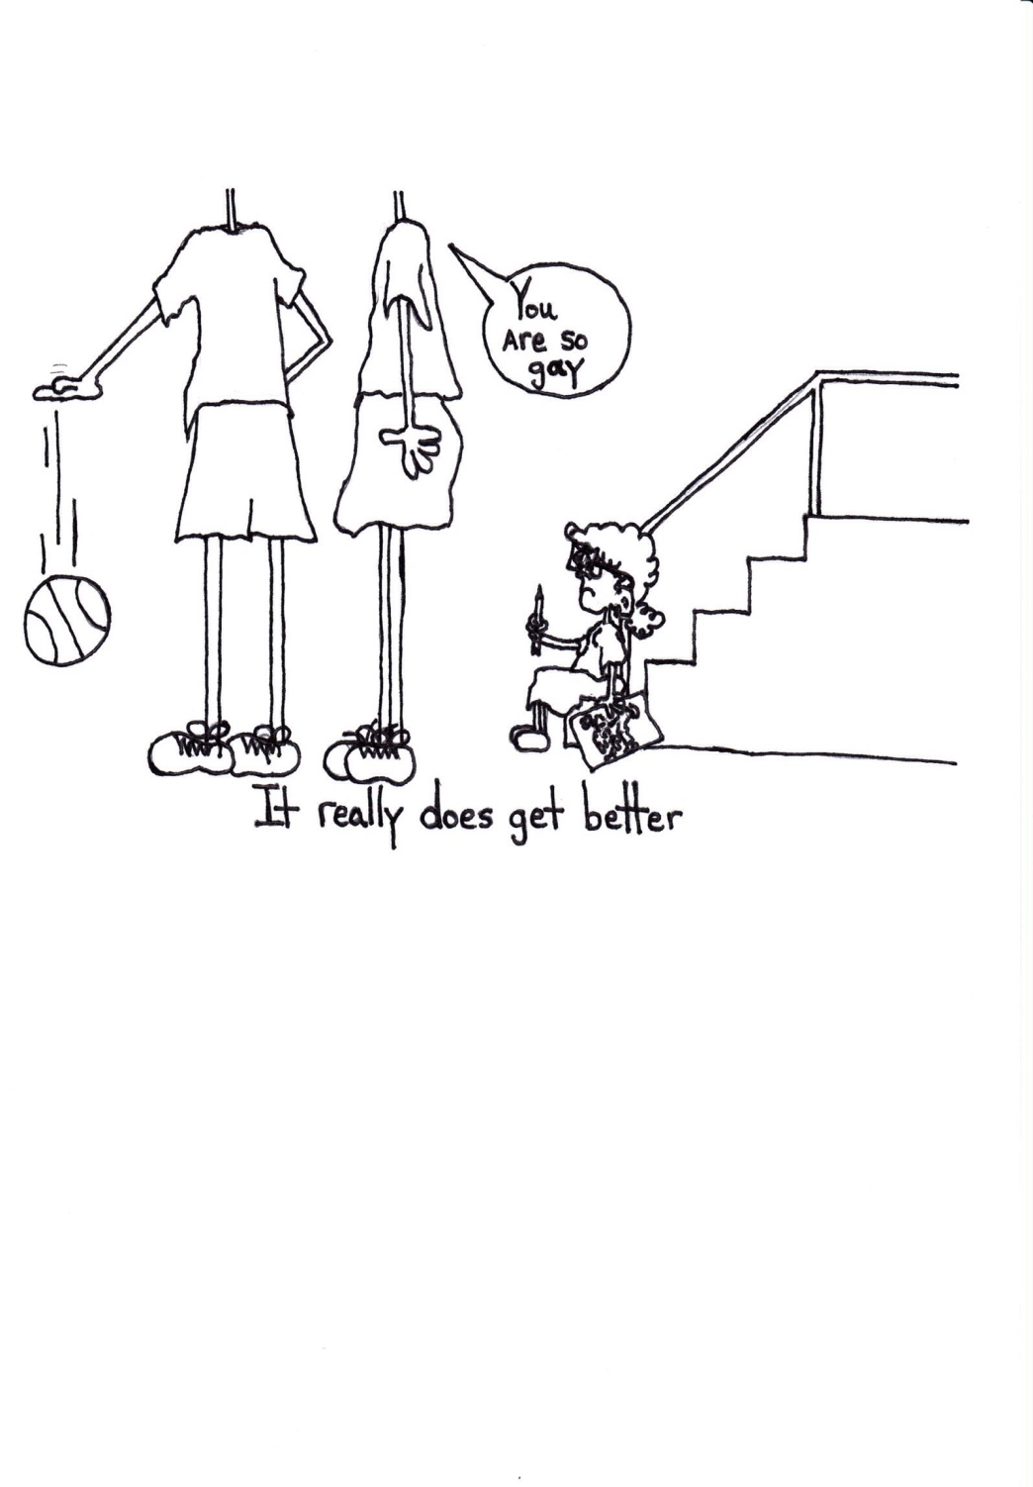
They won’t believe “it really does get better”
Its difficult to think about adulthood when you are just trying to get through the day

Slide 44
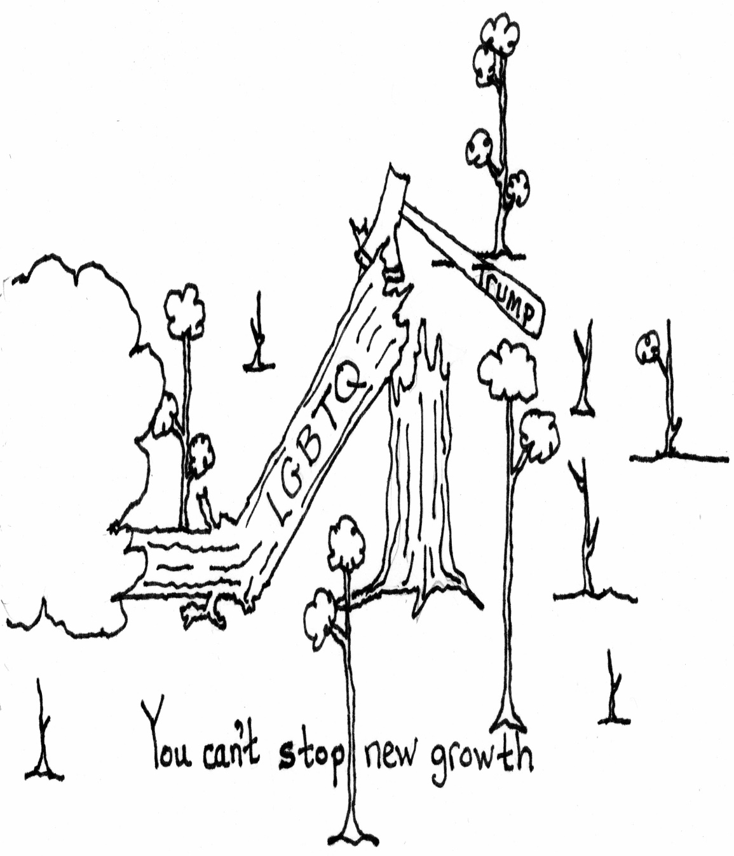
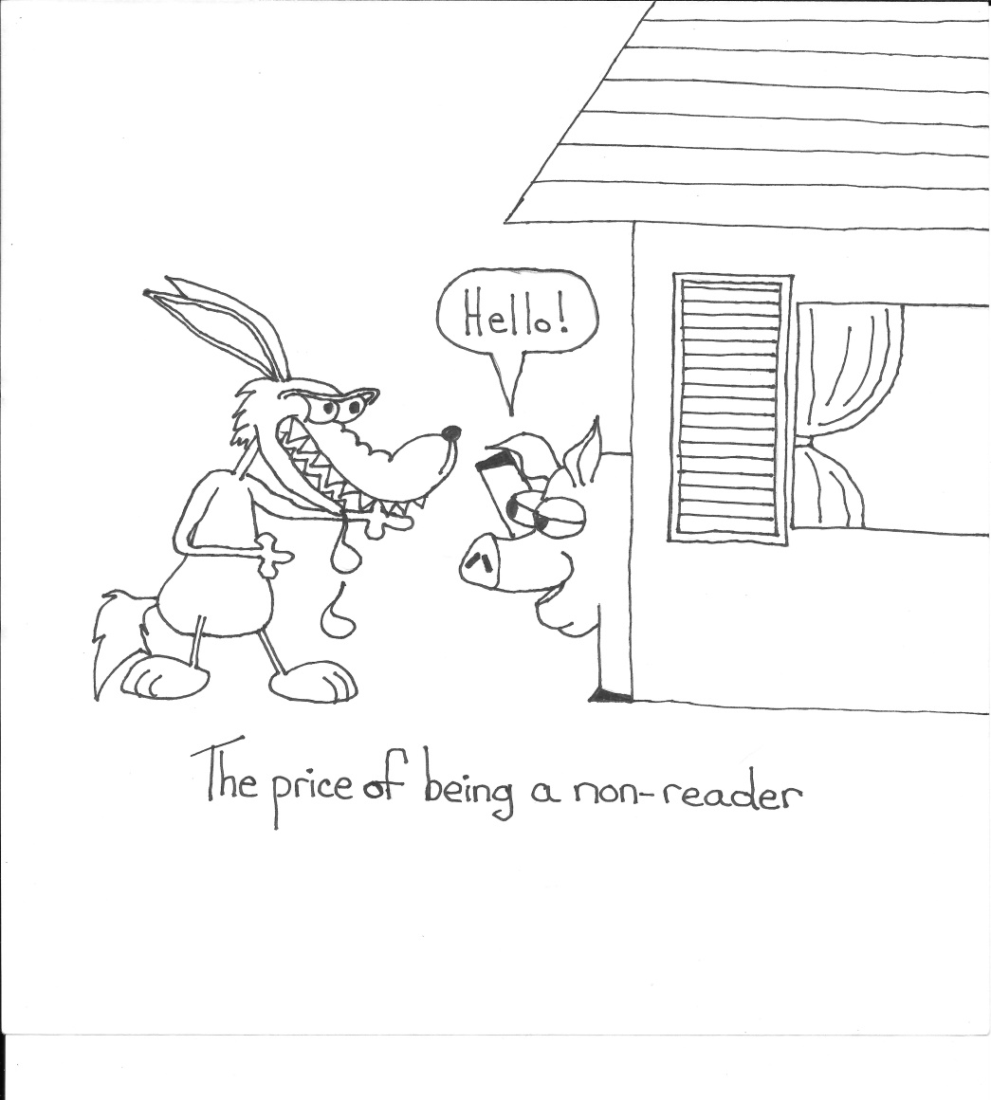
Generate hope and Educate

Slide 45
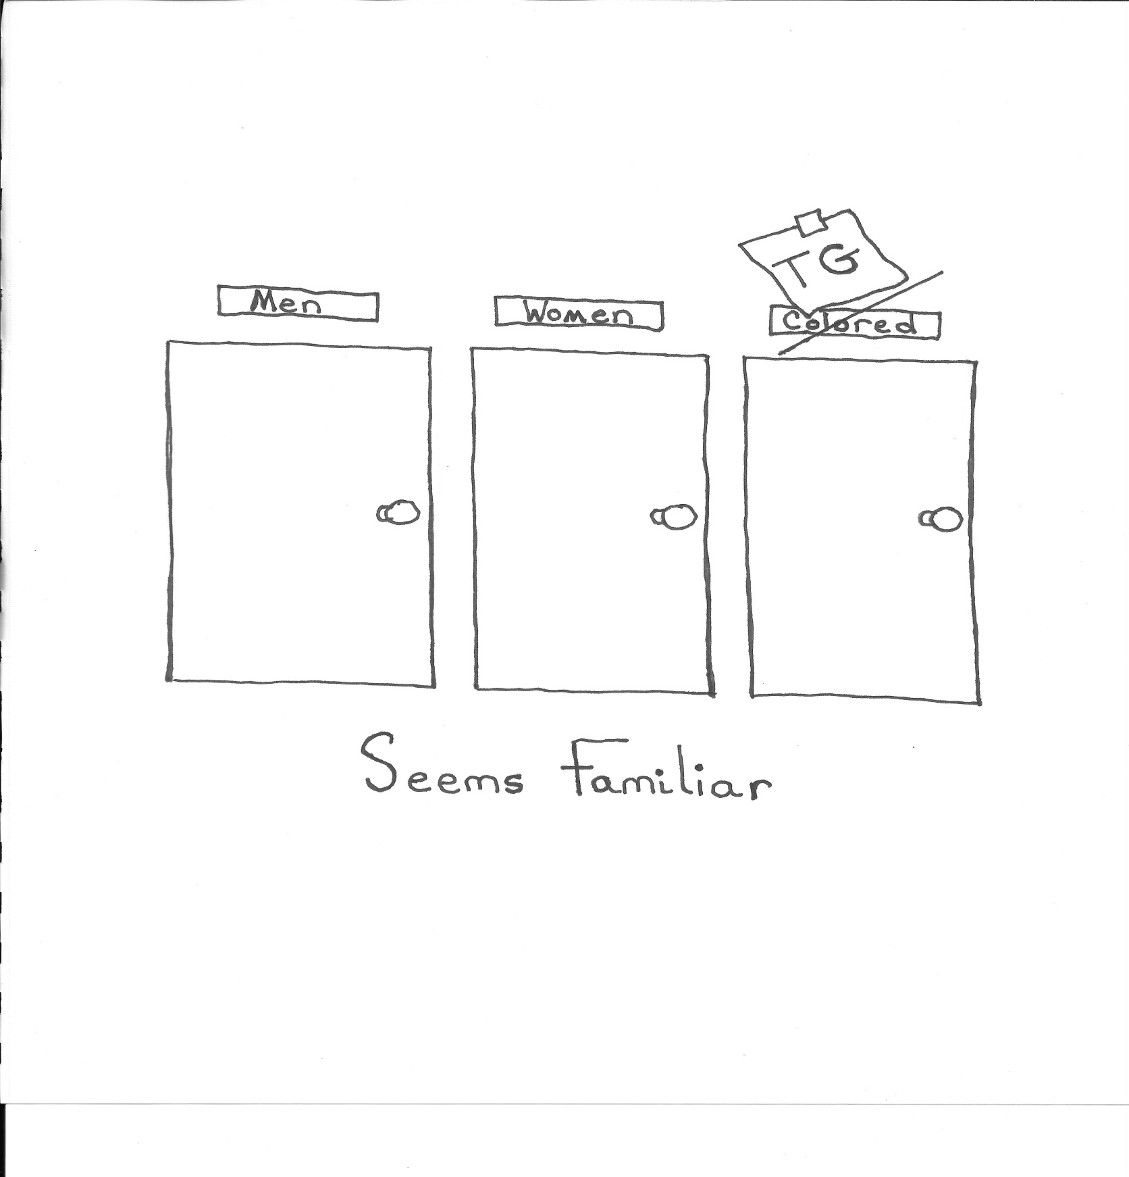
Anticipate the hardships…..
They won’t because they still surprise me

Slide 46
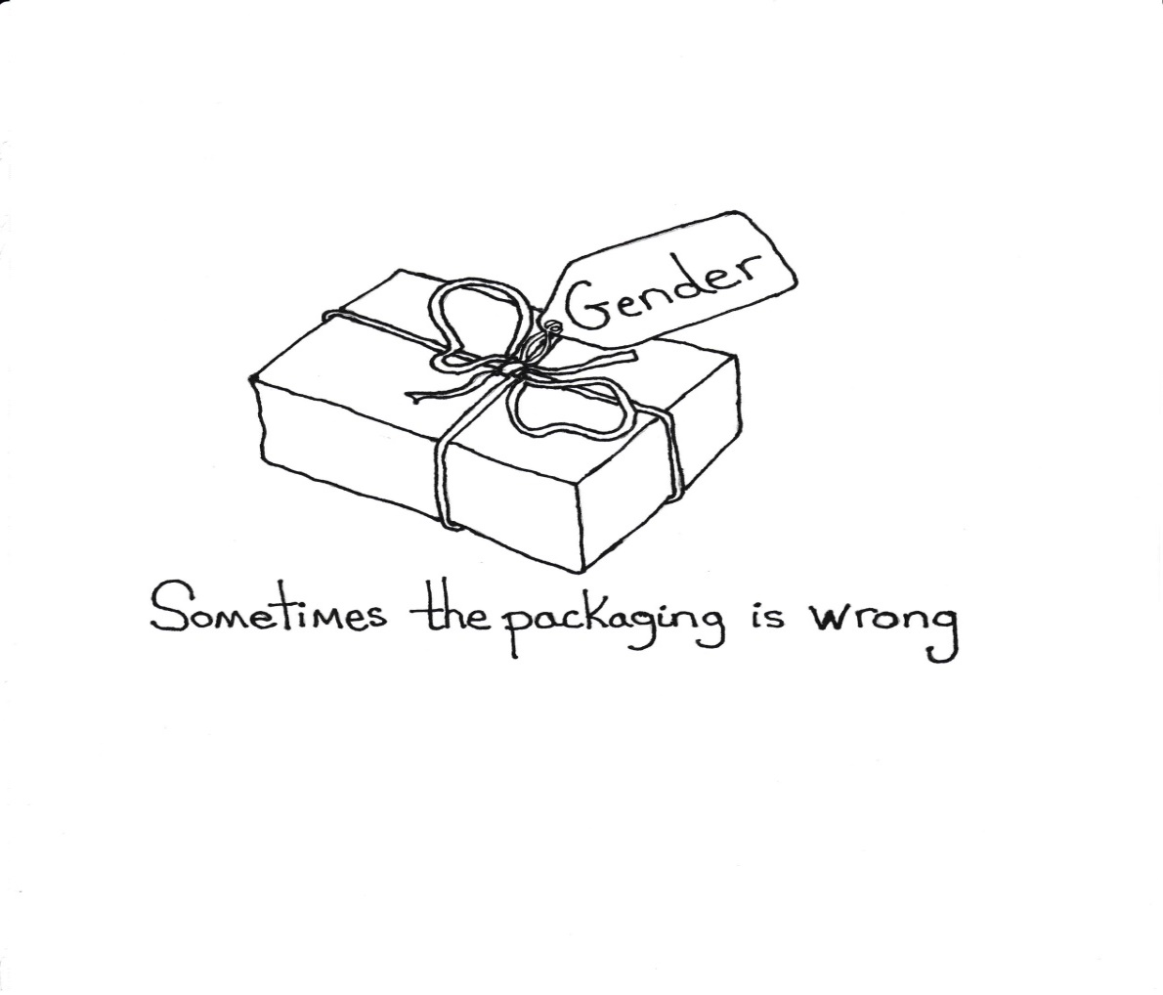
Our kids can’t grow up believing there is only one safe state
Their dreams can’t be geographically restricted…
They can’t be full citizens in 15 states…..

Slide 47
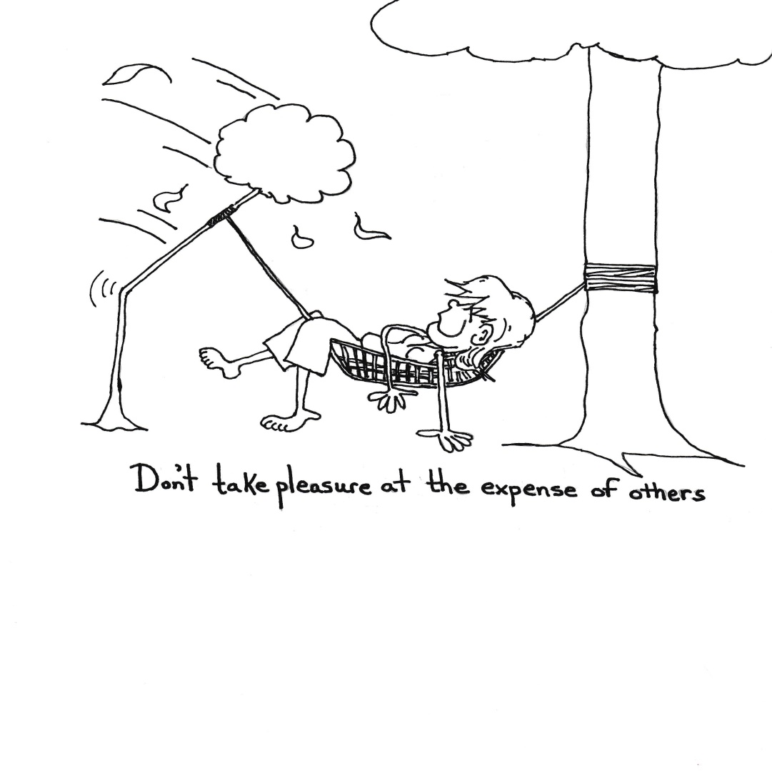
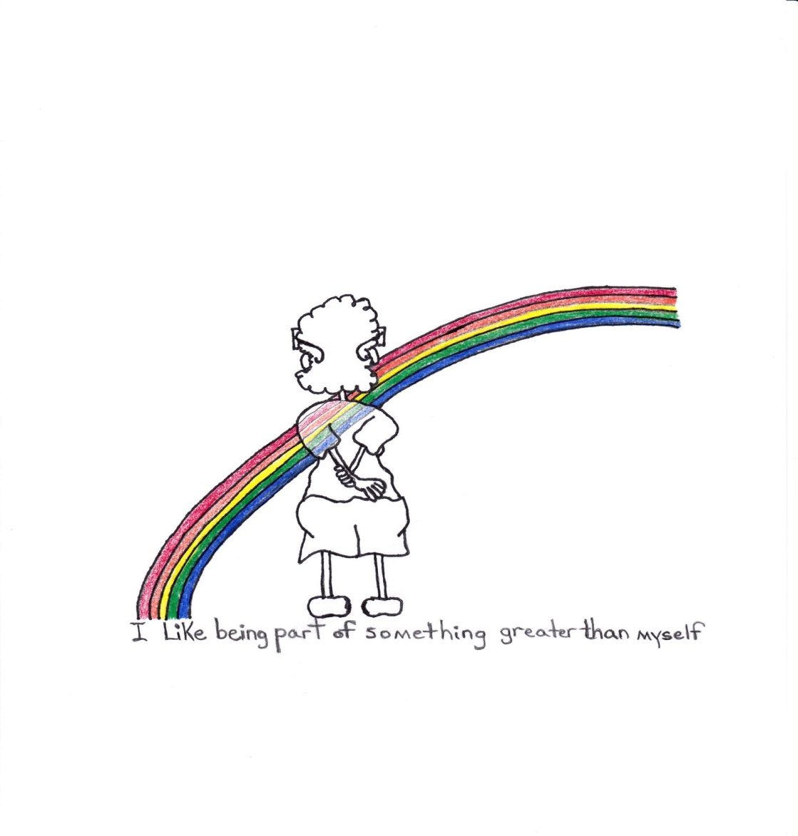
Activism can no longer be optional…and our concerns cannot not just be for people like ourselves

Slide 48
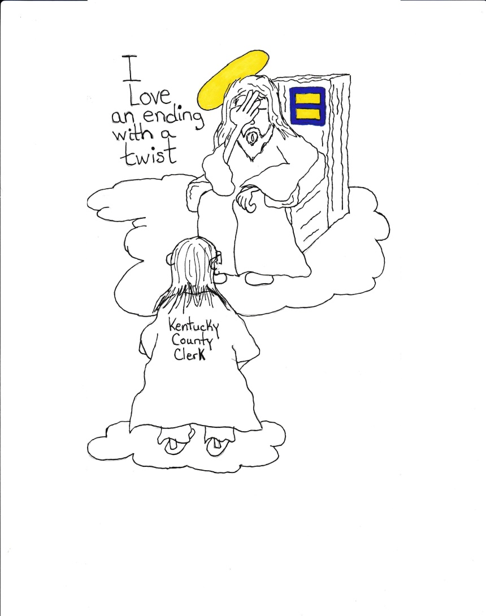
Belatedly or not I have had the opportunity to be happy….my obligation is to open that door for others. I also must work on behalf of those that never had the chance to be truly happy.

Slide 49
risk
Unsupported Kids will Self Medicate (I Did)
Start the Journey without a Doctor or Therapist
(I did)
Will find a Place they can be Themselves…Even if unsafe and Alone

Slide 50
The only thing worse than not knowing the answer ….is not understanding the question!
Things that I didn’t have but that our kids should be able to expect from us
A safe environment
A person on every staff…in every
building they can talk to
Less stress on “norms” and “the good ol’ days” (they weren’t so good and schools have not been the agents of change they need to be)
Help in the classroom and with the
home….support past the bells…

Slide 51
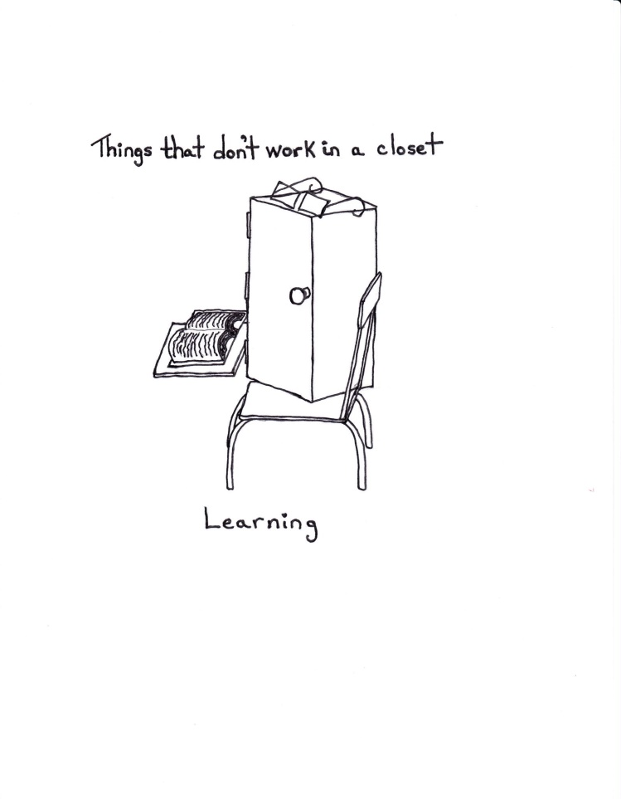
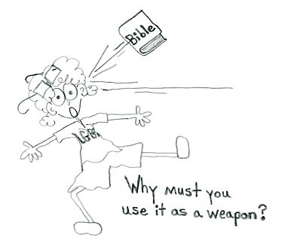
Transition

Slide 52

-There are dangerous people out there
-Denying our kids support and their access to a community puts them in danger

Slide 53
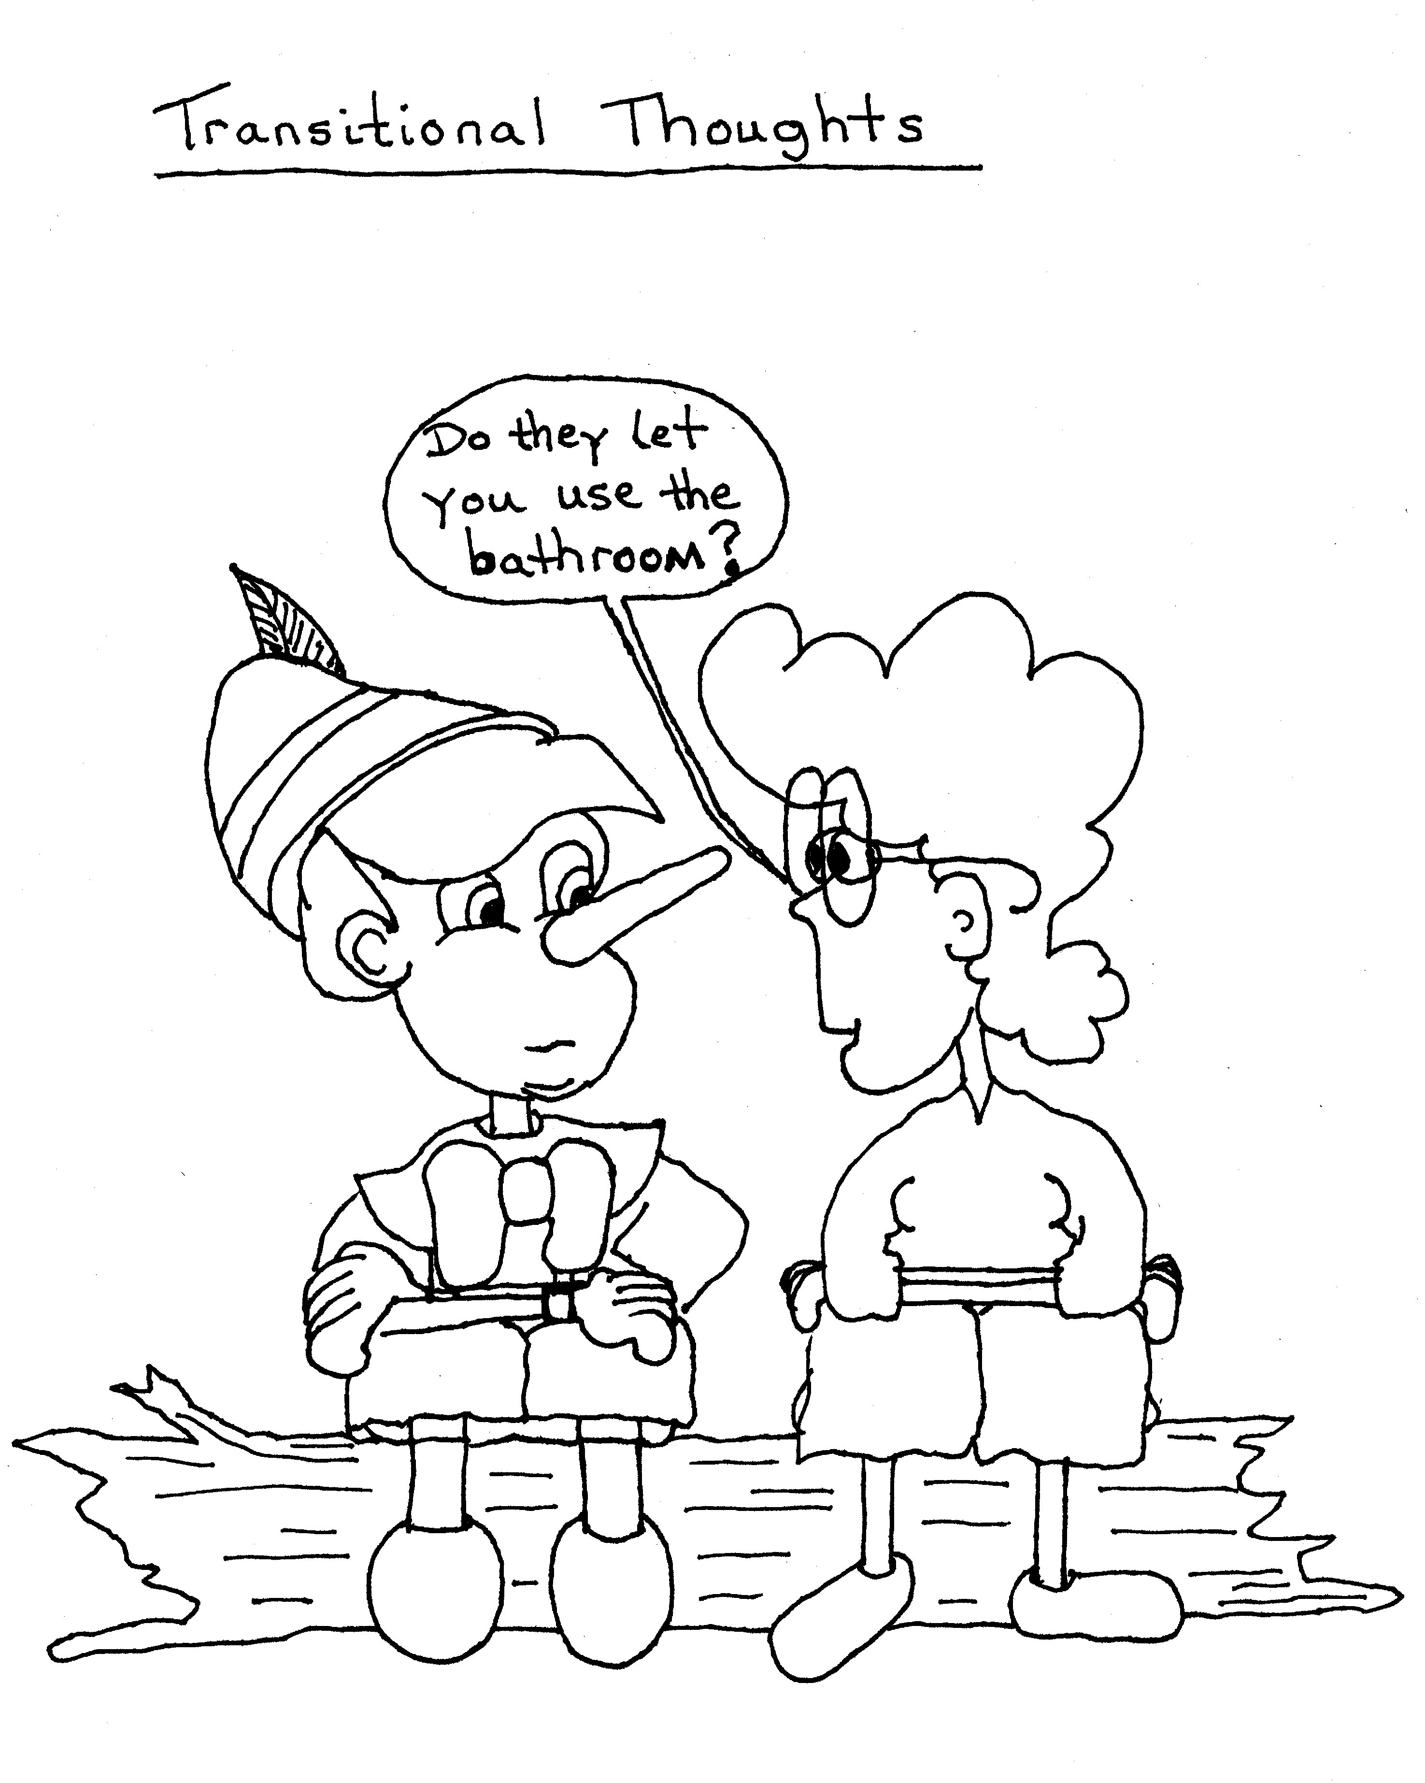
It’s Important to know there are others

Slide 54
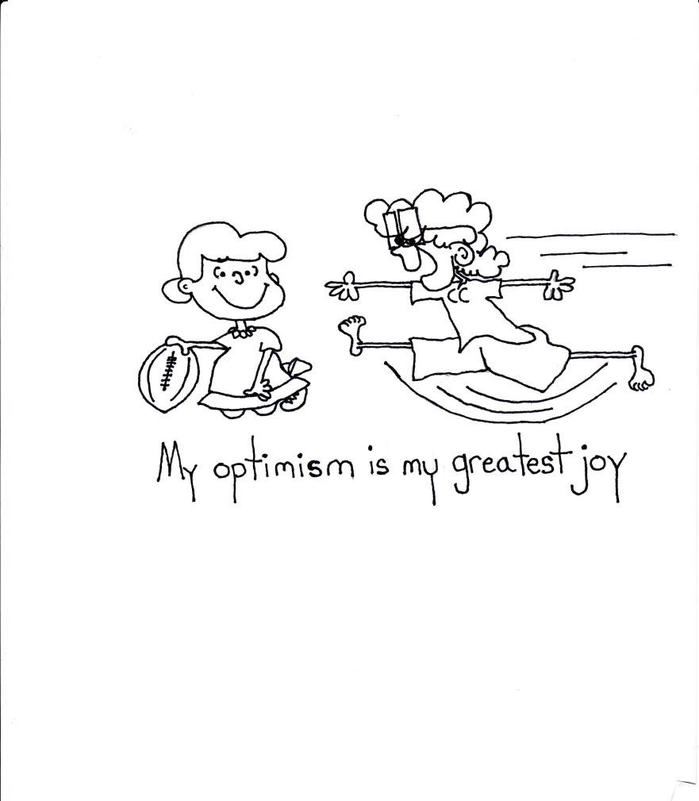
We aren’t going to get any help…..we are on our own
So we need to do more than is easy….we need to be exceptional….WE NEED TO BE AWARE
But we must hold on to optimism

Slide 55
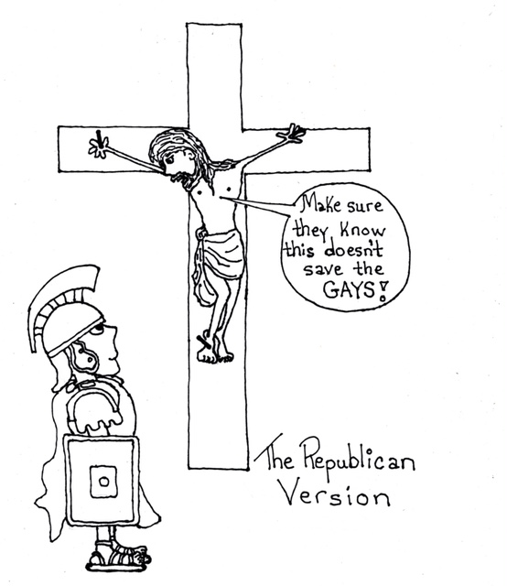
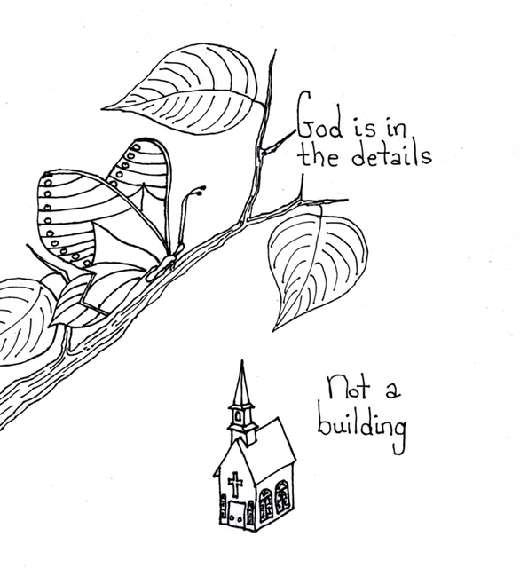
Struggle for faith both has Resulted in a lot of anger

Slide 56
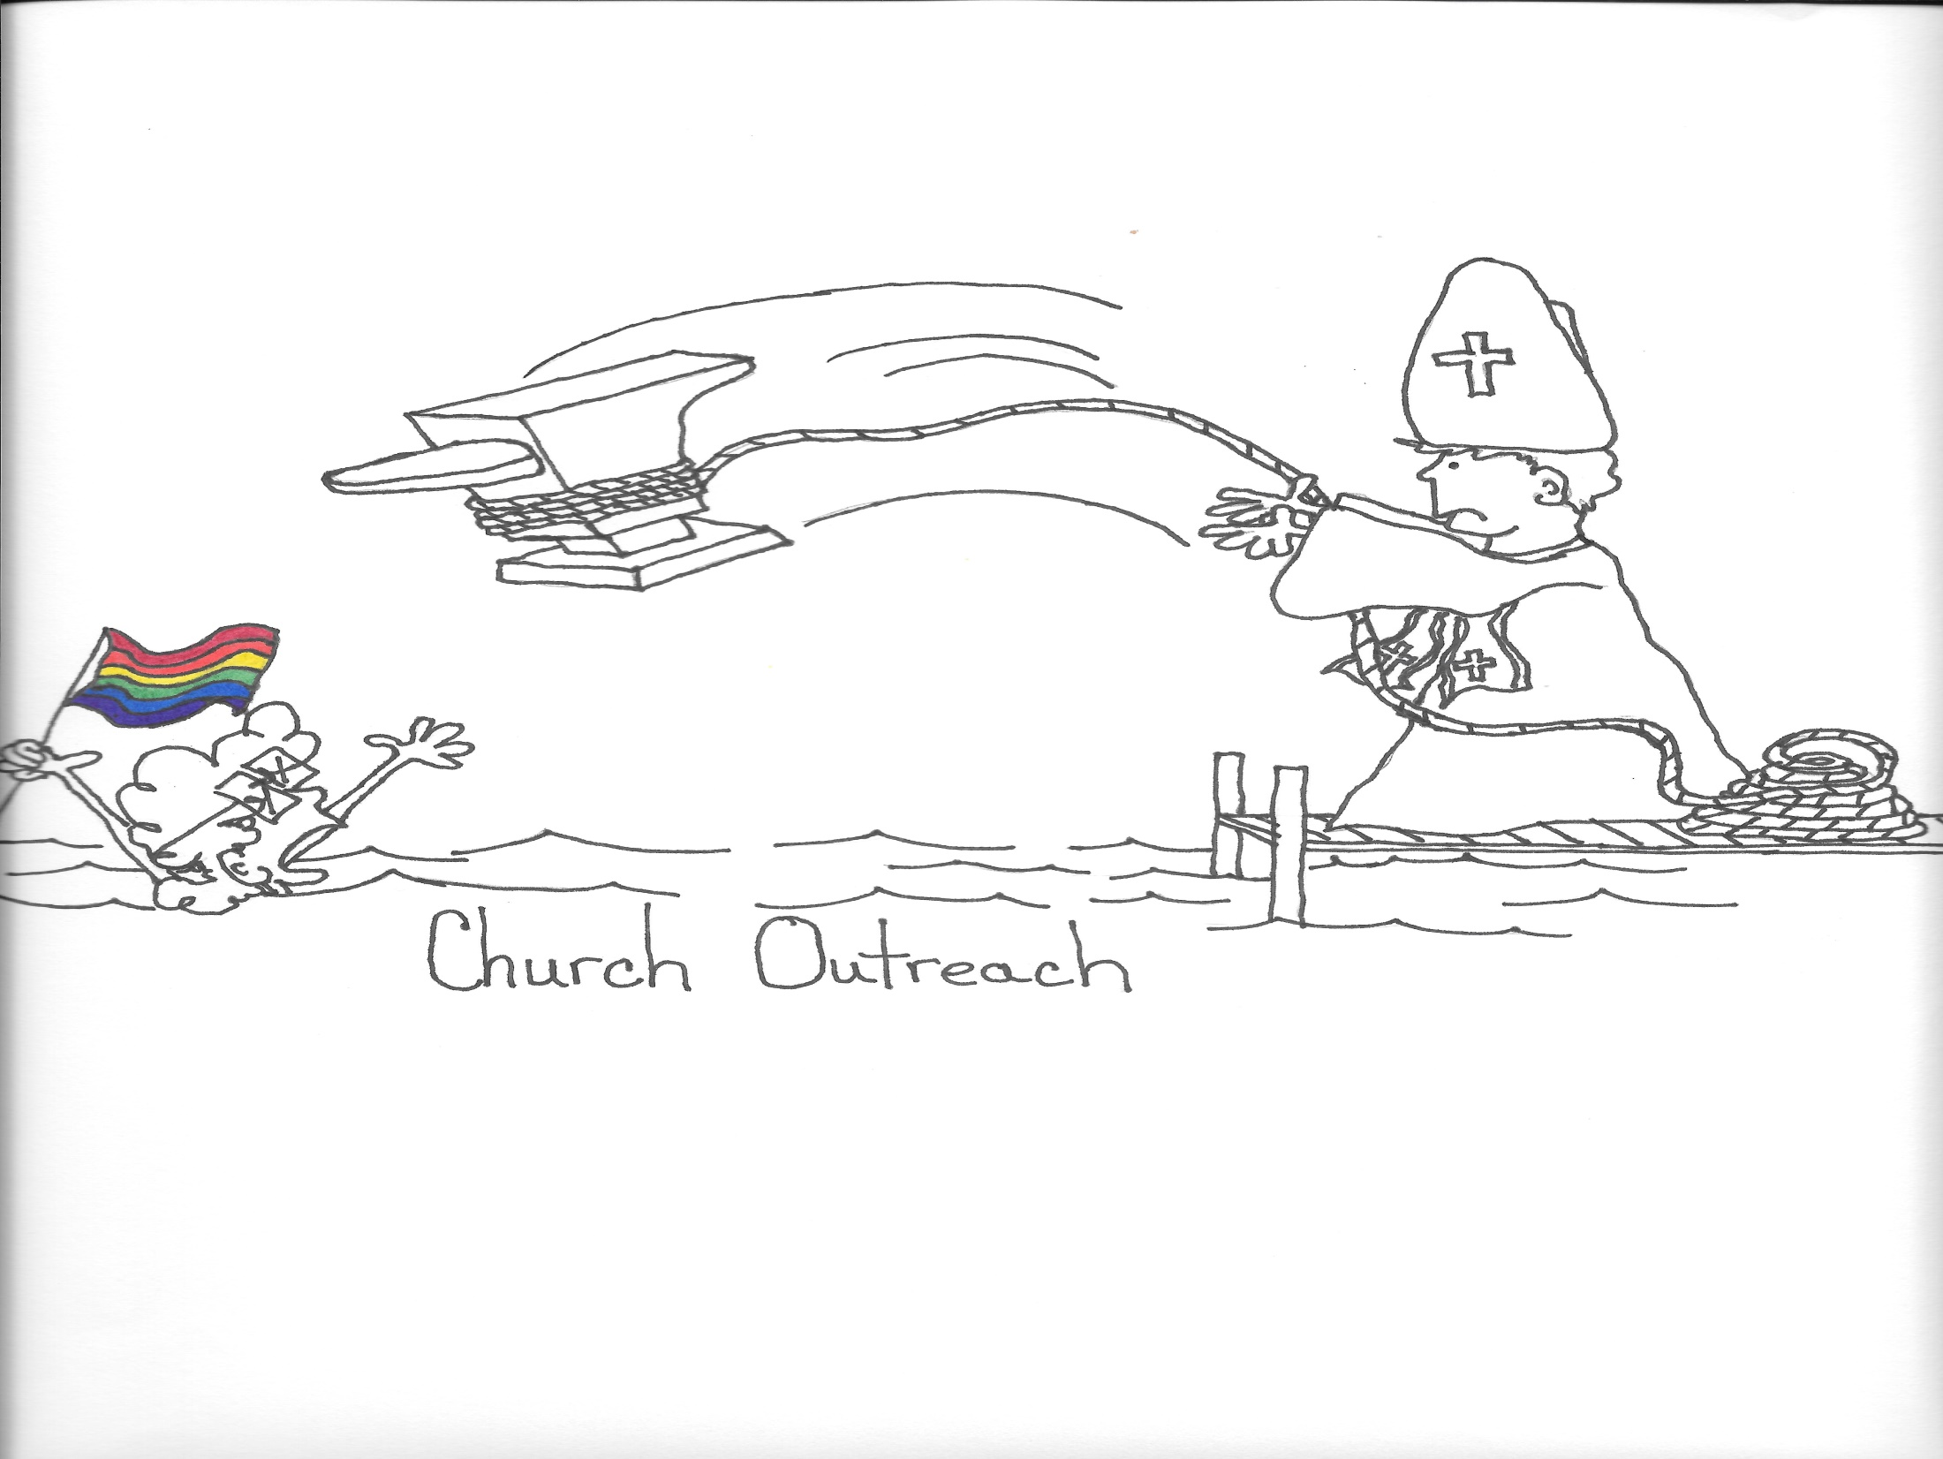

Slide 58
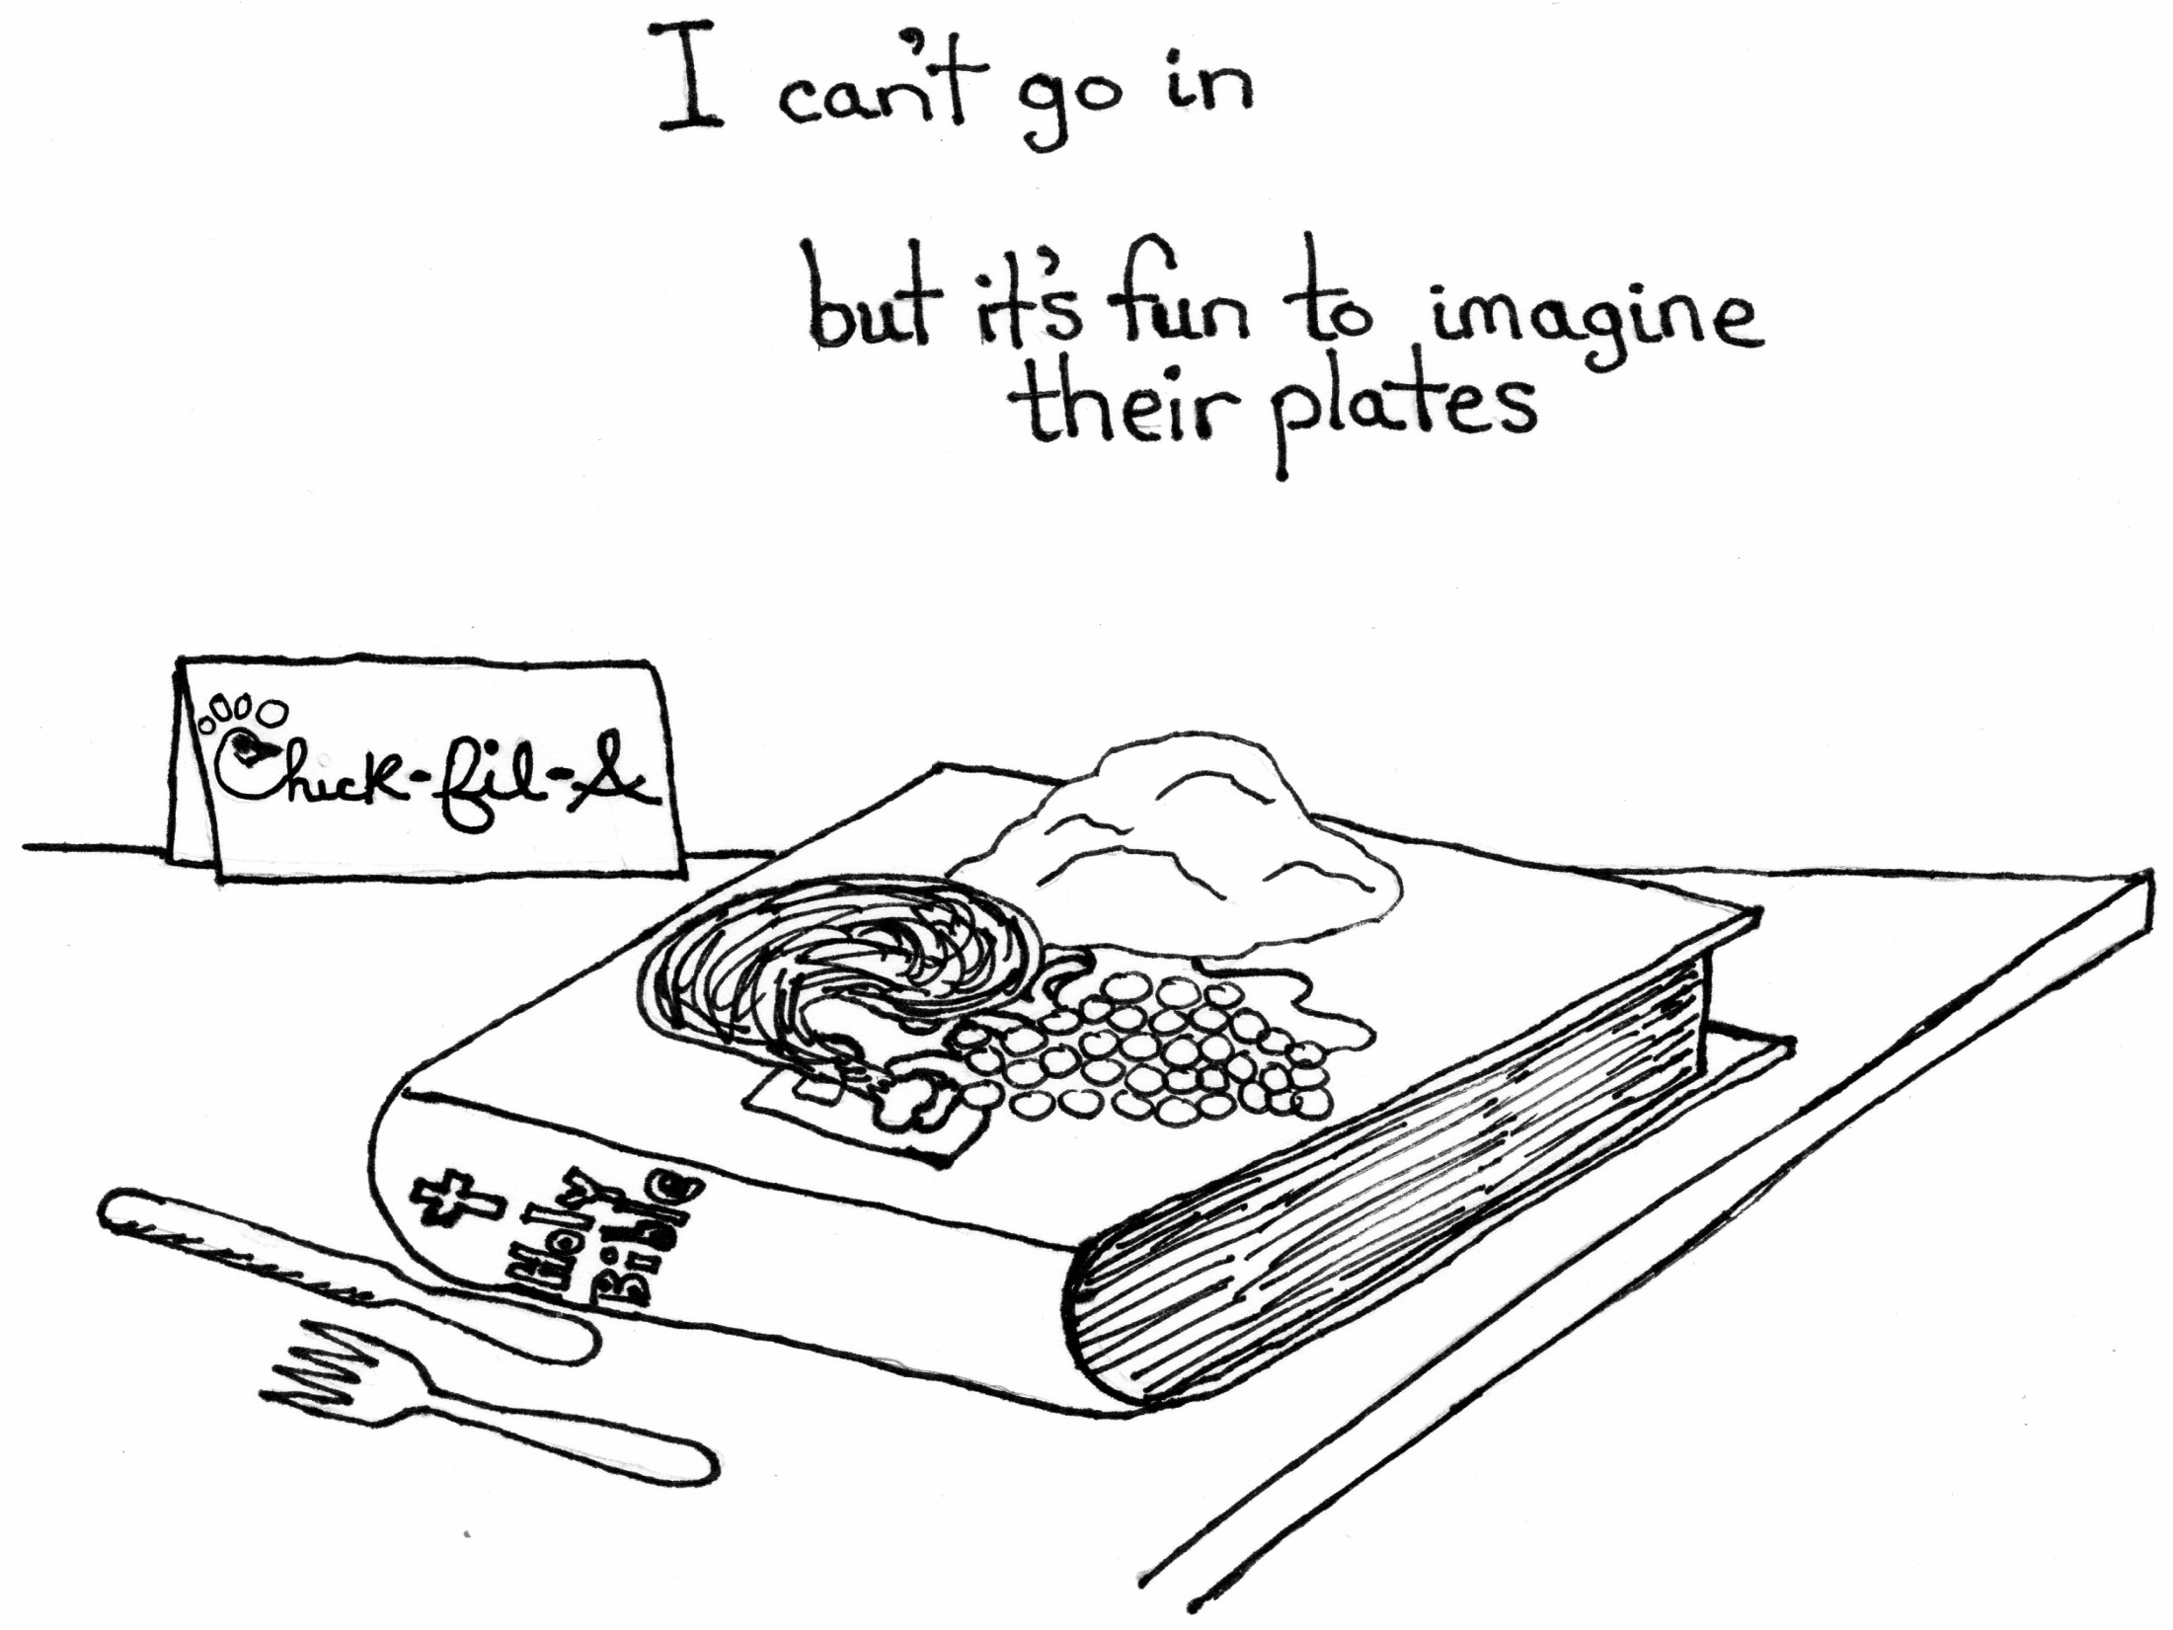

Slide 59
Anger is not the answer

Slide 62
Until 2000 I wanted to absolutely anyone else.
Now I am so thrilled to be me
I have published 5 books of sketches relating to LGBTQ students, teaching, being odd, and surviving
They are on Amazon.com but I will give some away today
If you are interested in copies for students I will give away the ones I can

Slide 63
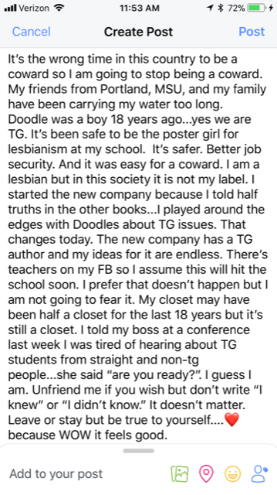
All the way out of the closet
A Conference in November changed my life
My Community being Represented by Non-Members because I am a Coward
This Note is the First Time TG was ever mentioned on my Facebook
Freed my friends
Freed my Mom
Freed My Self

Slide 64
My New Art

Slide 65
“Transitional thoughts”
For the First Time in 40 years Doodle is Entirely and Truly Me
Honesty is no longer Impossible
(or at least no longer “feels” impossible)
Not Surprised by there being Questions….but stunned how dumb they are!!!

Slide 66
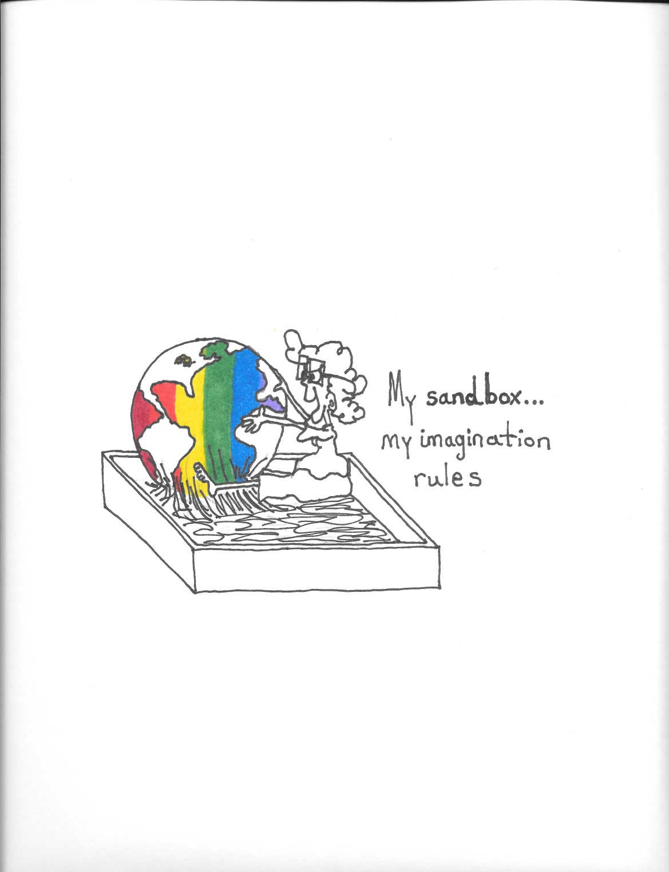
There is Hope
Kids need to see there is a ending that can be lived with.
But it means adults need to say “I am here and I am happy”
Teachers they know need to stop hiding their journey.
Its why I am here.

Slide 67
Will I miss my safety?
Move from the safety of Isolation to the Risk of Having to Trust Others

Slide 68
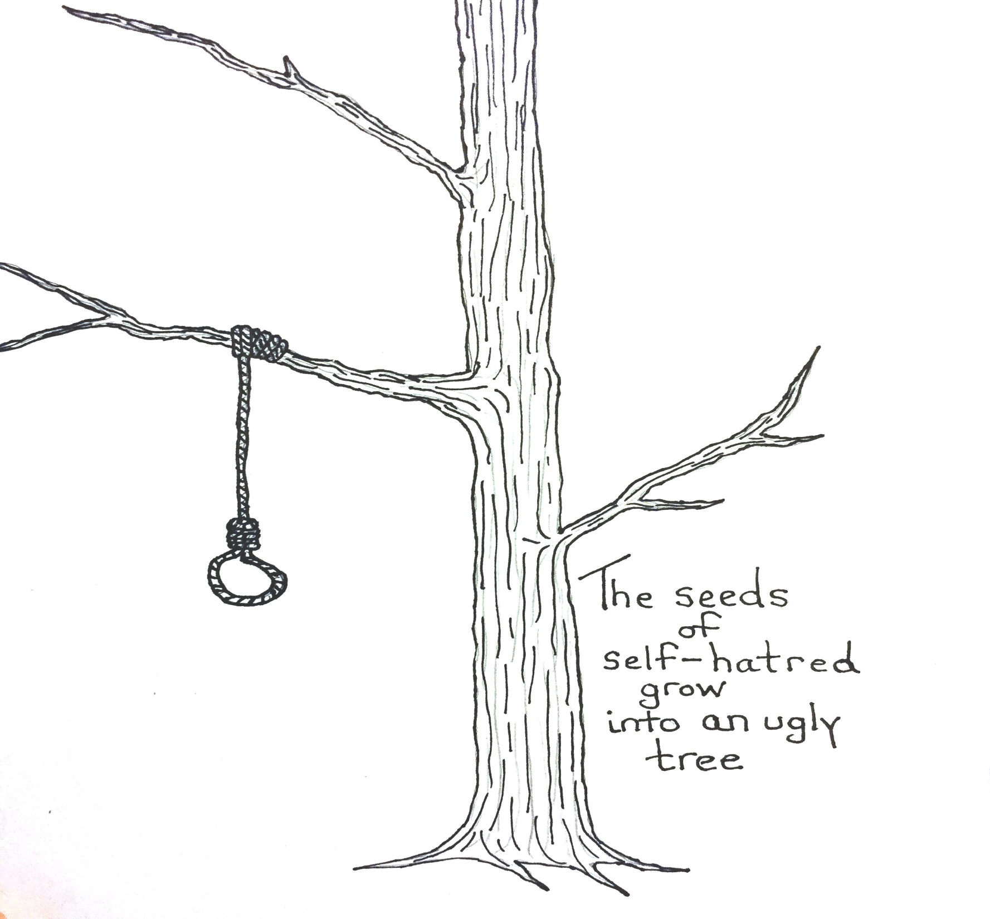
Rememberwhat is at stake

Slide 69
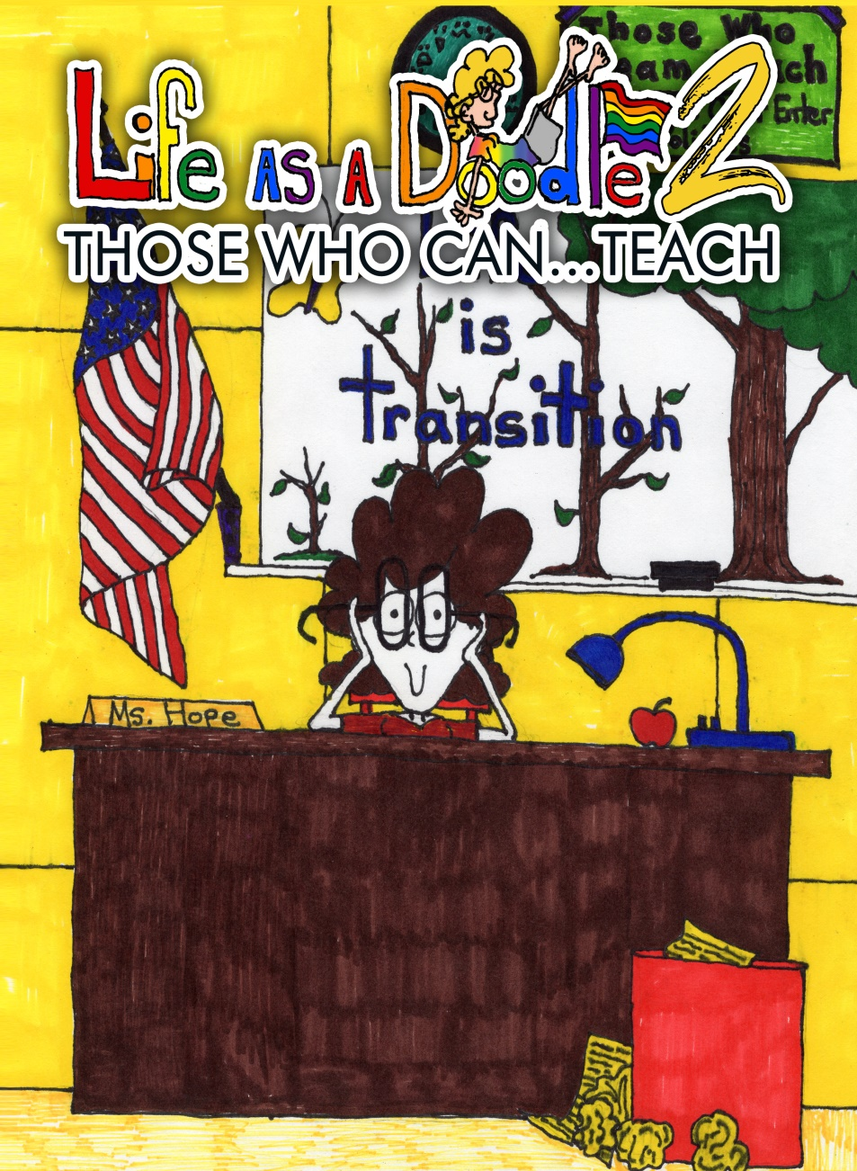
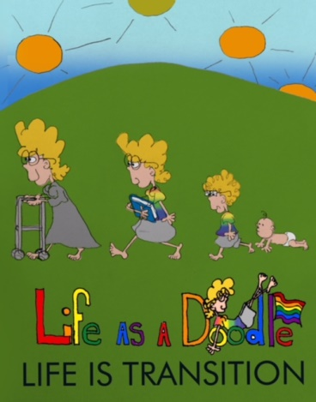
Don’t like the book you are in?
Write your own!

Slide 70
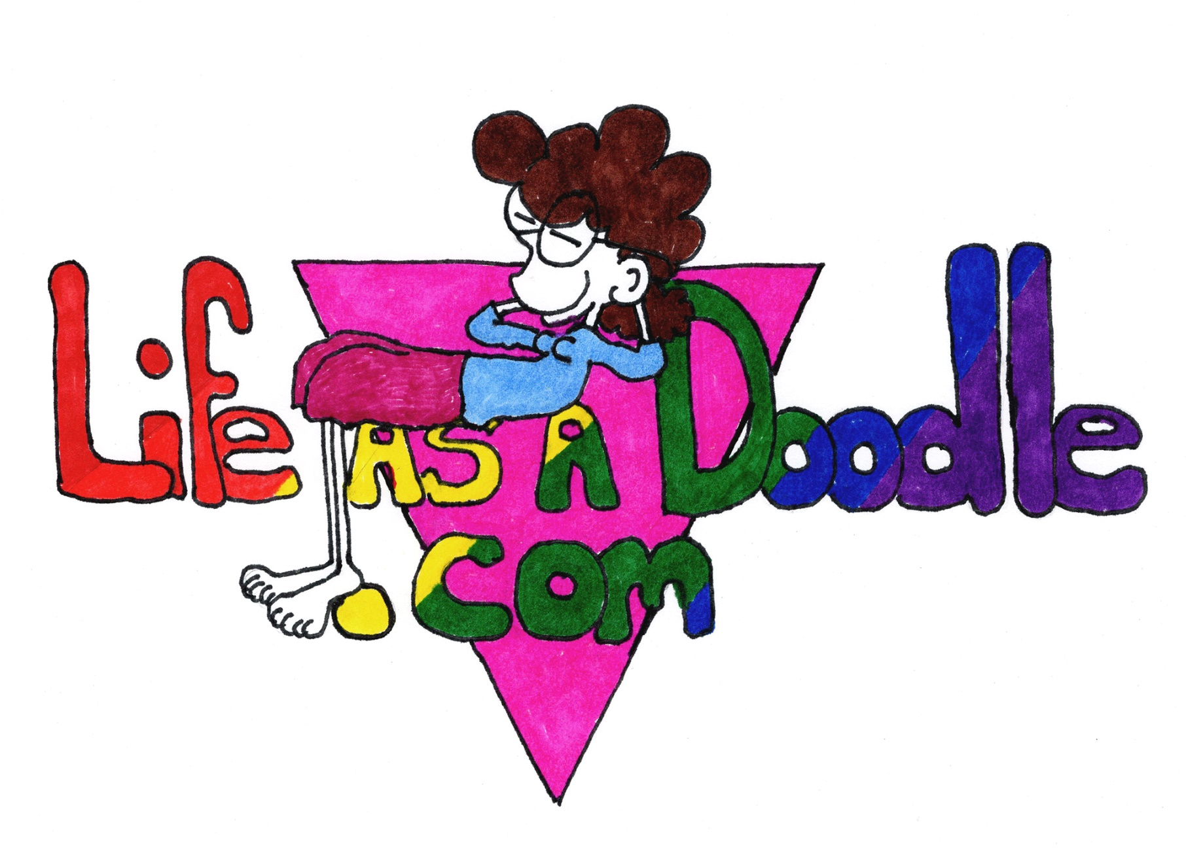
All 5 of my Books can be found at:
Along with a new doodle every day!

